Slide 1
Indian Country Infectious Disease ECHO COVID-19 Update
Jonathan Vilasier Iralu, MD, FACP, FIDSA
Indian Health Service Chief Clinical Consultant
for Infectious Diseases

Slide 2
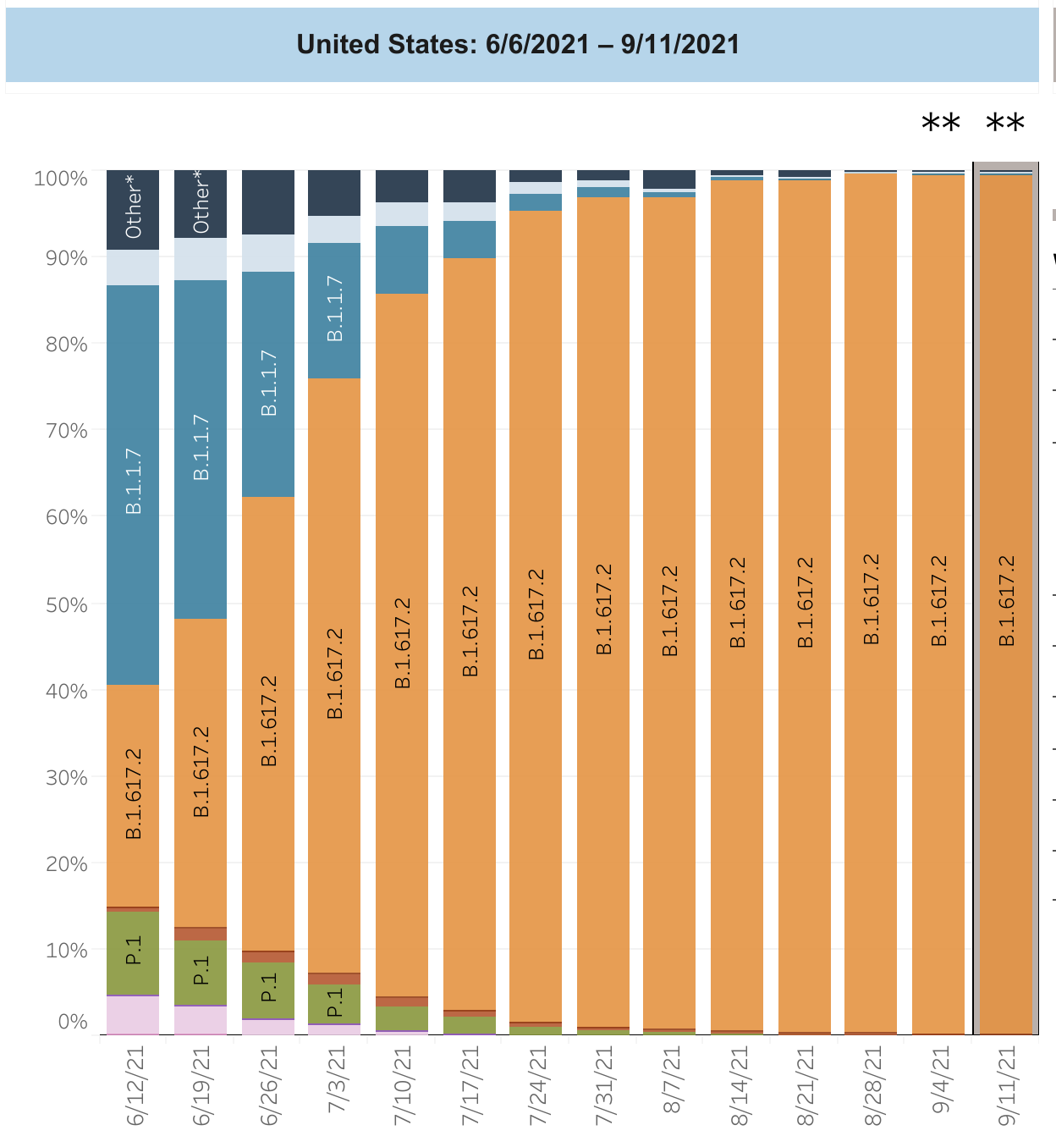
Virology
Delta Variant
Twice as contagious
More likely to result in hospitalization (Canada/Scotland)
More likely to affect the unvaccinated
Asymptomatic vaccinated persons can spread Delta Variant but for a shorter time period
https://www.cdc.gov/coronavirus/2019-ncov/variants/delta-variant.html

Slide 3
Diagnosis
PCR remains the recommended test by the IDSA
Two tests are required when there is a high index of suspicion of COVID-19
One test suffices when the index of suspicion is low
Nucleic Acid Amplification Tests are preferred over single and double antigen tests.
Antigen tests are not preferred over no testing!
https://www.idsociety.org/practice-guideline/covid-19-guideline-diagnostics/

Slide 4
Treatment
Mild outpatient COVID:
Monoclonal antibody treatment should be offered at all IHS/638 SUs for persons at risk for complications within 10 days:
Bamlanivimab plus etesevimab
Casirivimab plus imdevimab IV (20 minutes) or subQ (four injections)
Sotrovimab IV infusion
Post-Exposure Prophylaxis:
Casirivimab plus imdevimab IV or subQ can be given as post exposure prophylaxis within 7 days of exposure to COVID-19:
Unvaccinated
Vaccinated but immunocompromised
O’Brien et al, NEJM, 9/23/2021: Relative Risk Reduction 81% in recipients of subQ Rx in preventing symptomatic COVID
https://www.covid19treatmentguidelines.nih.gov/therapies/statement-on-bamlanivimab-plus-etesevimab/

Slide 5
Treatment
Outcome Comparison of high-risk Native American patients who did or did not receive Monoclonal Antibody Treatment for COVID-19
Published by Close, Jones, Jentoft, McAuley from Whiteriver Indian Hospital, JAM OpenNetwork
983 patients seen, 481 were met EUA high risk criteria
201 were given either BAM or CAS-IMD and compared retrospectively to those who did not receive Rx “for various reasons”
Mean age 50, median BMI 35.8, median time from symptom onset to infusion was 2 days
Mab recipients had lower proportion of
Acute medical visits (29% vs 48%) p <0.001
Hospitalizations (17 vs 43%) p <0.001
Transfers. (2 vs 9.3%) p = 0.001
ICU admission (0 vs 4.3%) p = 0.003
Death (0 vs 2.9%) p = 0.008
Let’s do it!!
https://pubmed.ncbi.nlm.nih.gov/34546375/
https://jamanetwork.com/journals/jamanetworkopen/fullarticle/2784401

Slide 6
Treatment
Molnupiravir
New oral investigational ribonucleoside analog drug developed by Merck
MOVe-OUT phase 3 clinical trial for at risk, non-hospitalized adults with mild to moderate COVID-19 and symptom onset within five days
775 patients were analyzed in interim analysis (planned on 1550 but stopped early)
7.3% in intervention arm vs 14% in placebo arm were hospitalized or died (p=0.0012)
Through day 29 there were Zero deaths in Molnupiravir patients vs 8 among controls
Active against Gamma, Delta and Mu variants
https://www.merck.com/news/merck-and-ridgebacks-investigational-oral-antiviral-molnupiravir-reduced-the-risk-of-hospitalization-or-death-by-approximately-50-percent-compared-to-placebo-for-patients-with-mild-or-moderat/

Slide 7
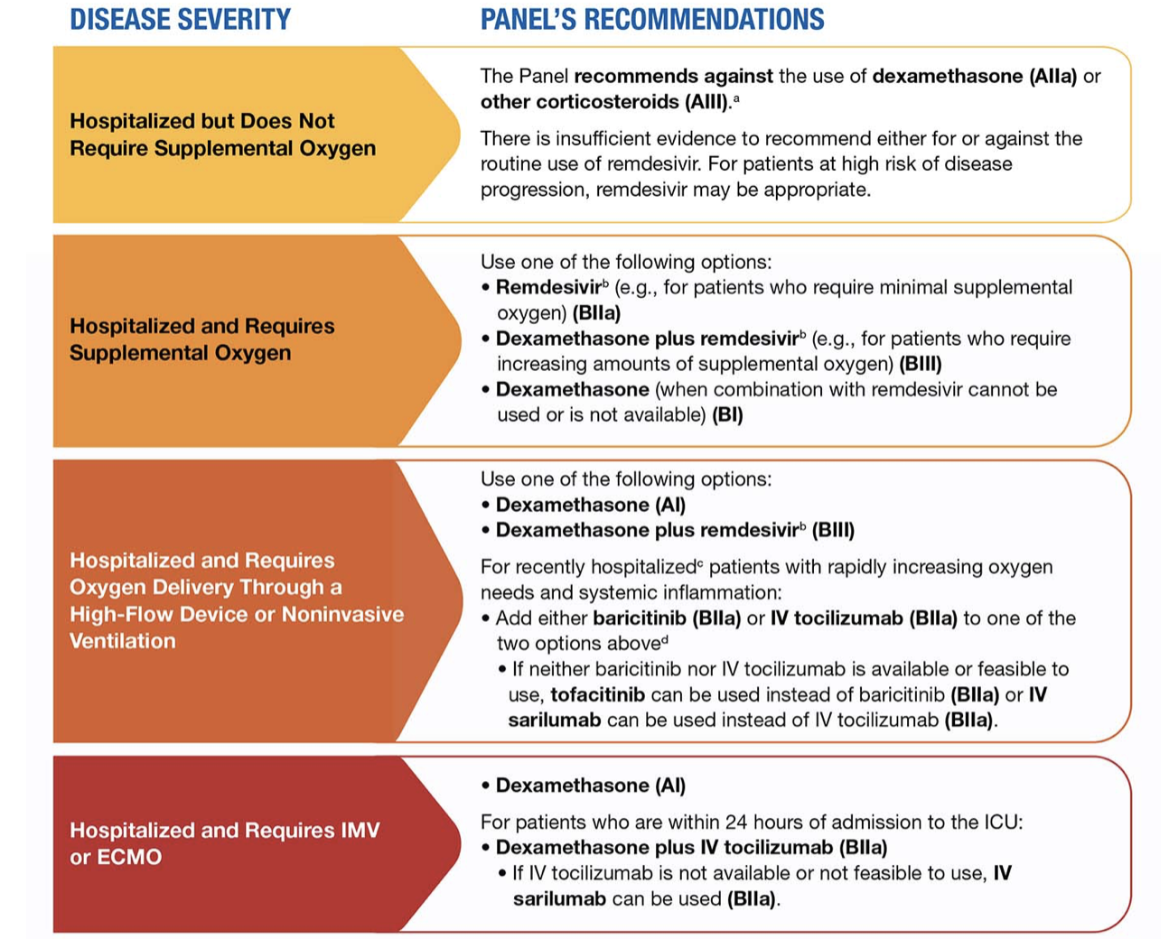
NIH Inpatient Treatment Guidelines https://files.covid19treatmentguidelines.nih.gov/guidelines/covid19treatmentguidelines.pdf

Slide 8
Prevention with vaccines
COVID-19 Booster for highest risk (28 days after initial series)
Moderate to high-risk immunocompromised persons
Transplant
Advanced or untreated HIV
Active Cancer treatment
Immunosuppressive therapy (Prednisone > 20 mg for 14 d, TNF, antimetabolites, etc)
Pfizer (12yrs and up) or Moderna (18 yrs and up) recipients eligible to receive same vaccine
https://www.fda.gov/media/144413/download
https://www.fda.gov/media/144637/download

Slide 9
Prevention with vaccines
Who Should get a Pfizer Booster 6 months after primary series?
Age > 65 year
Age > 18 in long term care setting
Age >50 with underlying medical conditions:
Cancer, stroke, CKD, COPD, DM, Heart disease, Obesity BMI >30Pregnancy, smoking
Down Syndrome, HIV, Neurologic conditions, BM > 25, other lung disease, Sickle Cell Disease, transplantation, substance use disorder, corticosteroids or other immunosuppressive conditions
Cystic fibrosis, thalasemia
Asthma, Hypertension, immune deficiencies, liver disease
https://www.cdc.gov/coronavirus/2019-ncov/vaccines/booster-shot.html

Slide 10
Prevention with vaccines
Who May get a Pfizer booster dose?
Age 18-49 with underlying conditions
Employees and residents aged 18-64 at increased risk for COVID-19 exposure and transmission because of occupational or institutional setting:
First Responders (health care workers, firefighters, police, congregate care staff)
Education workers(teachers, support staff, daycare workers)
Food and Agricultural, manufacturins and Grocery Store workers
Corrections workers, postal workers, public transit workers
https://www.cdc.gov/coronavirus/2019-ncov/vaccines/booster-shot.html

Slide 11
Prevention with vaccines- FDA 10/20/2021
Moderna vaccine boosters
½ the original series dose
Give 6 months after completing original series
Same FDA criteria as Pfizer
65 and older
18-64 at high risk of severe COVID-19
18-64 with frequent institutional or occupational risk of SARS-CoV-2 exposure
https://www.cdc.gov/coronavirus/2019-ncov/hcp/testing-overview.html#VaccinationSARSTesting

Slide 12
Prevention with vaccines FDA 10/20/2021
Johnson and Johnson booster
Given at least 2 months after original dose
For age 18 and up
“Mix and match” with any vaccine is OK.
Wait for ACIP/CDC and IHS Approval, please!
https://www.fda.gov/news-events/press-announcements/coronavirus-covid-19-update-fda-takes-additional-actions-use-booster-dose-covid-19-vaccines

Slide 13
Prevention through infection control
Asymptomatic Contacts of Covid-19 Cases
Unvaccinated:
Test immediately and repeat at day 5-7
Quarantine 14 days if both tests are negative (unless local jurisdiction says otherwise)
Vaccinated
No quarantine required
Test at day 3-5 or if symptoms develop.
On Navajo we test at day 0 and day 5 after last exposure
Wear a mask indoors for 14 days
https://www.cdc.gov/coronavirus/2019-ncov/hcp/testing-overview.html#VaccinationSARSTesting

Slide 14


