Slide 1
Motivational Interviewing
Kaylee Trottier, Ph.D
Executive Director Psychologist

Slide 2
Introductions and Information
Grievances can be directed to Indigenous Living Board of Directors
    Contact Jennifer Parisien jparisien@fsa-ig.com or Olivia Ochoa d.olivia.ochoa7@gmail.com

Slide 3
Learning Objectives
Define Motivational Interviewing
Describe several strategies that can be implemented
Describe the value of utilizing MI in brief healthcare settings

Slide 4
Motivational Interviewing
Developed by Miller and Rollnick in 1991
A counseling style that elicits behavior change by helping individuals explore and resolve ambivalence
Designed to produce rapid, internally motivated change
Productive conversations with patients about behavior.

Slide 5
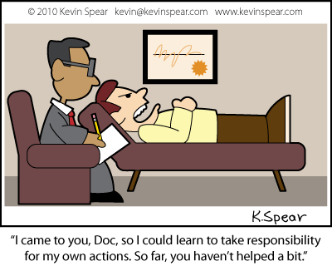
Ideologies
Individuals often seek medical attention looking for a medical cure.
Assumptions about individuals' motivations are usually false.
You are not tricking individuals into doing what they don’t want to do, eliciting and reinforcing the individuals' own motivations.
Notes:
No matter how individuals mistreat themselves they sometimes come to use to cure them.
Responsibility vs fault Will Smith
Autonomy requires a little detachment, acceptance that others can make their own decisions.
In fact it is not recommended that MI be used if counselor is invested in outcome of behavior change
Always honoring individual autonomy, refraining from judgment and taking responsibility for their behavior

Slide 6
Four General Principles
Express empathy
Develop discrepancy
Roll with resistance
Support self-efficacy
Notes:
Support self-efficacy by not assuming responsibility

Slide 7
Express Empathy
Acceptance facilitates change
  You do not need to agree of approve of behavior but seek to understand where the individual is.
Skillful reflective listening
Ambivalence is accepted as a normal part of change
Notes:
Steven Covey

Slide 8
Develop Discrepancy
MI can change individuals' perceptions without creating the sense of being pressured
People are more persuaded by what they hear themselves say than what others tell them.
Individual should present the arguments for change
Example, “You mentioned last week that your motivation to quit smoking was a 9/10” ………. “You also mention you bought a pack of cigarettes after you left the office”

Slide 9
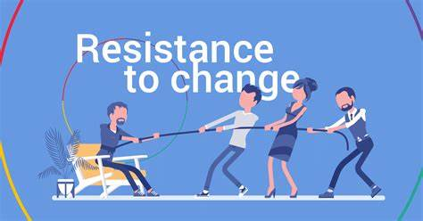
Roll with Resistance
Avoid arguing for change
Discord rather than resistance
New perspectives are invited not imposed
Individual is primary resource for answers and solutions
Notes:
Resistance is a signal to provider to respond differently, using discord refocuses attention on your response not the natural challenge to changing habits.

Slide 10
Support and Self-efficacy
A person’s belief in the possibility in change
Individual, not provider, is responsible and capable for carrying out change.

Slide 11

Problems with Standards of Practice
Medical providers often offer unwelcome advice that elicits resistance.
Advice must match motivation
Client knowledge of facts is weakly correlated to change.

Slide 12
Skills
Individual must determine treatment plan
  No decided what individual should do
Basic counseling skills
  Empathy, listening, partners
OARS
  Open ended questions
  Affirmations
  Reflections
  Summaries

Slide 13
Tools
1. Reflection
  Respond to “maybe I have some problems with alcohol but I am not alcoholic”
Open ended questions
Affirmations
Tracking Behavior/triggers
Shifting Focus
Reframing
Scales
Agreeing with a twist
  “no body can tell me how to raise my kids”
9. Emphasize their personal choices and control
  “I don’t think that it is going to work for me”
Notes:
1. You see alcohol is a problem for you and it also important that people not see you as an alcoholic – double sided reflection
2. The truth is that it is up to you how you raise your kids and what they learn. What is important for you that they learn?
5. It is certainly possible that after giving it a try you still won’t be any better off, so you may be right
7. How motivated are you to change on scale? Why are you at this number not a lower number?

Slide 14
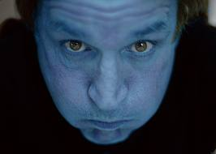
Traps
Avoid righting reflex
  “I know better” and “yes, but”
Question – Answer
Confrontation – Denial
Expert
Labeling
Premature focus
Blaming
Notes:
Righting reflex pulls for psychological response

Slide 15
Indigenous Communities
Do not forget that spirituality can be a large motivator. If you take the time to understand the individual's spirituality you may find motivation.
Family and ancestors can also be used to elicit dissonance.
Our way of speaking and respecting each other is a great foundation for MI. Our understanding and respect for others following their own path.
Notes:
Our ancestors are watching
Your path is not their path.
Lack of permanence in many of our language

Slide 16
What is SBIRT
An intervention based on “motivational interviewing” strategies
Screening: Universal screening for quickly assessing use and severity of alcohol; illicit drugs; and prescription drug use, misuse, and abuse
Brief Intervention: Brief motivational and awareness-raising intervention given to risky or problematic substance users
Referral to Treatment: Referrals to specialty care for patients with substance use disorders.

Slide 17
SBIRT Trainings
Home: All courses (healtheknowledge.org)
PowerPoint Presentation (rush.edu)
Evidence Supporting the Effectiveness of an SBIRT (samhsa.gov)
Screening Tools – SBIRT (miami.edu)
SA3522_sbirt_for_clinicians.pdf (reading.k12.ma.us)

Slide 18
Questions and Discussion

Slide 19
References
Duhigg, Charles. (2012). The power of habit : why we do what we do in life and business. New York, N.Y. :Random House : Books on Tape.
Covey, S. (2004). 7 Habits of Highly Effective People. Free Press.
Graham, S. (2015). Motivational Interviewing Made Easy. G. Scott Graham
Matulich, B. (2017. How To Do Motivational Interviewing: A Guidebook (Second Edition). Bill Matulich.
Motivational Interviewing Network of Trainers (2020). Understanding Motivational Interviewing. Retrieved from Understanding Motivational Interviewing | Motivational Interviewing Network of Trainers (MINT)
Rollnick, S., Miller, W., Butler, C. (2008). Motivational Interviewing in Health Care. The Guilford Press. New York London.

