Slide 1

Harm reduction support and perspective on return to use
Harm Reduction ECHO
September 7, 2021

Slide 2

Agenda
Welcome and Introductions
Presentation
Questions and Discussion

Slide 3

Deadly Duo
Notes:
Guilt is a feeling you get when you did something wrong, or perceived you did something wrong. Shame is a feeling that your whole self is wrong, and it may not be related to a specific behavior or event.
Talk to yourself like to you talk to someone you love
Reach out to someone you trust and tell your story,
Tell your story
Secrecy, silence and judgment are the things shame needs to grow.
Antidote is empathy https://www.youtube.com/watch?v=KZBTYViDPlQ

Slide 4
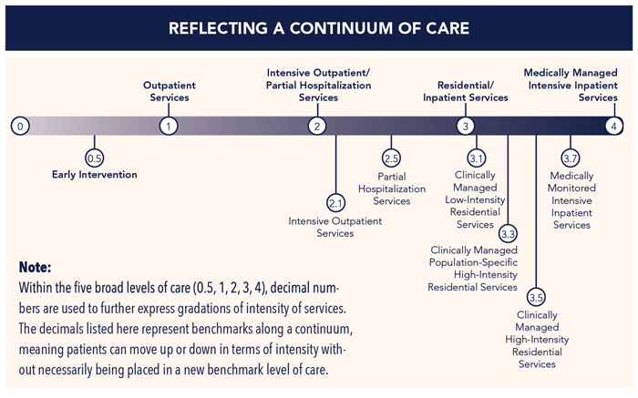
Notes:
https://www.asamcontinuum.org/knowledgebase/what-are-the-asam-levels-of-care/
The ASAM Criteria text describes treatment as a continuum marked by four broad levels of service and an early intervention level. Within the five broad levels of care, decimal numbers are used to further express gradations of intensity of services.These levels of care provide a standard nomenclature for describing the continuum of recovery-oriented addiction services. With the ASAM CONTINUUM™, clinicians are able to conduct a multidimensional assessment that explores individual risks and needs, as well as strengths, skills and resources. ASAM CONTINUUM then provides clinicians with a recommended ASAM Level of Care that matches intensity of treatment services to identified patient needs. To fully understand the different ASAM Levels of Care and appropriate matching of services to patient needs, refer to the Service Planning and Placement chapter in The ASAM Criteria: Treatment Criteria for Addictive, Substance-Related, and Co-Occurring Conditions (2013).
Called Early Intervention for Adults and Adolescents, this level of care constitutes a service for individuals who, for a known reason, are at risk of developing substance-related problems, or a service for those for whom there is not yet sufficient information to document a diagnosable substance use disorder. A detailed description of the services typically offered in this level of care, the care setting and how to identify what patients would benefit best from these services based on an ASAM dimensional needs assessment, begins on page 179 of The ASAM Criteria: Treatment Criteria for Addictive, Substance-Related, and Co-Occurring Conditions (2013).
Called Outpatient Services for adolescents and adults, this level of care typically consists of less than 9 hours of service/week for adults, or less than 6 hours a week for adolescents for recovery or motivational enhancement therapies and strategies. Level 1 encompasses organized services that may be delivered in a wide variety of settings. A detailed description of the services typically offered in this level of care, the care setting and how to identify what patients would benefit best from these services based on an ASAM dimensional needs assessment, begins on page 184 of The ASAM Criteria: Treatment Criteria for Addictive, Substance-Related, and Co-Occurring Conditions (2013).
Called Intensive Outpatient Services for adolescents and adults, this level of care typically consists of 9 or more hours of service a week or 6 or more hours for adults and adolescents respectively to treat multidimensional instability. Level 2 encompasses services that are capable of meeting the complex needs of people with addiction and co-occurring conditions. It is an organized outpatient service that delivers treatment services during the day, before or after work or school, in the evening, and/or on weekends. A detailed description of the services typically offered in this level of care, the care setting and how to identify what patients would benefit best from these services based on an ASAM dimensional needs assessment, begins on page 198 of The ASAM Criteria: Treatment Criteria for Addictive, Substance-Related, and Co-Occurring Conditions (2013).
Called Partial Hospitalization Services for adolescents and adults, this level of care typically provides 20 or more hours of service a week for multidimensional instability that does not require 24-hour care. Level 2 encompasses services that are capable of meeting the complex needs of people with addiction and co-occurring conditions. It is an organized outpatient service that delivers treatment services usually during the day as day treatment or partial hospitalization services. A detailed description of the services typically offered in this level of care, the care setting and how to identify what patients would benefit best from these services based on an ASAM dimensional needs assessment, begins on page 208 of The ASAM Criteria: Treatment Criteria for Addictive, Substance-Related, and Co-Occurring Conditions (2013).
Called Clinically Managed Low-Intensity Residential Services, this adolescent and adult level of care typically provides a 24 hour living support and structure with available trained personnel, and offers at least 5 hours of clinical service a week. Level 3 encompasses residential services that are described as co-occurring capable, co-occurring enhanced, and complexity capable services, which are staffed by designated addiction treatment, mental health, and general medical personnel who provide a range of services in a 24-hour living support[DM1] setting. A detailed description of the services typically offered in this level of care, the care setting and how to identify what patients would benefit best from these services based on an ASAM dimensional needs assessment, begins on page 222 of The ASAM Criteria: Treatment Criteria for Addictive, Substance-Related, and Co-Occurring Conditions (2013).
Called Clinically Managed Population-Specific High-Intensity Residential Services, this adult only level of care typically offers 24-hour care with trained counselors to stabilize multidimensional imminent danger along with less intense milieu and group treatment for those with cognitive or other impairments unable to use full active milieu or therapeutic community. Level 3 encompasses residential services that are described as co-occurring capable, co-occurring enhanced, and complexity capable services, which are staffed by designated addiction treatment, mental health, and general medical personnel who provide a range of services in a 24-hour treatment setting. A detailed description of the services typically offered in this level of care, the care setting and how to identify what patients would benefit best from these services based on an ASAM dimensional needs assessment, begins on page 234 of The ASAM Criteria: Treatment Criteria for Addictive, Substance-Related, and Co-Occurring Conditions (2013).
Called Clinically Managed Medium-Intensity Residential Services for adolescents and Clinically Managed High-Intensity Residential Services for adults, this level of care provides 24-hour care with trained counselors to stabilize multidimensional imminent danger and prepare for outpatient treatment. Patients in this level are able to tolerate and use full active milieu or therapeutic communities. Level 3 encompasses residential services that are described as co-occurring capable, co-occurring enhanced, and complexity capable services, which are staffed by designated addiction treatment, mental health, and general medical personnel who provide a range of services in a 24-hour treatment setting. A detailed description of the services typically offered in this level of care, the care setting and how to identify what patients would benefit best from these services based on an ASAM dimensional needs assessment begins on page 244 of The ASAM Criteria: Treatment Criteria for Addictive, Substance-Related, and Co-Occurring Conditions (2013).
Called the Medically Monitored High-Intensity Inpatient Services for adolescents and Medically Monitored Intensive Inpatient Services Withdrawal Management for adults, this level of care provides 24-hour nursing care with a physician’s availability for significant problems in Dimensions 1, 2, or 3. Patients in this level of care require medication and have a recent history of withdrawal management at a less intensive level of care, marked by past and current inability to complete withdrawal management and enter into continuing addiction treatment. This is the appropriate setting for patients with subacute biomedical and emotional, behavioral, or cognitive problems that are so severe that they require inpatient treatment. Level 3 encompasses residential services that are described as co-occurring capable, co-occurring enhanced, and complexity capable services, which are staffed by designated addiction treatment, mental health, and general medical personnel who provide a range of services in a 24-hour treatment setting. A detailed description of the services typically offered in this level of care, the care setting, and how to identify what patients would benefit best from these services based on an ASAM dimensional needs assessment, begins on page 265 of The ASAM Criteria: Treatment Criteria for Addictive, Substance-Related, and Co-Occurring Conditions (2013).
Called Medically Managed Intensive Inpatient Services for adolescents and adults, this level of care offers 24-hour nursing care and daily physician care for severe, unstable problems in ASAM Dimensions 1, 2 or 3. Counseling is available 16 hours a day to engage patients in treatment. A detailed description of the services typically offered in this level of care, the care setting and how to identify what patients would benefit best from these services based on an ASAM dimensional needs assessment begins on page 280 of The ASAM Criteria: Treatment Criteria for Addictive, Substance-Related, and Co-Occurring Conditions (2013).

Slide 5
Definition of Recovery
A process of change through which individuals improve their health and wellness, live a self-directed life, and strive to reach their full potential. –Substance Abuse and Mental Health Services Administration (SAMHSA)
Recovery does not have to mean abstinence, there are many paths to recovery and we don’t get to define recovery for anyone other than ourselves

Slide 6
Recovery Program Examples
12 Step meetings (NA, AA, CMA, etc)
SMART Recovery
Wellbriety (sobriety, recovery and wellness)
HAMS (Harm Reduction, Abstinence, and Moderation Support)
Moderation Management (secular, not abstinence-based)
Recovery Dharma, Refuge Recovery (Buddhist recovery)
Harm Reduction Works (welcomes anyone on the spectrum of use, including abstinent)

Slide 7
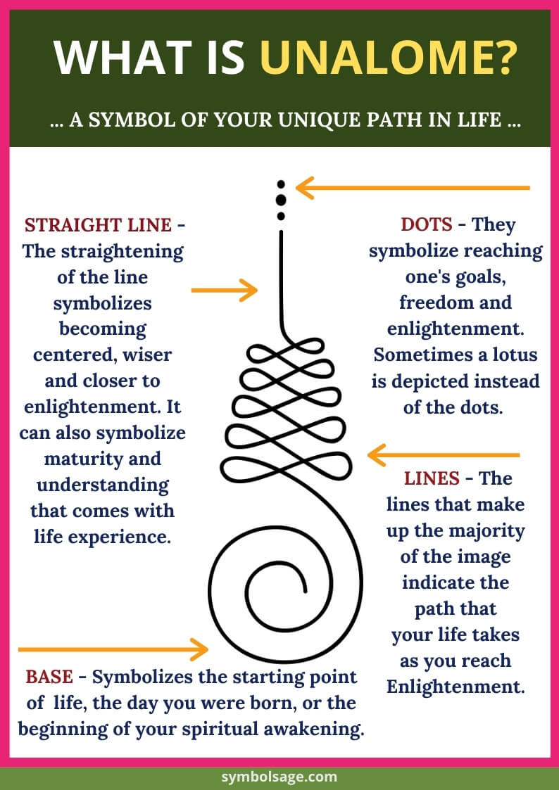
Unalome
The lines that make up the majority of the image indicate the path that your life takes as you reach Enlightenment. Life is never a straight line. It is full of twists and turns, lessons that we have to learn and the struggles that we face. Sometimes our life goes back upon itself because we have to retrace our steps so that we can become wiser.
As we gain greater awareness, our consciousness expands, and the loops that make up the Unalome lines become tighter toward the top of the image. This tightness in the loops is a symbol of one becoming more centered and aligned with the divine and one’s journey towards enlightenment.

Slide 8

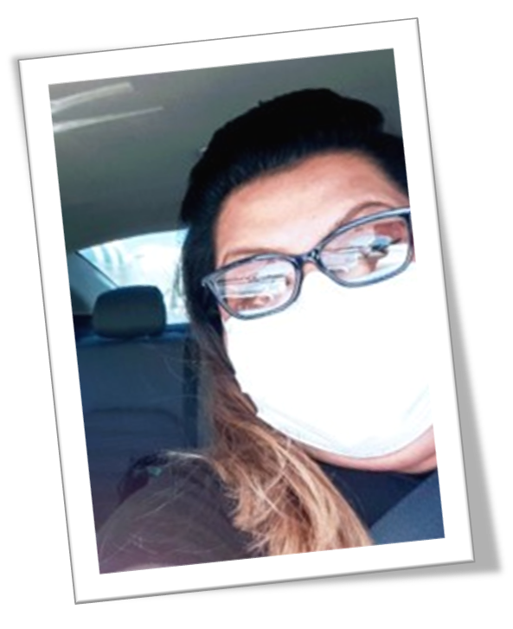
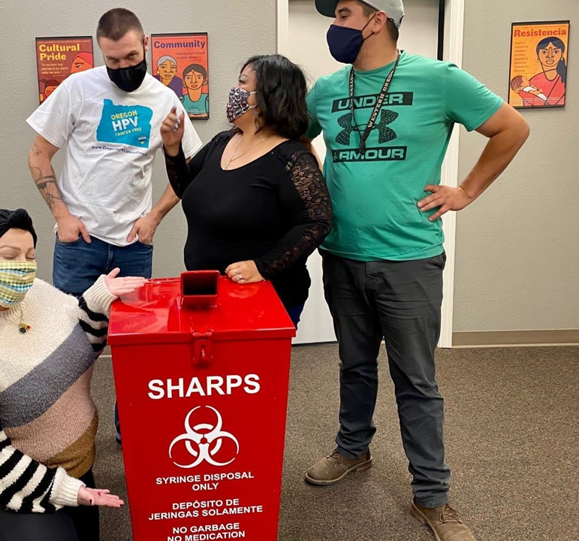
Oregon peer-based intervention providing:
  Recovery support
  Overdose prevention and harm reduction services
  Testing and treatment for HCV (also HIV, HAV, HBV)
  … offered independently of engagement in treatment or another program/referral
eerRecovery Initiated in Medical Establishments + HCV/HIV Testing
and Linkage
to Treatment
What is PRIME+?
Peer Recovery Initiated in Medical Establishments +
HCV/HIV Testing and Linkage to Treatment

Slide 9
PRIME+ peers…
are people in long-term recovery, credentialed as Peer Recovery Specialists, with harm reduction and infectious disease prevention training
reach out to people who are at risk of or receiving treatment for overdose, infection or other health issues related to substance use
engage people who are at varying stages of change, using a harm reduction approach
support people in their recovery journey to reach self-identified goals for health, well-being, and quality of life
Who are PRIME+ peers and what do they do?

Slide 10
Linkage to substance use treatment and recovery supports
Linkage to physical healthcare
Support for infectious disease testing and treatment (hepatitis C)
Access to community resources for
basic needs (food, housing, identification)
Support signing up for health insurance (OHP)
Access to harm reduction supplies like safer use kits and naloxone
Emotional and crisis support
Examples of PRIME+ peer services

Slide 11
Community partners make referrals
  Hospitals/Emergency Departments
  Emergency Medical Services
  Coordinated Care Organizations (CCOs)
  Health clinics, primary care providers
  Public health departments
  Substance use disorder (SUD) treatment program, sobering centers
  Justice system
  Syringe service programs
Peers do direct community outreach to engage individuals in the community
Individuals can “self refer”
How does someone connect to PRIME+ peer services?

Slide 12
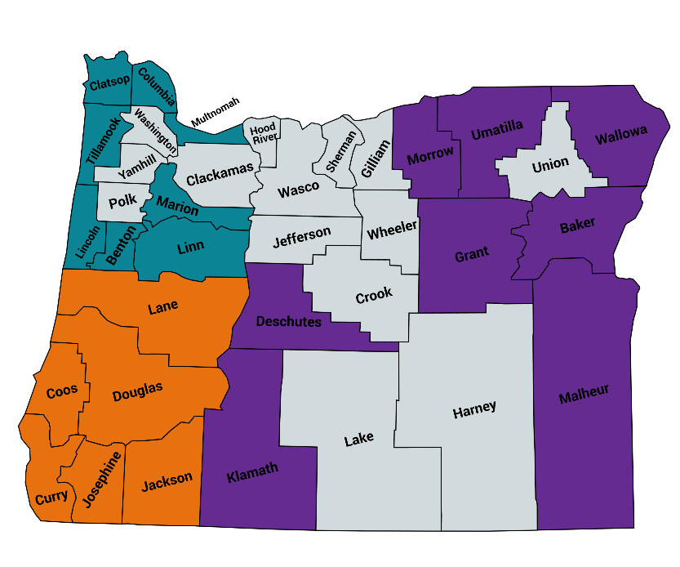
East
Baker, Deschutes, Grant, Klamath, Malheur, Morrow, Umatilla, Wallowa
50+ peers
26 counties
18 organizations
3 regions
PRIME+ Sites:
Where are they?
North
Benton, Clackamas, Clatsop, Columbia, Lincoln, Linn, Marion, Multnomah, Tillamook, Washington
South
Coos, Curry, Douglas, Jackson, Josephine, Lane

Slide 13
Prime Plus Program Services
Moral support, role-modeling, problem-solving, and advocacy
Referrals to and assistance accessing community resources, care coordination, and healthcare services
STI prevention services, such as syringe exchange and education - overdose prevention supplies, such as naloxone and fentanyl testing strips
Rides and other practical assistance as resources allow
Referral and linkage to substance use treatment, if client is ready and willing

Slide 14

Why we approach returning to use with compassion
Short stories

Slide 15

Peers & Harm Reduction Workers
Warm handoffs can be given in both directions, so that people have support no matter where they are on the continuum of drug use.
Cutting people off from services if they return to use can cause harm
Are there barriers to service at your organization? If so, what can be done to remove some of those barriers?

Slide 16

Setting clients up for success, no matter the outcome
This can help minimize shame
Let them know there are many paths to recovery
Let them know you do not have any particular expectations and the most important thing is that they are as safe and healthy as possible.
Eliminating expectations is important, because we don’t want clients to feel that they are not living up to OUR expectations. Also, expectations can cause resentments!

Slide 17

Setting clients up for success, no matter the outcome
It is important for clients to know that you are keeping the door open, and that they can come back to you at any time, for any reason, without judgement.
If they don’t feel comfortable in a treatment program, it doesn’t mean there is anything wrong with them.
Let them know they are Goldilocks, and they can try different approaches until they find the one that suits them best!

Slide 18

Setting clients up for success, no matter the outcome- when they leave for treatment
Be clear and verbalize that they are welcome back if they ever need harm reduction services again.
There is no shame in going to treatment just to detox, lower their tolerance, or give their body and veins a break. That is still a success!
Remind them that if they decide to return to use after a break, they are at a much higher risk for overdose.
Let them know that they can also still call you for help with other things- referrals for services, recovery support (if applicable).

Slide 19

Facts about Relapse
Talking about relapse does not encourage relapse.
Relapse does not mean you failed
Relapse does not mean treatment didn’t work
Relapse does not mean you threw away the time you were abstinent (you still learned and were abstinent for that time period)
Relapse does not mean a person didn’t want recovery badly enough, or that they didn’t work hard enough

Slide 20
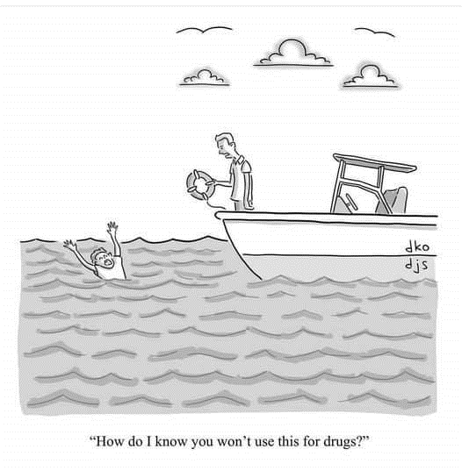
Overdose & Infection Safety Plans can be valuable for everyone, even in recovery
These are similar to relapse prevention plans
https://www.indiancountryecho.org/wp-content/uploads/2019/07/The-OD-Safety-Plan.pdf
https://www.zerooverdose.org/
How do I know you won’t use this for drugs?

Slide 21
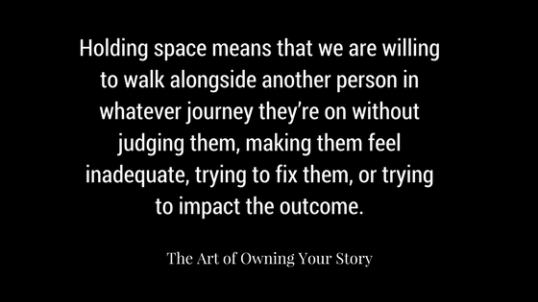
When a client says they are abstinent or in recovery- how do you respond?
Harm reduction is neutral to the issue of whether or not a person is using drugs.
What can you say to support someone’s personal journey?
How can you hold space for someone?
Open up for discussion

Slide 22
When a client says they are abstinent or in recovery- how do you respond?
If they are immediately praised, this can show expectations of them. Praising abstinence can make a person feel guilt and shame if they return to use.
Ask them to expand about what that is like for them, and how it is working out for them.
You can praise their efforts to try something new, and also their willingness to address things that are not working out for them.
Let them know that you support them if they continue to stay abstinent but also will support them (without judgement) if they return to use and need supplies or resources, so that they are welcome back no matter what happens in the future.

Slide 23
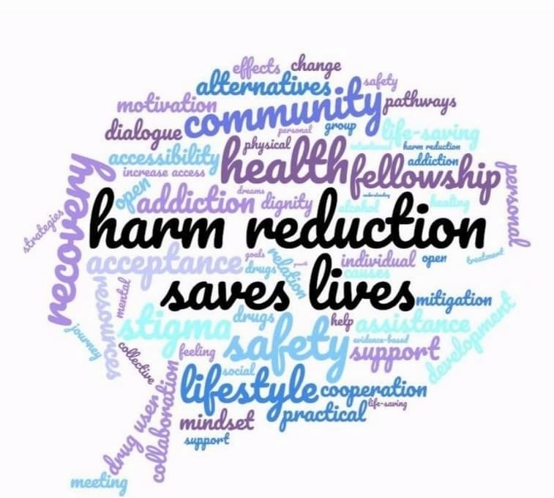
References- Alternative recovery programs
https://www.smartrecovery.org/
https://wellbriety.com/
https://hams.cc/
https://moderation.org/
https://recoverydharma.org/
https://www.refugerecovery.org/
https://linktr.ee/hrw (Harm Reduction Works)

