Slide 1
Patient Evaluation Before Initiating HIV PrEP
Jorge Mera, MD, FACP
Cherokee Nation Health Services

Slide 2
Disclosures
Jorge Mera has no actual or potential conflict of interest in relation to this program/presentation.

Slide 3
Outline
Case Presentation: Mr. P
Clinical/Laboratory evaluation
Rationale for labs
Interpretation of HIV and HBV serology
Screening for STIs
Counseling the Patient
Kidney function evaluation prior to PrEP delivery
Osteoporosis evaluation Prior to Starting PrEP
Treatment considerations

Slide 4
Mr. P
HPI: Mr. P is a 32-year-old MSM who is requesting PrEP. He mentions he heard about PrEP from a friend and thinks he may be a candidate. He is feeling well, experienced a gonococcal urethritis 5 months ago that was treated and has been asymptomatic since then.
Sexual History: He does not have a stable sexual partner, uses condoms 50% of the time and engages in receptive anal intercourse. Has had 5 different sexual partners in the last 6 months of which 4 have reported to him that their HIV status is negative and 1 is unknown. He does not use drugs during sex. His last condom less receptive anal sexual encounter was 8 days ago. The HIV status of his partner in the last encounter is unknown.
PMH: Gonococcal urethritis treated 5 months ago. Otherwise, unremarkable
PE: Vital signs are normal, weight 70 kg, height 175 cm, BMI 23, otherwise normal.

Slide 5
HCV antibody
HIV1/2 Antigen/Antibody Immunoassay
GC/Chlamydia in urine, oropharynx and rectum
HBsAg, HBsAb, HBcAb
Complete Blood Count:
Comprehensive Metabolic Panel
Negative
Negative
Negative
HBV viral load
40,000 international units/mL
HBsAg and HBcAb reactive. HBsAb not detectable
Normal
MP: ALT 72 IU/L, AST 45 IU/, creatinine 0.9 mg/dL, GFR 116 ml/min, albumin 4.5 g/dL, total bilirubin 0.7 mg/dL, INR 1.0.
Mr. P: Labs

Slide 6
Which of the following statements are true for Mr. P?
a) Meets criteria for PrEP but needs counseling for Hep B
b) Will need an HIV RNA after day 10 of last sexual exposure or a repeat 4th generation HIV Assay within 3 weeks
c) Will need Hep B treatment before he can start PrEP
d) A and B are true
e) B and C are true

Slide 7
Outline
Case Presentation: Mr. P
Clinical/Laboratory evaluation
Rationale for labs
Interpretation of HIV and HBV serology
Screening for STIs
Counseling the Patient
Kidney function evaluation prior to PrEP delivery
Osteoporosis evaluation Prior to Starting PrEP
Treatment considerations

Slide 8
Lab Workup Before Prescribing
HIV PrEP
HIV:
HIV1/2 Antigen/Antibody Immunoassay (4th generation assay)
HIV-1/HIV2 antibody differentiation immune assay
Nucleic Acid Test (NAT)
HBV serologies:
HBsAb: Surface antibody
HBsAg: Surface antigen
HBcAb: Total core antibody
HCV antibody
Renal function
Creatinine/GFR, Microalbumin/creatinine ratio
STI screening
RPR
Pregnancy screening
If previously treated substitute for HCV RNA
GC/Chlamydia (Oral, anal and urine/vaginal)
“4th Generation Assays should be used for screening”
“Patients with Chronic HB need to be counseled for the risk of reactivation if PrEP is discontinued”
“STI self-reported risk is not always reliable”
“Pregnancy is not a contraindication for PrEP”

Slide 9
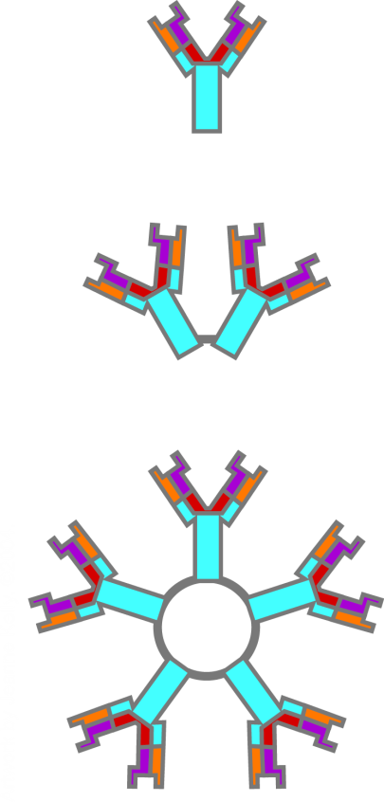

HIV Diagnostic Tests
ELISA
4th Generation
3rd Generation
1st & 2nd Generation
Patients P24 Ag
Patients IgG
Patients IgM
P24 monoclonal Ab
Antigen: Viral synthetic peptides or
recombinant proteins

Slide 10
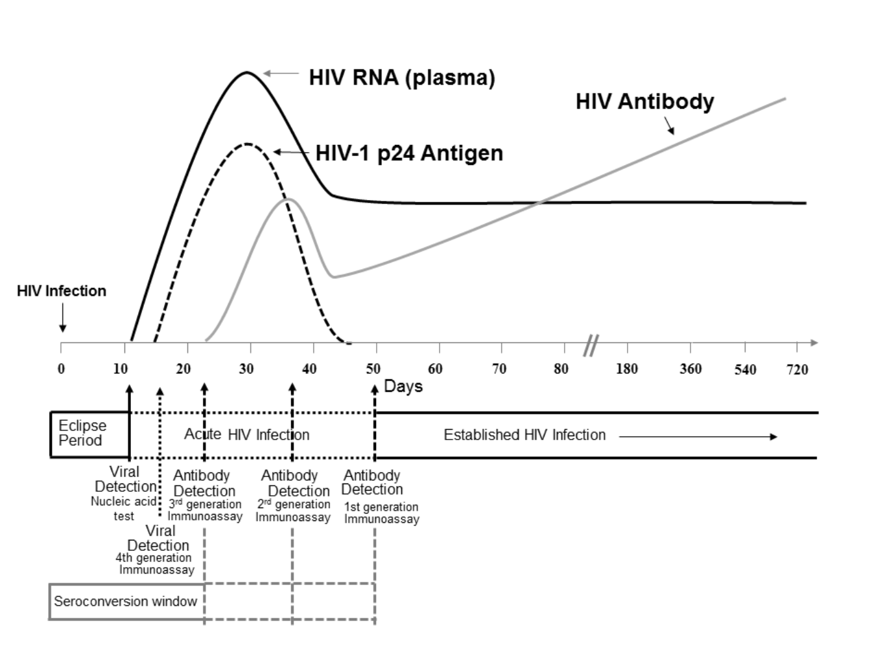
Sequence of Appearance of Laboratory Markers for HIV- Infection
Time to positivity
3rd Generation | IgG and IgM Antibody | 20-30 days
4th Generation | IgG and IgM Antibody & P24 Ag | 15-20 days
HIV RNA | RNA | 10-15 days
Ultrasensitive HIV RNA | RNA | 5 days
Laboratory testing for the diagnosis of HIV infection : updated recommendations
June 27, 2014 http://dx.doi.org/10.15620/cdc.23447

Slide 11
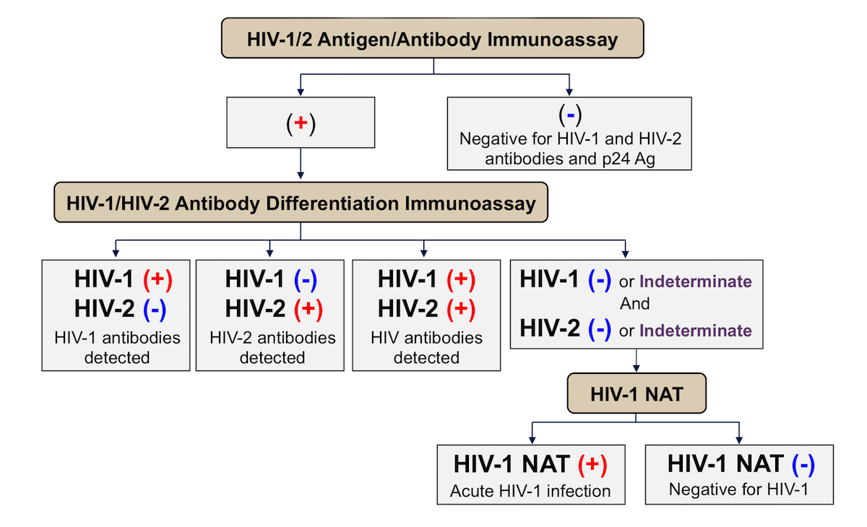
CDC and APHL Recommended Laboratory Testing for the Diagnosis of HIV Infection
David H Spach, MD. HIV Diagnostic Testing. National HIV Curriculum, University of Washington
Laboratory testing for the diagnosis of HIV infection : updated recommendations
June 27, 2014 http://dx.doi.org/10.15620/cdc.23447

Slide 12
HIV Testing Summary
The preferred HIV screening test is a fourth-generation antigen/antibody assay.
A third-generation assay is acceptable if an antigen-antibody test is not available, and the clinical history suggests that acute HIV infection is unlikely.
Rapid tests that use oral fluid should not be used
HIV RNA should be performed prior to initiating PrEP in the following groups of patients
Patients with signs or symptoms suggestive of acute HIV infection within the previous four weeks.
Patients with an indeterminate antigen/antibody test.
Patients who report a high-risk exposure within four weeks of starting PrEP, regardless of symptoms.
You may start “Rapid PrEP” but will need to repeat HIV testing within 4 weeks
Depending on initial test used and clinical history
12% false negatives rates in acute HIV

Slide 13
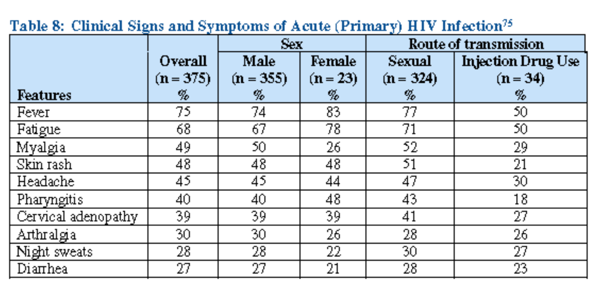
Symptoms of Acute HIV
These Symptoms Should be Absent 30 days prior to starting PrEP!!!
https://www.cdc.gov/hiv/pdf/risk/prep/cdc-hiv-prep-guidelines-2017.pdf

Slide 14
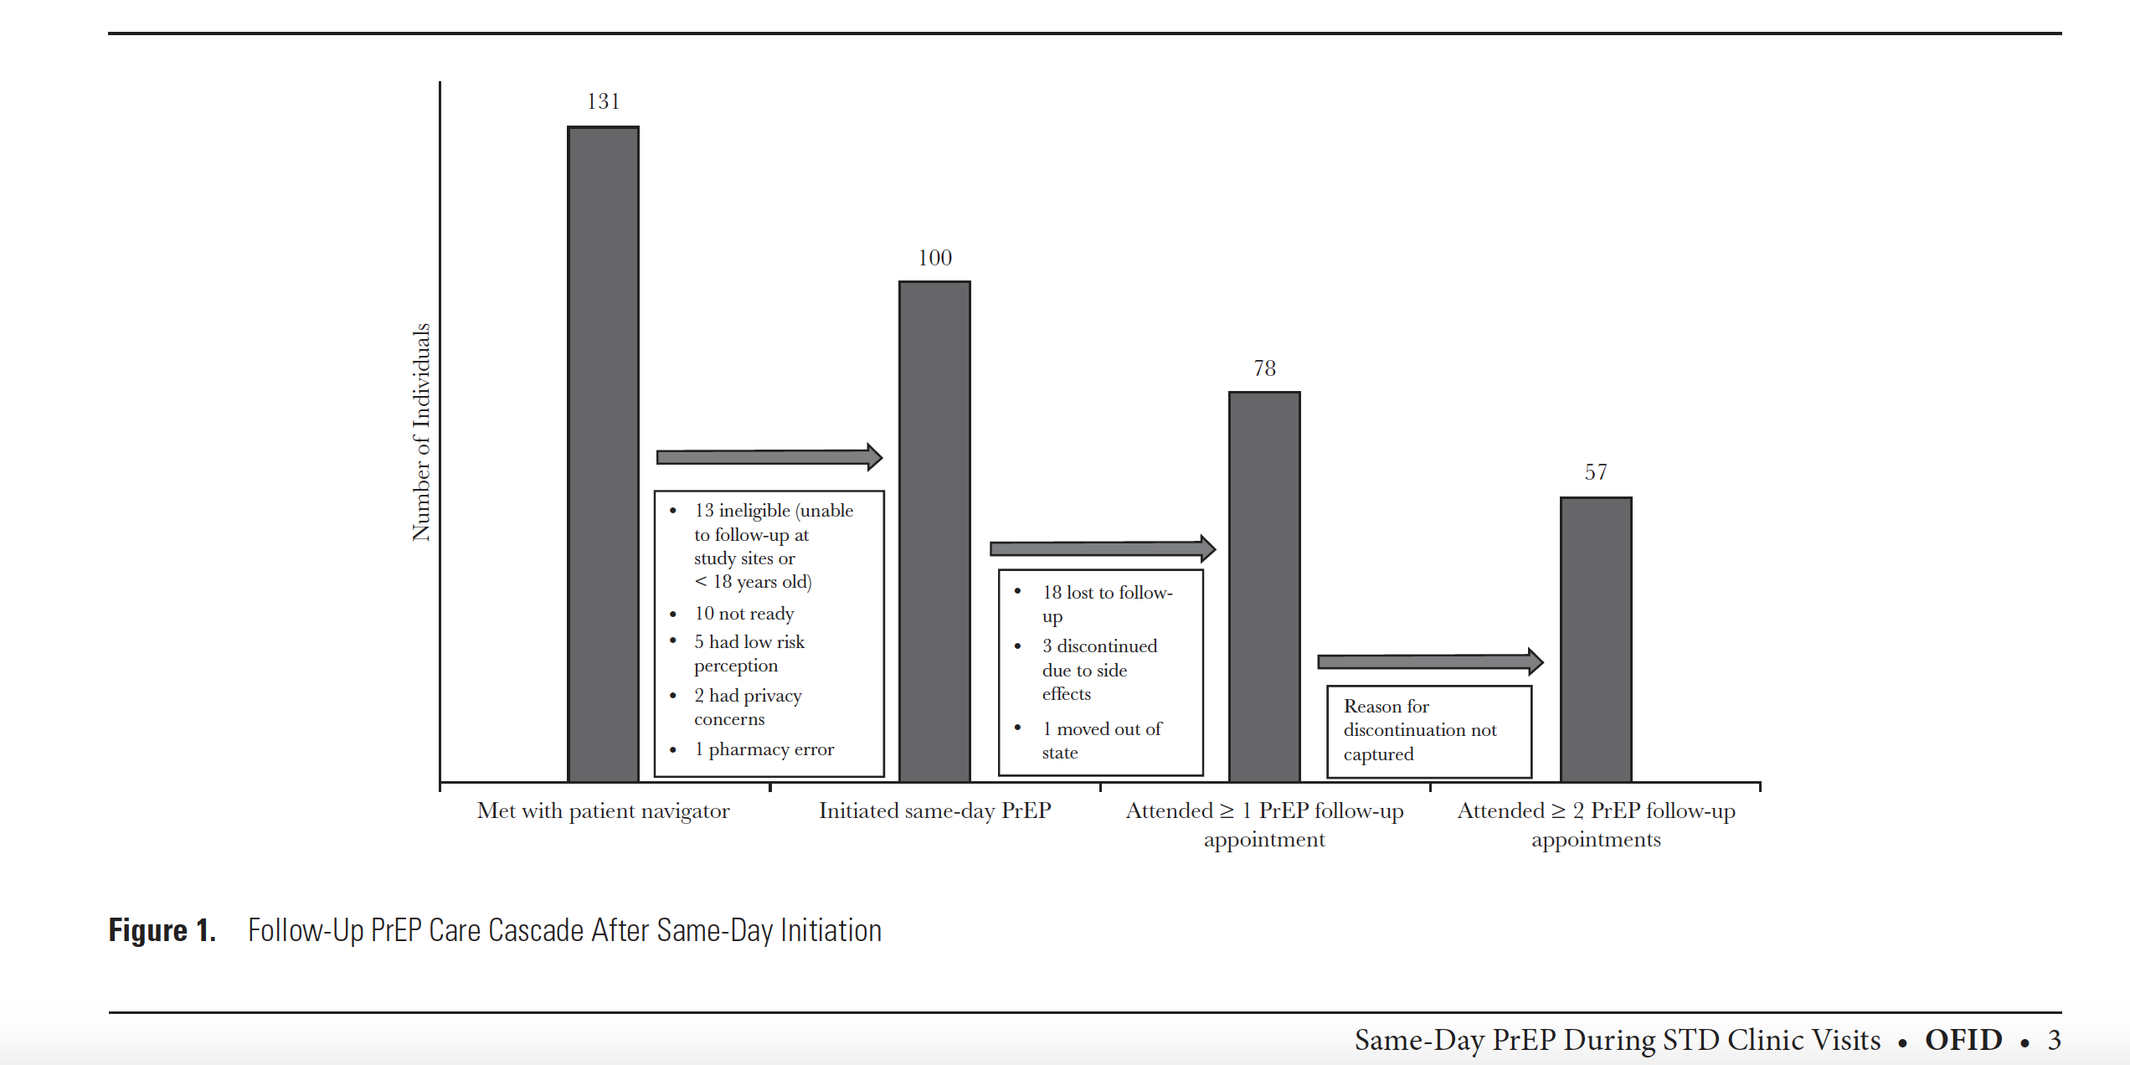
Same-Day HIV Pre-Exposure Prophylaxis (PrEP) Initiation During Drop-in Sexually Transmitted Diseases Clinic Appointments Is a Highly Acceptable, Feasible, and Safe Model that Engages Individuals at Risk for HIV into PrEP Care

Slide 15
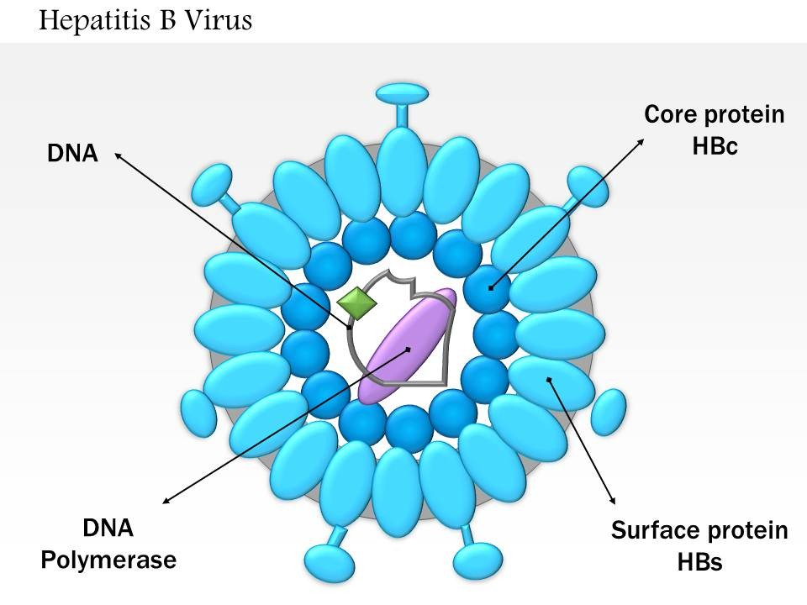
Hepatitis B Viral Structure
HBcAb IgM and IgG
Viral Load
HBAg, HBsAb

Slide 16
HBV Diagnostic Markers
Serologic Marker Results
HBsAg | Total Anti-HBc | IgM Anti-HBc | Anti-HBs | Interpretation
- | - | - | - | Never infected and no evidence of immunization
+ | + | + | - | Acute infection
+ | + | - | - | Chronic infection
- | + | - | -/+ | “Recovered” from past infection and not immune, low level carrier
- | - | - | + | Immune (immunization)
HBeAg- High infectivity
HBeAb- Low infectivity
Weinbaum CM, et al. MMWR Recomm Rep. 2008;57(RR-8):1-20.
Notes:
Slide: Typical Interpretation of Serologic Test Results for HBV Infection
Antigens and antibodies associated with HBV infection include HBsAg, anti-HBs, HBcAg, anti-HBc, HBeAg, and anti-HBe. At least one serologic marker is present during each of the different phases of HBV infection.¹
The serologic markers typically used to differentiate between acute, resolving, and chronic infection are HBsAg, anti-HBc, and anti-HBs, as noted in the slide.¹
Reference
Weinbaum CM, Williams I, Mast EE, et al. Recommendations for identification and public health management of persons with chronic hepatitis B virus infection. MMWR Recomm Rep. 2008;57(RR-8):1-20.

Slide 17
Isolated HBc
Window period of acute hepatitis B
Anti-HBs has fallen to undetectable levels many years after recovery from acute hepatitis B
HBsAg titer has fallen below the cutoff level for detection in those with chronic hepatitis B
Approximately 0.5 percent per year
HBsAg mutations (false negative)
False-positive test result.
An individual at low risk for disease
What do you do?
  HBV DNA (Viral Load)
  HBeAb and HBeAg
  If all are negative, may consider vaccination

Slide 18
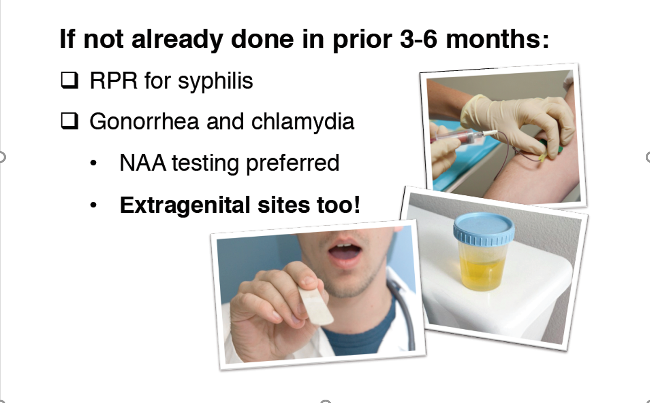
Screen for STIs
https://www.cdc.gov/hiv/pdf/risk/prep/cdc-hiv-prep-guidelines-2017.pdf

Slide 19
Renal Function Evaluation
Serum creatinine will determine the candidacy and selection of an agent for PrEP.
Individuals with a eGFR <30 ml/min/1.73 m² are not candidates for PrEP with either TDF-FTC or TAF-FTC
Individuals with an eGFR <60 mL/min/1.73 m² are not candidates for PrEP with TDF-FTC.
For patients with an eGFR >60 mL/min/1.73 m², but with risk factors for renal disease (eg, diabetes, hypertension, older age [eg, >40 years], nephrotoxic medications)
Obtaining baseline proteinuria and glycosuria is prudent (Not recommended by Guideline Panels)
In general, the risk of kidney injury with PrEP is low in patients without HIV taking TDF-FTC.
Certain risk factors have been associated with declines in renal function:
Baseline eGFR <90 mL/min/1.73 m²
Age greater than 40
Renal effects appear to be even less frequent with TAF-FTC than TDF-FTC.
In a meta-analysis the odds ratio of i creatinine elevations in patients who received TDF-based PrEP compared with placebo was 1.36 and only 6% of these patients had creatinine elevations that were greater than 1.3 times the upper limit of normal
In a meta-analysis the odds ratio of i creatinine elevations in patients who received TDF-based PrEP compared with placebo was 1.36, (95% CI 1.09-1. But only 6% of these patients had creatinine elevations that were greater than 1.3 times the upper limit of normal

Slide 20
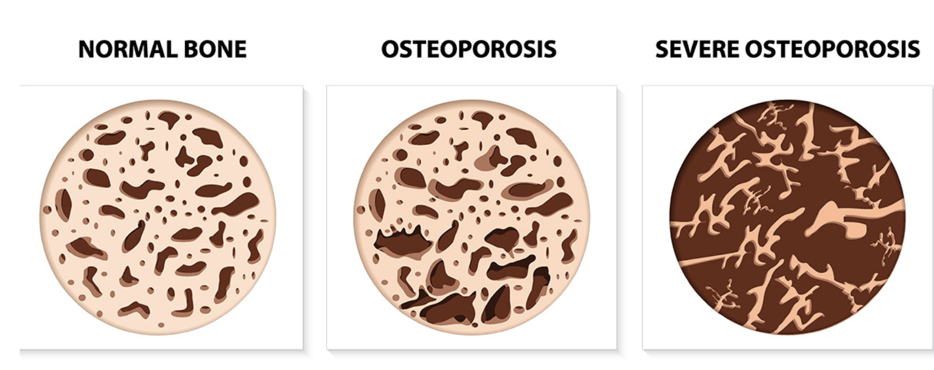
Osteoporosis Screening
Importance of osteoporosis history, risk factors or presence of osteopenia
It informs our regimen selection for PrEP
If only TDF-FTC is available discuss with patient risk of osteoporosis vs HIV
Bone loss appears to be greatest during the first six months, and then stabilizes
The need for routine bone density screening prior to initiating PrEP is unclear
Consider obtaining a baseline DXA scan in:
Patients who have a history of osteoporosis
Those who are at high risk for osteoporosis
Patients on TDF-FTC may have decrease in bone mass
The bone loss seen with TDF may be of more concern in adolescent MSM
There are no proven strategies to attenuate bone loss in patients taking PrEP.
But no differences in the rate of fractures have been reported
DXA: Dual energy X-ray Absorptiometry

Slide 21
Preferred PrEP Regimens
For the Majority of patients TDF-FTC rather than TAF-FTC.
Due to greater experience
TAF has been associated with mild but greater weight gain and slight changes in lipid parameters that are less favorable compared with TDF-FTC
When is TAF/FTC a consideration
MSM and transgender women with bone and renal disease
Adolescents
Pros of using it: They appear to be at higher risk for loss of bone mineral density
Cons of using it: Not well studied in this population

Slide 22
Women and Transgender Men
If risk is mainly through vaginal sex avoid TAF-FTC.
The DISCOVER trial, which compared TAF-FTC and TDF-FTC for PrEP, only evaluated those who engaged primarily in anal-receptive sex
For patients with eGFR is <60 mL/min/1.73 m²
Consider deferring PrEP if other alternatives for prevention can be sustained.
For those with eGFR ≥60 mL/min/1.73 m2 but have have risk factors for renal disease
A trial with TDF-FTC and close monitoring is warranted
For those with or at risk of osteoporosis
Weigh the the risk of HIV with the potential risk of exacerbating bone disease with the uncertainty of TAF vs TDF
TAF-FTC is the only option if PrEP is used with the uncertainty of efficacy

Slide 23
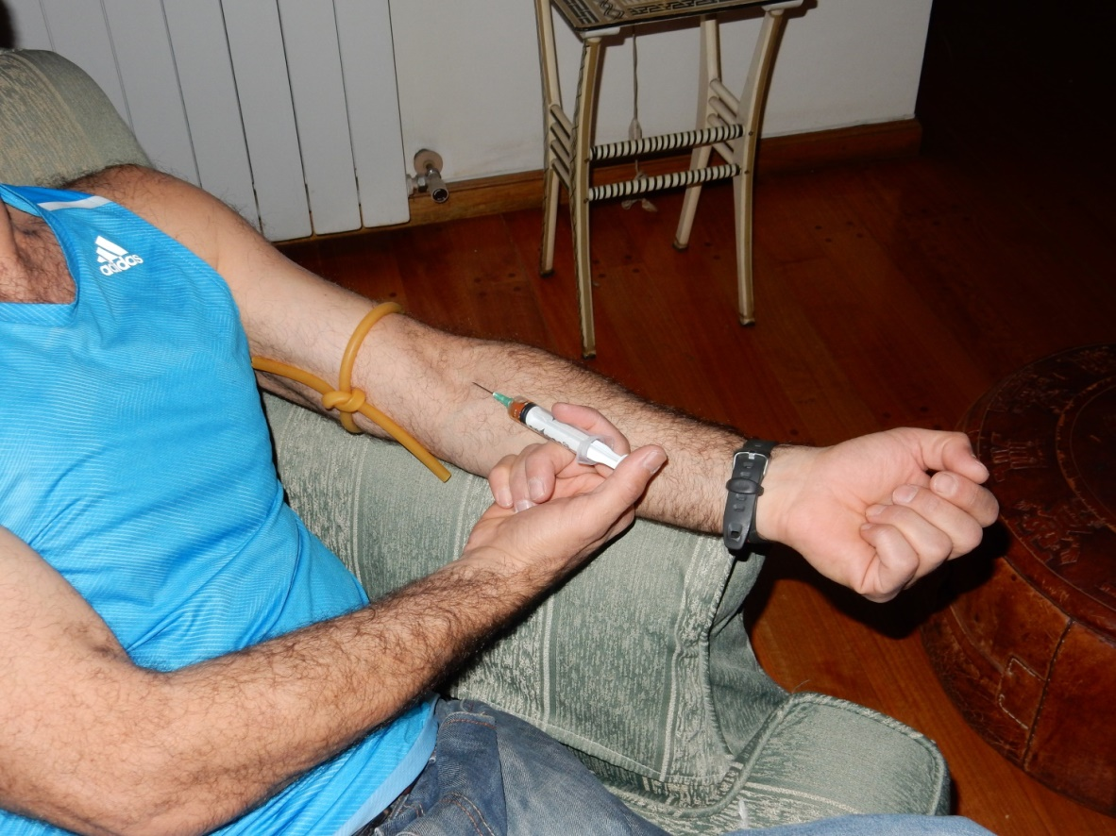
Persons who inject drugs
Always maximize other harm reduction strategies
Use of sterile needles/syringes and non sharing paraphernalia practices
TDF-FTC is the best option if feasible
TAF-FTC not studied when IDU is the only HIV risk factor, but it is an option for those patients with renal disease and osteoporosis:
TAF achieves higher peripheral blood mononuclear cell concentrations than TDF

Slide 24
Counseling the Patient
Establish ground rules
Quarterly visit
First follow-up could be in 1 month
Discuss common side effects
Flatulence, nausea, GI upset, headache
Usually resolve in 30 days
Discuss potential risks
Bone demineralization
Nephrotoxicity
Discuss Adherence Strategies
No HIV test: NO PRESCRIPTION!!!!

Slide 25
HCV antibody
HIV1/2 Antigen/Antibody Immunoassay
GC/Chlamydia in urine, oropharynx and rectum
HBsAg, HBsAb, HBcAb
Complete Blood Count:
Comprehensive Metabolic Panel
Negative
Negative
Negative
HBV viral load
40,000 international units/mL
HBsAg and HBcAb reactive. HBsAb not detectable
Normal
MP: ALT 72 IU/L, AST 45 IU/, creatinine 0.9 mg/dL, GFR 116 ml/min, albumin 4.5 g/dL, total bilirubin 0.7 mg/dL, INR 1.0.
Mr. P: Labs

Slide 26
Which of the following statements are true for Mr. P?
a) Meets criteria for PrEP but needs counseling for Hep B
b) Will need an HIV RNA after day 10 of last sexual exposure or a repeat 4th generation HIV Assay within 3 weeks
c) Will need Hep B treatment before he can start PrEP
d) A and B are true
e) B and C are true

