Slide 1
Certifying Dental Therapists with the
Portland Area CHAP Certification Board
CHAP Learning Collaborative
August 10, 2021
Miranda Davis, DDS, MPH
Native Dental Therapy Initiative Project Director
Northwest Portland Area Indian Health Board

Slide 2
DHATS work under authorization of a License or Certification
Tribal License:
Tribes may create own licensing board
May license for own Tribe only or also for other Tribes (with legal agreement)
State License:
Requires state legislation
Oversight by state board
Not limited to IHS/Tribal sites
Federal Certification: Community Health Aide Program (CHAP)
  Alaska CHAP has certified providers in Alaska since 1968
  IHS Circular 20-06 approved CHAP nationalization in 2020
    Creates national and Area CHAP Certification Boards
    Certifies providers working in IHS/Tribal sites only (urban programs excluded)
Notes:
Important to note that per the circular – federal certification is the only acceptable certification for participation in a Community Health Aide Program (language below from the policy section 5C).
In this forum, it will be important to support tribal sovereignty by saying that a Tribe as a sovereign government has the right (and responsibility) to regulate health care providers as part of carrying out its duty to provide for the health and wellbeing of their community, however, for participation in a CHAP program (i.e ability to use federal CHAP funds (if they are available), ability to add CHAP to their funding agreements, ability for IHS facilities to use CHAP providers) the providers must also be certified by the federal or area certification board.
5 C. Certification Boards. All providers who wish to provide services under the CHAP must be certified by one of the following boards:
1. CHAP National Certification Board (NCB). The NCB is a federal board chaired by the IHS Chief Medical Officer (CMO) or his or her delegate and may be comprised of Federal and Tribal representatives from each ACB. Functions of the NCB and board composition are addressed in the Standards and Procedures.
2. CHAP Area Certification Boards (ACBs). The ACBs are federal certification boards located in the contiguous 48 states and may be comprised of Federal and Tribal representatives. Their membership must include at least one federal representative appointed by the respective IHS Area Director. The ACB establishes board composition in its standards and develops the procedures of each respective board to certify individuals as their respective provider types.

Slide 3
National CHAP Certification Board (NCB)
Area CHAP Certification
Boards (ACBs)
Include at least one federal representative appointed by the respective IHS Area Director
Establishes standards and procedures that detail board composition
May enter agreements with other ACBs
Outlines the minimum program standards for all CHAP provider types (outside of Alaska)
Chaired by the IHS CMO
Made up of representatives of the ACBs
Notes:
(5)(C) 1. CHAP National Certification Board (NCB). The NCB is a federal board chaired by the IHS Chief Medical Officer (CMO) or his or her delegate and may be comprised of Federal and Tribal representatives from each ACB. Functions of the NCB and board composition are addressed in the Standards and Procedures.
2. CHAP Area Certification Boards (ACBs). The ACBs are federal certification boards located in the contiguous 48 states and may be comprised of Federal and Tribal representatives. Their membership must include at least one federal representative appointed by the respective IHS Area Director. The ACB establishes board composition in its standards and develops the procedures of each respective board to certify individuals as their respective provider types.

Slide 4
Portland Area CHAP Certification Board (PACCB)
Extensive planning process – workgroup since early 2018
Approved by resolution at NPAIHB QBM - July 2020
  This was the first Board Meeting held after IHS released Circular 20-08
First PACCB Meeting held August 3 and 5, 2021:
  Affirmed 13-member board
  Affirmed acting bylaws, and part of standards and procedures
Still to do:
  Affirm remaining standards and procedures, forms and application process
  Develop Academic Review Committees (ARCs)
    Behavioral Health and Dental Health (BHARC and DHARC)
    Conduct independent reviews of curriculum to ensure alignment with current AI/AN health needs
Timeline goal: have processes in place to issue certifications by Fall 2021

Slide 5
Portland Area CHAP Workgroup
Creation
First meeting in early 2018
Set up through NPAIHB Delegates to get input from Portland Area tribes
Open to all (43) Portland Area Tribes
Included important State partners from all 3 Medicaid agencies
Establish leadership in the workgroup from Area tribes (not NPAIHB staff) to ensure that Area tribes are driving agenda and discussion
Notes:
.

Slide 6

Dental components of Circular 20-06
Sec. 4. F: “DHATs shall only practice in states that authorize the use of DHAT services.”
Roles and responsibilities for other DHA roles will be specified in National CHAP Standards and Procedures and other applicable ACB requirements
    This process could take up to two years
OPM approved Position Description for DHAT (GS-0640-09) in early 2020
25 U.S.C § 1616l(d)(2)(B).
25 U.S.C §1616l(d)(3).

Slide 7
Dental Health Aide Therapist restriction in
Indian Health Care Improvement Act (IHCIA) 2010:
25 U.S.C Section 1616l(d)(2)(B) provides that “. . .the national CHAP. . . “shall exclude dental health aide therapist services from services covered under the program.”¹ . . . except. . . where DHAT services are “authorized under State law to supply such services in accordance with State law.”²
Per federal law, DHATs are the ONLY level of CHAP provider that requires state authorization – other categories of CHAP providers do not, including all levels of CHA/P, BHA/P, and PDHA I & II, and EFDHA I & II
25 U.S.C § 1616l(d)(2)(B).
25 U.S.C §1616l(d)(3).
Notes:
CHAP Circular 4 (F). DHATs also must meet the federal training requirements for certification. However, DHATs shall only practice in states that authorize the use of DHAT services. This requirement applies to Tribes and Tribal Organizations seeking to include a CHAP as a PSFA in an ISDEAA contract or compact.

Slide 8
OR and WA legislation language authorizing
Dental Therapists to work via CHAP certification
Oregon Dental Therapy Bill (HB2528) language:
SECTION 6.(2) Subsection (1) of this section does not prohibit: (g) The performance of duties by a federally certified dental health aide therapist or tribally authorized dental therapist in a clinic operated by the Indian Health Service, including, as described in 25 U.S.C. 1603, an Indian Health Service Direct Service Tribe clinic, a clinic operated under an Indian Self-Determination and Education Assistance Act of 1975 (P.L. 93-638) contract or a clinic operated under an urban Indian organization
Washington RCW 70.350.020 Authorization—Conditions
(1) Dental health aide therapist services are authorized by this chapter under the following conditions:
(a) The person providing services is certified as a dental health aide therapist by:
(i) A federal community health aide program certification board; or
(ii) A federally recognized Indian tribe that has adopted certification standards that meet or exceed the requirements of a federal community health aide program certification board;
Notes:
ONLY DHAT requires state authorization – all other CHAP providers do not require state authorization

Slide 9
**S&Ps have not yet been finalized by PACCB; this information may change
PACCB Standards and Procedures (S&Ps)**
Certification of Dental Health Aides
  Training, Education, (program certified by DARC)
  Preceptorship:
    Preceptorship requirements are different for each DHA level
    DHAT: demonstrate each procedure in scope with competence at least 3 times
  Scope of Practice, Supervision, and Competencies
    SDF and Antimicrobials have been added
Continuing Education credits required: 24 hours per year

Slide 10
PACCB S&Ps** - continued
Provisions for special conditions:
  Delayed application:
    Meets all requirements for initial certification
    Has met applicable CE requirements during previous two years
  Existing or prior license/certification
    If license/cert is current or lapsed < 6 months before application date, applicant may be eligible for certification with preceptorship equal to that of certification renewal for unlapsed certificate (demonstrate each procedure in scope with competence at least once)
    If license/cert lapsed > 6 months before application date, applicant must complete preceptorship equal to that of initial certification.
**S&Ps have not yet been finalized by PACCB; this information may change

Slide 11
Application for DHAT Certification**
Must meet requirements for education/training and preceptorship
Be employed or sponsored by the Indian Health Service or a tribe or tribal program operating a community health aide program in the Portland Area under the ISDEAA.
Application form, submitted electronically
No fees at this time; fees will likely be added when needed to support administrative costs (currently covered by grant funding).
**Application forms and processes have not yet been finalized by PACCB

Slide 12
Application for DHAT Certification (cont’d)**
Processes and details being planned:
Electronic submission
Interim/provisional certification option being considered for applications submitted between PACCB meetings
Database to store information
Questions??
**Application forms and processes have not yet been finalized by PACCB

Slide 13
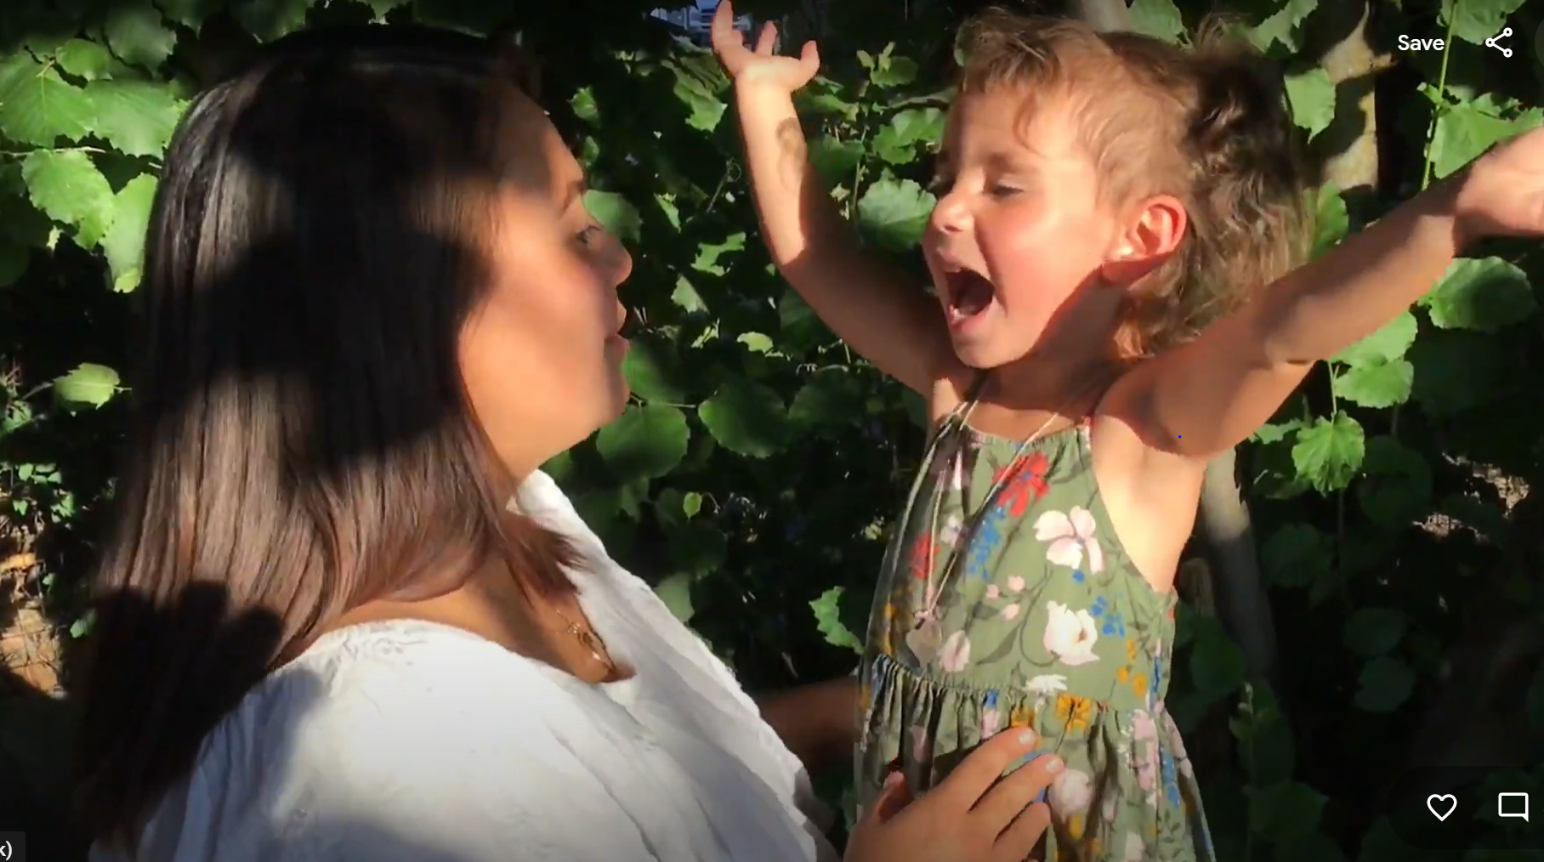
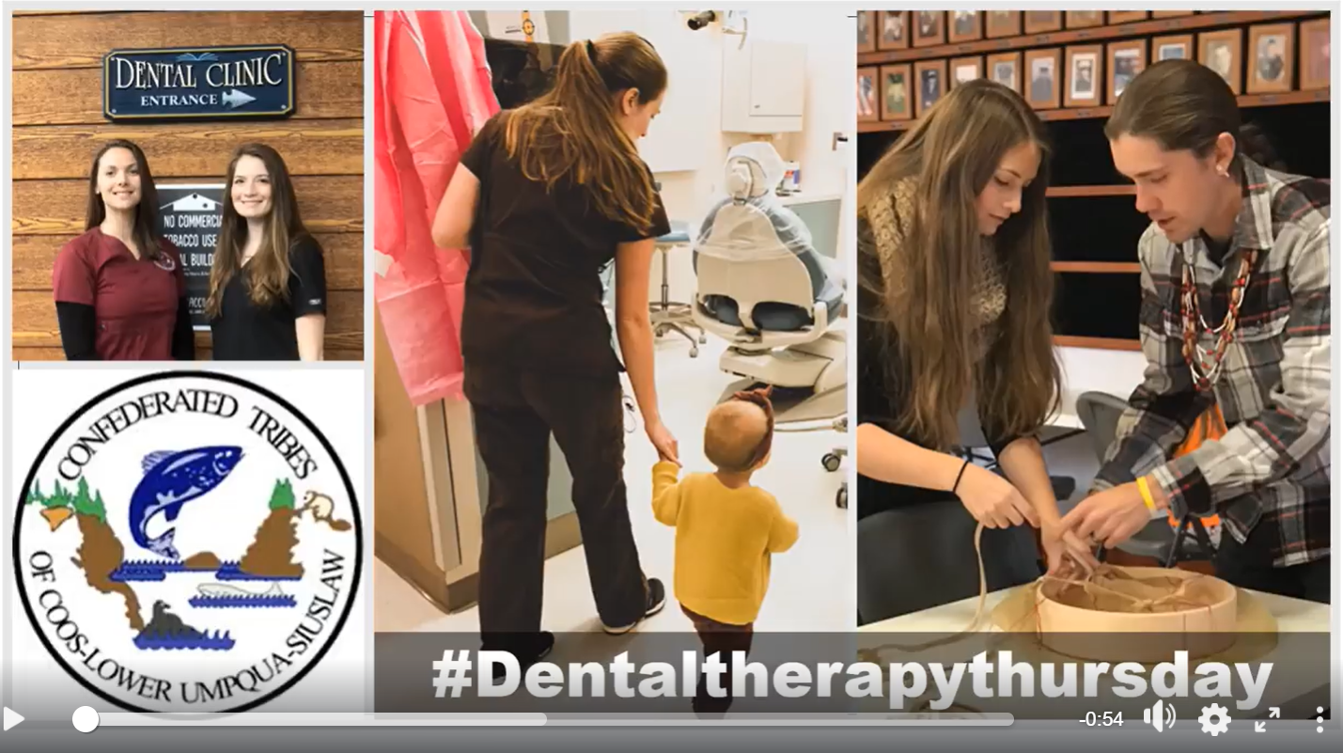
#Dental
Therapy
Thursday
Arielle Cawston, LDT – Colville
Naomi Petrie, DHAT - CTCLUSI
Notes:
During a time when people are often isolated or quarantined and getting so much of their information over the internet, our dental therapists have decided to spread the oral health message online. On the left here is DT Sarah Chagnon who has created oral health instruction videos and put them on YouTube. On the right is an example of one of our #DentalTherapyThursdays videos that each feature a dental therapist sharing why oral health is so important for their communities. Please check them out online!

Slide 14
Native Dental Therapy Initiative
– a Tribal Community Health Provider Project at –
Northwest Portland Area Indian Health Board
2121 SW Broadway, Suite 300, Portland, Oregon 97201
503.228.4185 Main │ 503.228.8182 Fax │www.npaihb.org
Christina Peters, Tribal Community Health Provider (TCHP) Director cpeters@npaihb.org
Miranda Davis, Native Dental Therapy Initiative (NDTI) Director mdavis@npaihb.org
Pam Johnson, NDTI Manager pjohnson@npaihb.org
https://twitter.com/NWDentalTherapy
www.tchpp.org
Notes:
the education program later.

