Slide 1
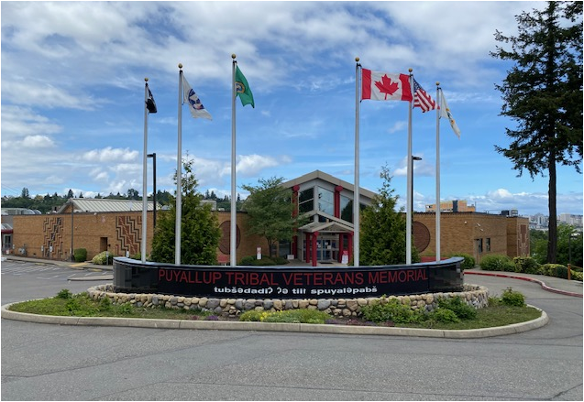
COVID-19: Portland Area Update for Dental Operations
Presented by Sean Kelly D.D.S., MSHS.
Clinical Consultant
Northwest Tribal Dental Support Center
Notes:
Good afternoon.
Thank you for having me for this presentation. COVID-19: Portland Area Update on Dental Operations

Slide 2
COVID-19: Portland Area Update for Dental Operations.
Upon completion of this course, participants will be able to:
1. Use current guidelines from the CDC, OSHA, IHS and the ADA (WA/OR/ID DOH as applicable) for necessary planning and strategies for dental clinics operations.
2. Know how to prioritize patient appointments based on staffing, supply levels, engineering/administrative controls and other factors amid the COVID-19 pandemic.
3. Know the appropriate PPE for patient care; with a focus on aerosol generating vs. non-aerosol generating procedures.
Notes:
Here are the course objectives. Financial disclaimer: This presentation is not sponsored by any outside entities, there are no corporate sponsors and that any products or companies presented here today are done so for general information purposes.

Slide 3
COVID-19: Portland Area Update for Dental Operations Survey:
1. 28 of 36 (78%) Clinics Participated in the survey.
2. All Clinics are open and are providing some level of service, from basic screenings and referrals to providing complex dental care.
3. Levels of Service a. Urgent/emergent care: All clinics (100%) however for some it may be screening urgent patients and then referring for treatment. b. Routine: 20 (71%) c. Preventive (may include hygiene): 21 (75%) d. Complex (Elective): 14 (50%) e. Other: (Outdoor children screenings), (Full services for children, Urgent only for adults), (Emergency treatment, high risk hygiene, partials and dentures and crown deliveries)
Notes:
The results of the dental operations survey recently completed by our programs.

Slide 4
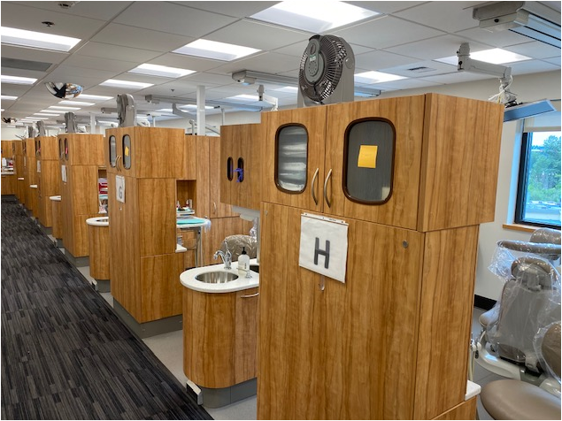
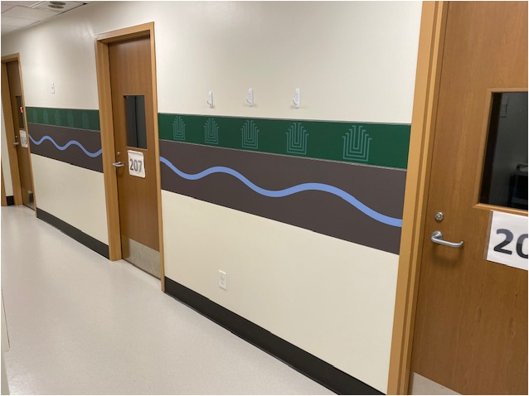
So we are open for business, right?

Slide 5
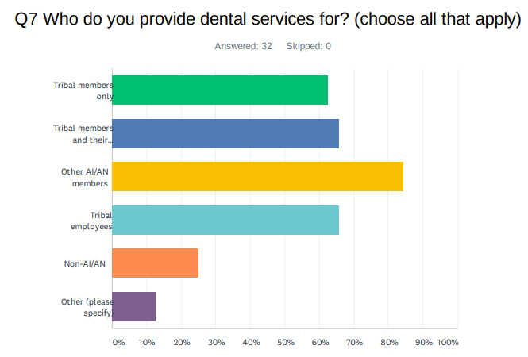
COVID-19: Portland Area Dental Operations Survey:
4. Aerosol-Generating Procedures: 26 (93%)
5. COVID-19 Testing: 20 (71%)
6a. Rapid Test: 14
6b. Standard: 6
7. Who we serve:
Notes:
We are providing services to many in our communities.

Slide 6
COVID-19: Portland Area Dental Operations Survey:
8. Please provide any comments to describe services you provide that may be unique, or that you feel would benefit other programs as you mitigate the many issues surrounding dental care during the pandemic.
- Extended appointments to allow operatory turn-over and air exchange. Using HEPA filters to decrease aerosols.
- Surgically clean air filters in every room do a great job of mitigating our risk.
- Tele-dental visits, mostly for indirect contact of COVID patients with urgent needs.
- Maximize social distancing with minimal waiting room use and having an open operatory between each patient in the chair.
- Utilize tele-dentistry. Figuring out incorporating COVID-19 testing for dental patients, currently tests occur in the medical clinic.
- We purchased air filtration, and extraoral evacuation for our hygienist.
- Scheduling all emergency/urgent treatment needs to prevent congregating of walk-in patients in our waiting area.
Notes:
Additional comments provided from the survey, each bullet represents a different program.
Question had been asked of me regarding RDHs having their own DA’s to assist during AGPs. This may be a topic worthy of discussion.

Slide 7
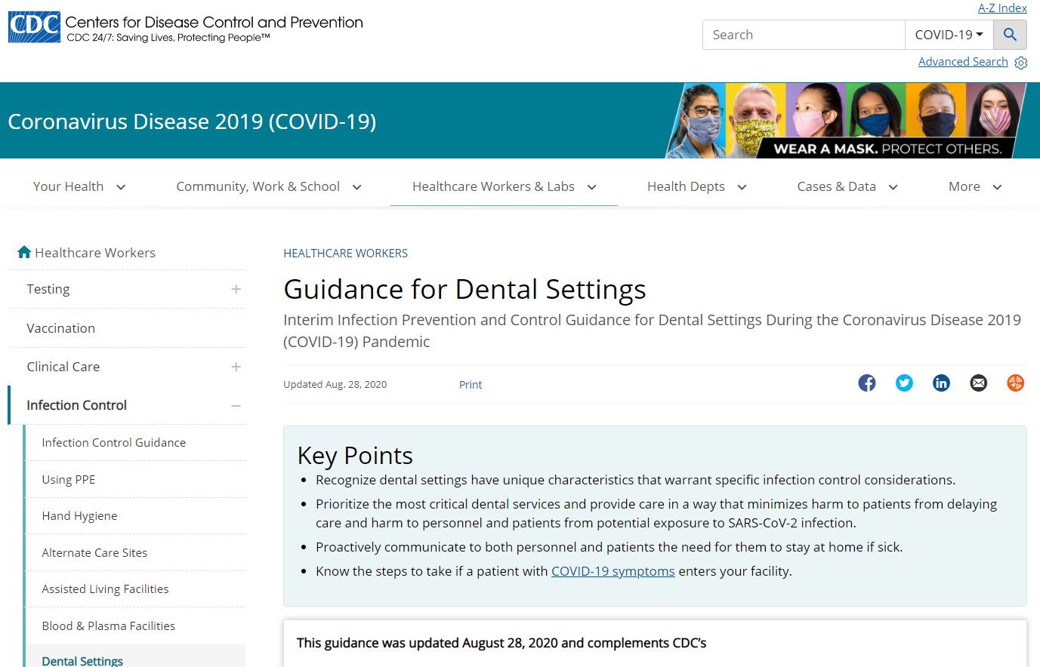
So how do you determine the level of services you should provide?
https://www.cdc.gov/coronavirus/2019-ncov/hcp/dental-settings.html
Notes:
So how do you determine the level of services you should provide?
First I would direct our attention to the CDC guidelines, Note last update was August 28th.

Slide 8
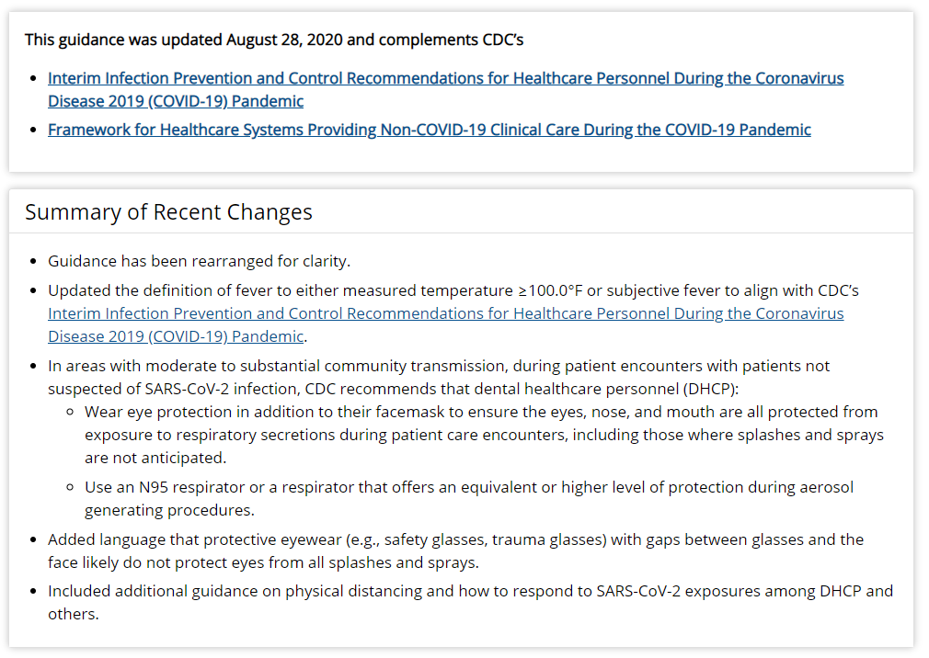
So how do you determine the level of services you should provide?
https://www.cdc.gov/coronavirus/2019-ncov/hcp/dental-settings.html
Notes:
Within the Guidance for the Dental Settings is the link to “Framework for Healthcare Systems Providing Non-Covid-19 Clinical Care During the COVID-19 Pandemic”. It is the 2nd bullet in the top section in this slide.

Slide 9
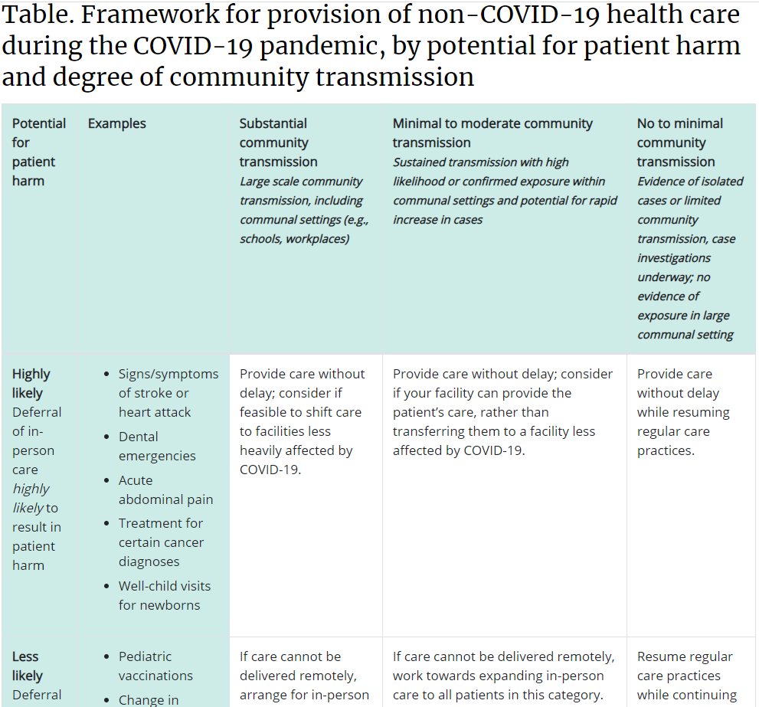
So how do you determine the level of services you should provide?
https://www.cdc.gov/coronavirus/2019-ncov/hcp/framework-non-COVID-care.html
Notes:
Within this portion of the CDC guideline is a framework represented here in this table. One needs to consider potential harm of the patient if tx is not provided AND the degree of community transmission in determining what level of services to provide. For Example in this table, which I’m only showing you the top ½ for now, The first column is the Potential for Patient Harm, Dental Emergencies fall in the Highly Likely category. Moving to the right the columns have decreasing community transmission. (Read them)

Slide 10
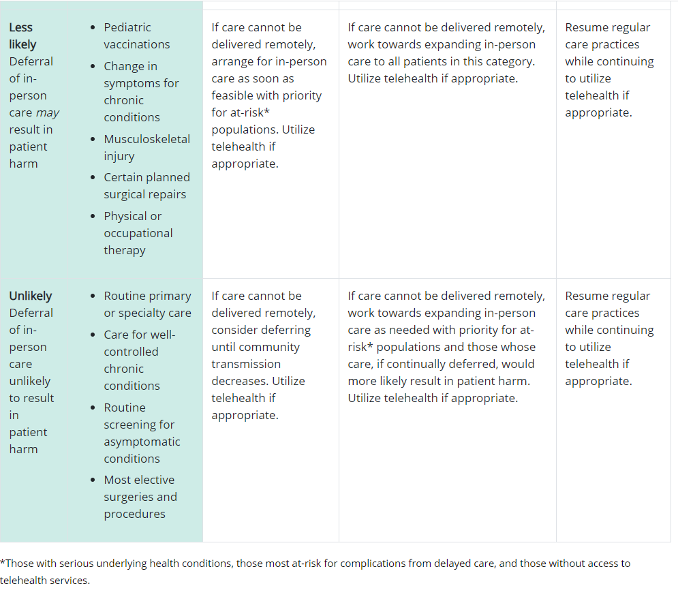
So how do you determine the level of services you should provide?
https://www.cdc.gov/coronavirus/2019-ncov/hcp/framework-non-COVID-care.html
Notes:
“Unlikely” (potential to cause patient harm); it is this scenario I believe that many of us are probably transitioning in and out of regarding the levels of Community Transmission. And it is a moving target in deciding when to provide routine and preventive dental care.

Slide 11
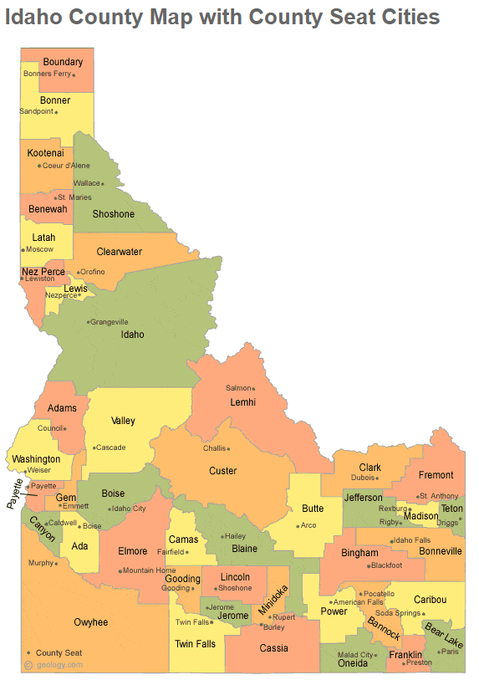
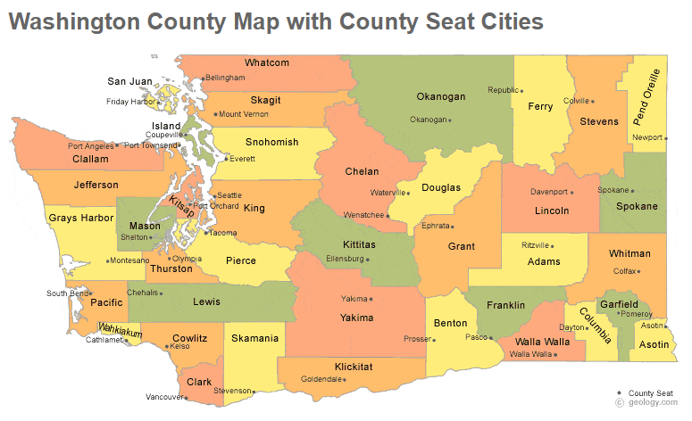
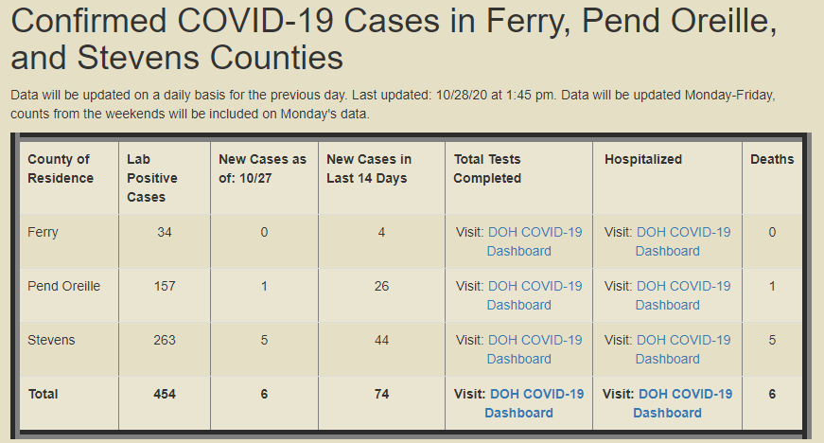
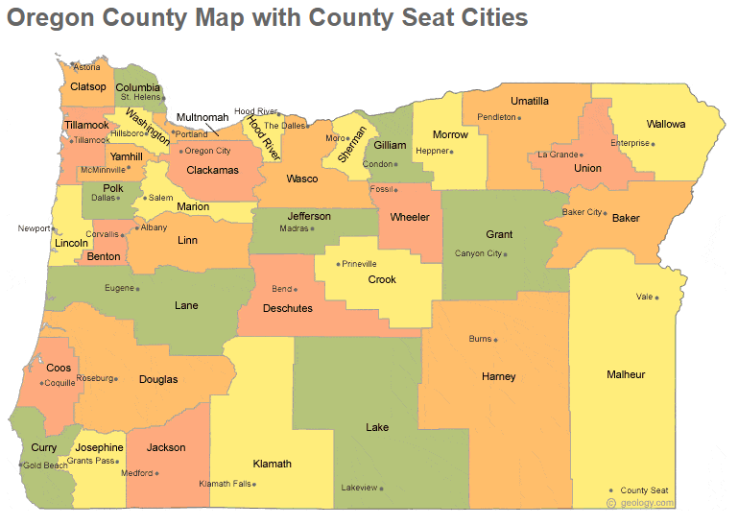
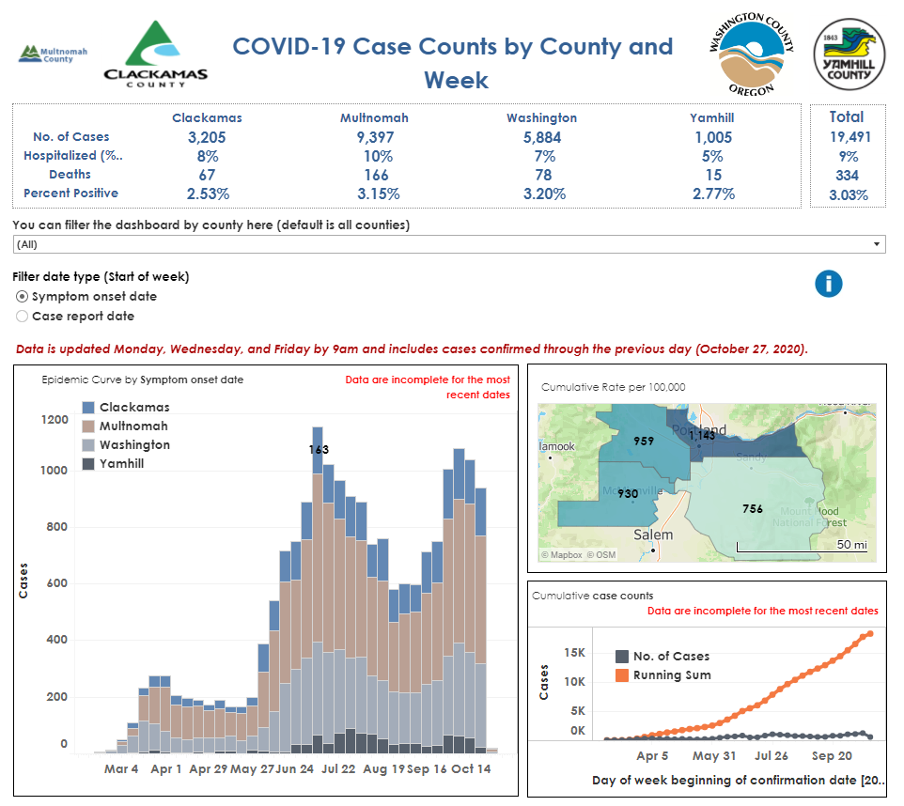
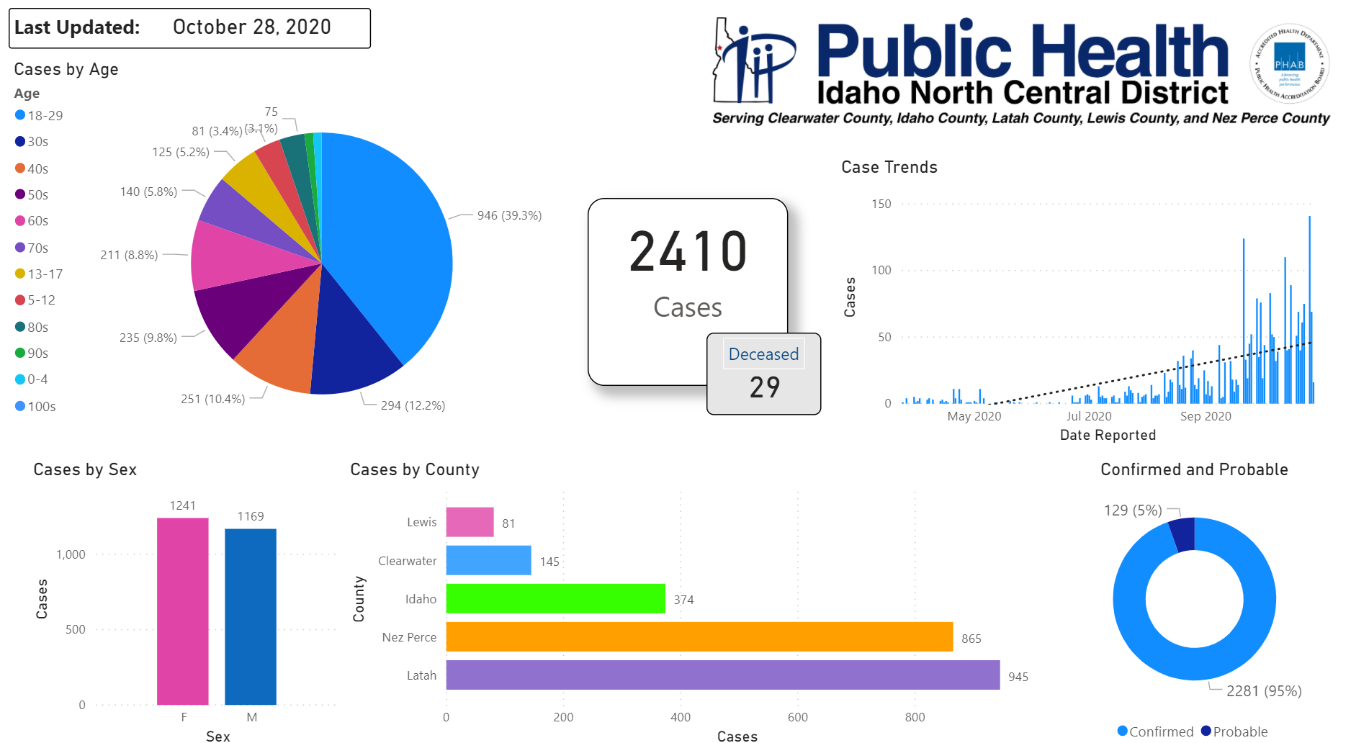
Community Transmission?
https://www.netchd.org/covid-19/covid-19-case-count-information/
https://www.idahopublichealth.com/district-2/novel-coronavirus
https://multco.us/novel-coronavirus-covid-19/regional-covid-19-data-dashboard
Notes:
How to know your levels of Community Transmission? Rely on your local health department. Your CEO/Health Directors will be monitoring your community using such resources which will be key to making decisions for your clinic. Here are a few examples:
-NE Washington, impacting some of our tribes in the Tri-County area (Ferry, Stevens and Pend Oreille counties).
-Idaho North Central District includes the Nez Perce tribe.
-The Multnomah County is combined with several other counties around Portland, this resource would benefit NARA. Each uses various info-graphics to display data

Slide 12
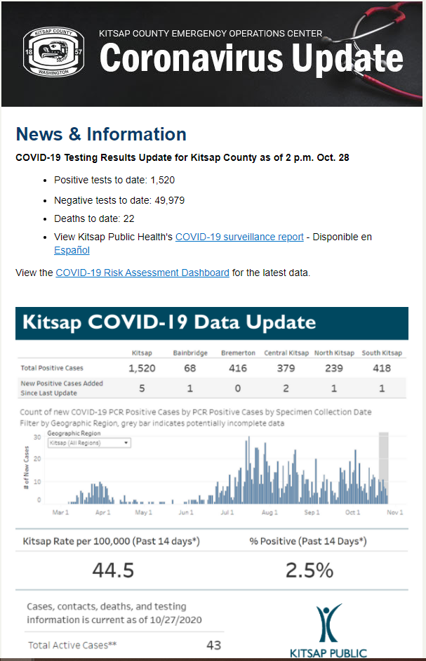
So how do you determine the level of services you should provide?
Community Transmission?
Subscribe to your own county’s Department of Health COVID-19 updates.
Notes:
This is Kitsap County where I live, I get daily emails. At work, which is in Tacoma, I receive daily emails from the Tacoma – Pierce Co. Department of Health. So you may subscribe to receive these updates

Slide 13
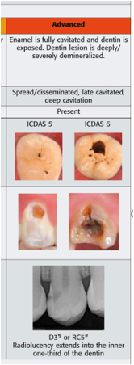
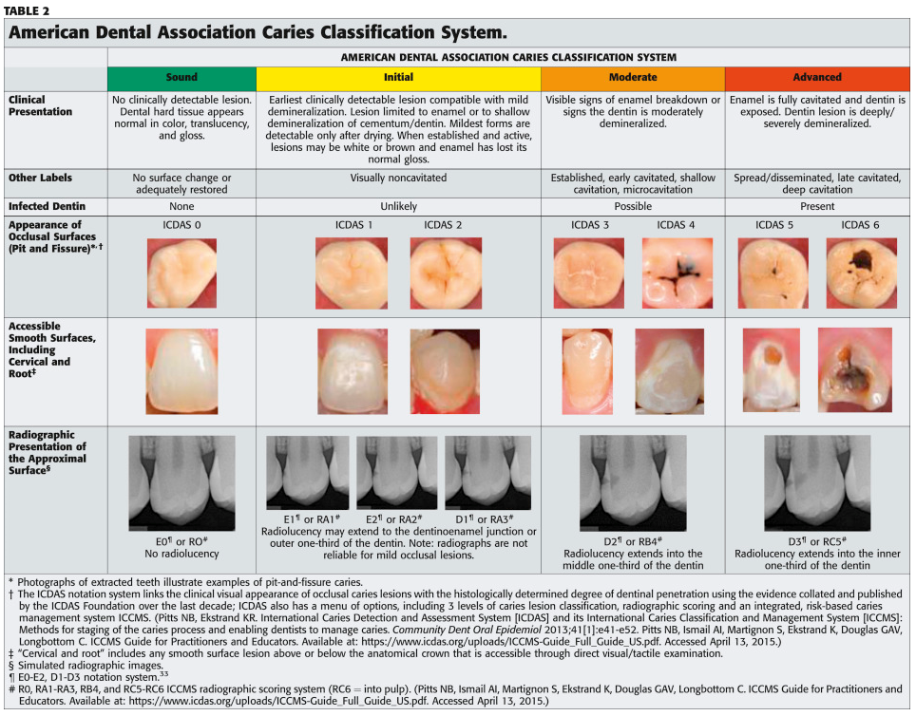
  Patient Priority: Based on urgent needs, and those who are emergent; those who will likely have a dental emergency within the next 3 months. Use “Risk Assessments” to prioritize patient care.
Notes:
Also a reminder to prioritize patient treatment based on risk assessments. This I touched upon during my last presentation, and is still very important.

Slide 14
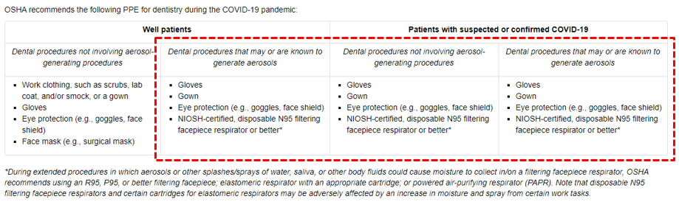
N95 vs Level III vs Level I/II masks; know when to use each.
https://www.osha.gov/SLTC/covid-19/dentistry.html
Notes:
Per OSHA, PPE recommendations do not change between an AGP on a well patient a patient with suspected or confirmed COVID-19. N95s are recommended for AGPs.

Slide 15
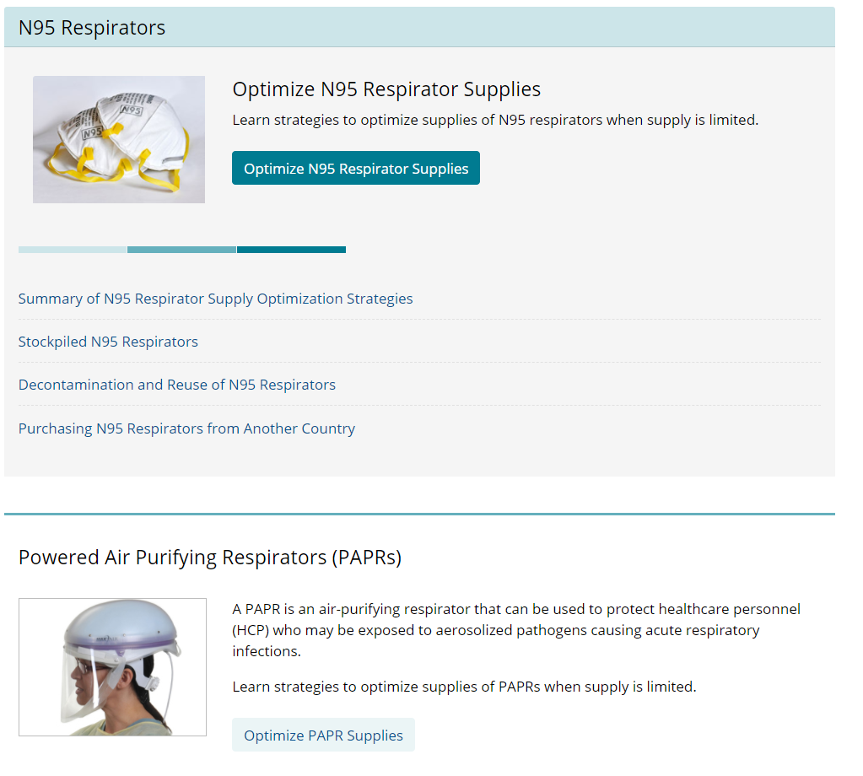
So how do you determine the level of services you should provide?
N95 Shortage?
https://wwhttps://www.cdc.gov/coronavirus/2019-ncov/hcp/n95-other-respirators.htmlw.cdc.gov/coronavirus/2019-ncov/hcp/framework-non-COVID-care.html
Notes:
Supply is also a key issue for our determining levels of service. N95s seem to be one of the most critical items discussed among our programs. Here is the CDC link addressing N95 Respirator Supplies.

Slide 16
So how do you determine the level of services you should provide?
Know your “Capacity Strategy” for PPE
Conventional Capacity Strategies (should be incorporated into everyday practices)
Contingency Capacity Strategies (during expected shortages)
Crisis Strategies (during known shortages)
When N95 Supplies are Running Low
https://www.cdc.gov/coronavirus/2019-ncov/hcp/respirators-strategy/index.html
https://www.cdc.gov/coronavirus/2019-ncov/hcp/checklist-n95-strategy.html
Notes:
Knowing your Capacity Strategy will allow you to take the next step in determining the services you may provide (read the definition for each). The CDC website page (links) will provide more details regarding each strategy.

Slide 17
So how do you determine the level of services you should provide?
Know your “Capacity Strategy” for PPE
Consider the decisions to provide certain levels of dental care in light of PPE availability.
Per the CDC:
“Ensure that you have the appropriate amount of personal protective equipment (PPE) and supplies to support your patients. If PPE and supplies are limited, prioritize dental care for the highest need, most vulnerable patients first – those at most risk if care is delayed”.
And…
“For example, extended use of facemasks and respirators should only be undertaken when the facility is at contingency or crisis capacity and has reasonably implemented all applicable administrative and engineering controls. Such controls include selectively canceling elective and non-urgent procedures and appointments for which PPE is typically used by DHCP. Extended use of PPE is not intended to encourage dental facilities to practice at a normal patient volume during a PPE shortage, but only to be implemented in the short term when other controls have been exhausted. Once the supply of PPE has increased, facilities should return to conventional strategies.”
https://www.cdc.gov/coronavirus/2019-ncov/hcp/dental-settings.html
Notes:
Regarding these CDC statements I would be cautious in allowing routine and preventive dental services while using extended use N95 FFR. If DHCP were to be exposed to SARS-Cov-2 and contract COVID-19 while doing so, then I would be concerned that the dental program may be subject to litigation due to not following appropriate guidelines.

Slide 18
CDC and the N95 Use/Re-use Guidelines
Still need to re-use N95s (contingency or crisis mode) to provide urgent dental services? Some clinics use services for decontaminating N95s. The CDC also supports using the “5 day paper bag” method. Per the CDC:
A limited reuse strategy to reduce the risk of self-contamination
One strategy to reduce the risk of contact transfer of pathogens from the FFR to the wearer during FFR reuse is to issue five N95 FFRs to each healthcare staff member who care for patients with suspected or confirmed COVID-19. The healthcare staff member can wear one N95 FFR each day and store it in a breathable paper bag at the end of each shift with a minimum of five days between each N95 FFR use, rotating the use each day between N95 FFRs. This will provide some time for pathogens on it to “die off” during storage [8]. This strategy requires a minimum of five N95 FFRs per staff member, provided that healthcare personnel don, doff, and store them properly each day.
As a caution, healthcare personnel should treat reused FFRs as though they are contaminated, while preventing FFR contamination prior to donning by following the precautions outlined in the reuse recommendations found here. Hand hygiene with soap and water or an alcohol-based hand sanitizer with at least 60% alcohol should be performed before donning and after touching or adjusting the FFR while in use (if necessary for comfort or to maintain fit) or after doffing.
https://www.cdc.gov/coronavirus/2019-ncov/hcp/ppe-strategy/decontamination-reuse-respirators.html
Notes:
What if one used a UV light on the N95 before storing it? The virus needs a living organism to survive. Sitting in a breathable bag for days or weeks, and no chemicals to kill the virus. Something to think about. Other options are to cover with a level 1, 2 or 3 mask during use and change it between patients while leaving the N95 on. At least for AGPs.

Slide 19
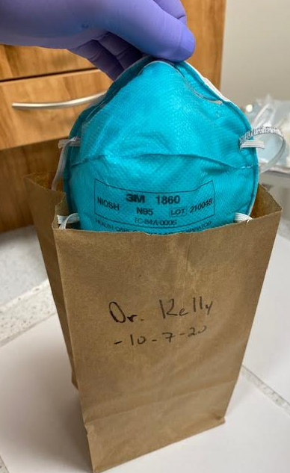
CDC and the N95 Use/Re-use Guidelines
https://www.cdc.gov/coronavirus/2019-ncov/hcp/ppe-strategy/decontamination-reuse-respirators.html
Notes:
.

Slide 20
CDC and the N95 Use/Re-use Guidelines
What is limited FFR reuse?
Limited FFR reuse refers to the practice of using the same N95 FFR or other filtering facepiece respirator for multiple encounters with patients but removing it (doffing) after each encounter [1]. This is different than extended use of an FFR where the same FFR is worn continuously for encounters with multiple patients. During limited reuse, the FFR is stored in between encounters to be put on again (donned) prior to the next encounter with a patient. Decontamination of N95 FFRs may be considered as part of limited reuse strategies. Extended use may also be considered as part of limited reuse strategies whereby an N95 FFR is worn for multiple patient contacts then stored or decontaminated before being reused. More information on implementing reuse and extended use can be found here.
The number of times that an FFR can be reused is limited by:
Fit
Filtration performance
Contamination and soiling
Damage
FFRs visibly contaminated with blood, respiratory or nasal secretions, or other bodily fluids should be discarded and not reused. FFRs that are damaged (e.g. broken straps, broken nose piece), malformed, or are unable to pass a fit check should also be discarded and not reused.
More information on limited FFR reuse can be found here.
https://www.cdc.gov/coronavirus/2019-ncov/hcp/ppe-strategy/index.html
Notes:
N95 Filtering Facepiece Respirator: Defining limited reuse that also may incorporate Extended Use.

Slide 21
CDC and the N95 Use/Re-use Guidelines
When should limited reuse be implemented?
Limited FFR reuse is just one of several strategies available for addressing an N95 FFR crisis capacity situation when there is a known shortage of devices after conventional and contingency capacity strategies have been implemented. It should only be considered during a crisis capacity situation during a declared public health emergency. When an N95 FFR crisis situation no longer exists, limited FFR reuse should not be utilized.
Before deciding to implement FFR reuse, facilities should explore opportunities to switch to respirators that are designed to be decontaminated and reused (e.g., elastomeric respirators or powered air-purifying respirators) to reduce demand for FFRs and the need for crisis capacity strategies.
Notes:
Note the PAPR was recently discussed in the most recent Dental Chief’s meeting. There are Advantages and Disadvantages in using a PAPR however we do not have adequate time today to discuss this further.

Slide 22
CDC and the N95 Use/Re-use Guidelines
Limitations for Limited FFR reuse
Decrease in N95 FFR fit and filtration performance
NIOSH-certified N95 FFRs are designed to filter 95% of particles when appropriately fitted to the wearer’s face. This means that an N95 that is not properly fitted to the face will likely give the wearer less protection. N95 FFRs are designed to be single-use devices but may be used multiple times under crisis capacity strategies. N95 FFR performance will decrease as the number of hours and number of donnings and doffings increase.
The number of times that an FFR can be reused will likely be limited by its fit because the tethering straps can become weaker or stretched after each donning. Each time an N95 FFR is donned or doffed, the integrity of the straps may be impacted. Repeated donning and doffing will result in the straps no longer being able to generate enough force to create a tight seal with the face. The resulting poor seal will allow unfiltered air to enter the N95 FFR and into the wearer’s breathing zone.
CDC recommends limiting the number of donnings for an N95 FFR to no more than five per device.
Notes:
Limit donnings to no more than 5

Slide 23
CDC and the N95 Use/Re-use Guidelines
If supplies are even more constrained, and five respirators are not available for each worker who needs them, N95 FFR limited reuse with FFR decontamination may be necessary.
What is FFR decontamination?
Decontamination is a process to reduce the number of pathogens on used FFRs before reusing them. It is used to limit the risk of self-contamination. Decontamination and subsequent reuse of FFRs should only be practiced where FFR shortages exist. Decontamination should only be performed on NIOSH-approved FFRs without exhalation valves.
At present, FFRs are considered one-time use products, and there are currently no manufacturer-authorized methods for FFR decontamination before reuse. Only respirator manufacturers can reliably provide guidance on how to decontaminate their specific models of FFRs. In the absence of manufacturer’s recommendations, third parties, such as decontamination companies, safety organizations, or research laboratories, may also provide guidance or procedures on how to decontaminate respirators without impacting their performance.
An effective FFR decontamination method should reduce the pathogen burden, not harm the fit or filtration performance of the FFR, and should present no residual chemical hazard. NIOSH reviewed the literature on decontaminating FFRs because of these considerations. NIOSH found that, as of April 2020, ultraviolet germicidal irradiation, vaporous hydrogen peroxide, and moist heat have shown the most promise as potential methods to decontaminate FFRs.
Notes:
DECONTAMINATION OF FFR IS EXPLAINED.

Slide 24
CDC and the N95 Use/Re-use Guidelines
On March 29, 2020, the U.S. Food and Drug Administration (FDA) issued the first Emergency Use Authorization (EUA) for a process to decontaminate, and subsequent EUAs have been issued. Healthcare facilities should check the FDA Emergency Use Authorizations websiteexternal icon for the most up-to-date information.
The effectiveness of using any of the methods mentioned in this guidance should be explored with specific FFR models and with the manufacturer and, if needed, third party expert input and support to better understand the impact on respirator performance, including filtration and fit, and structural integrity, including integrity of head straps and other parts.
Employers should be able to demonstrate effectiveness of any decontamination methods used against the likely contaminants (i.e., pathogens) of concern including SARS-CoV-2. Employers should also ensure that any decontamination methods used, including those for which an FDA EUA has been issued, do not produce additional safety hazards (e.g., electrical arcs resulting from placing FFRs with metal parts into microwaves), or that workers are adequately protected from those hazards through appropriate engineering and administrative controls, safe work practices, and personal protective equipment.
Decontamination might cause poorer fit, reduced filtration efficiency, and reduced breathability of disposable FFRs as a result of changes to the filtering material, straps, nose bridge material, or strap attachments of the FFR. Decontamination may produce chemical inhalation risks and should be evaluated for off-gassing.
While decontamination and subsequent reuse of FFRs void the NIOSH approval and are not permitted under OSHA’s respiratory protection standard during normal conditions of use, these options may need to be considered during a crisis capacity situation when FFR shortages exist.
Notes:
Very complicated steps in MONITORING decontamination methods. “Employers should be able to demonstrate effectiveness of any decontamination methods used…”. Do programs really have the means to accomplish this?

Slide 25
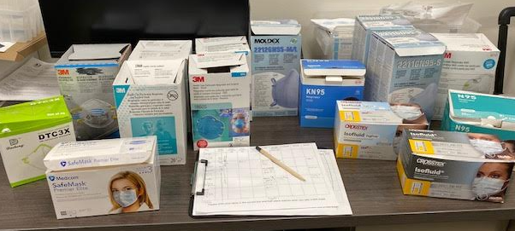
CDC and the N95 Use/Re-use Guidelines
https://www.cdc.gov/coronavirus/2019-ncov/hcp/ppe-strategy/decontamination-reuse-respirators.html
Notes:
So again the link to the CDC website that addresses these topics. Note also that tracking your burn-rate is important. The monitoring of usage and determining your CAPACITY STRATEGY will help in deciding your levels of service.

Slide 26
N95/PPE Resources
IHS, Emergency Management, Henry Schein, Patterson Dental, McKesson and others.
Maintain records of usage (Burn Rates).
Notes:
Know your Vendors for masks and other PPE: IHS, State and Local Emergency Management Programs, and private companies such as Henry Schein, McKesson, Patterson Dental, and Others. Maintain records of usage (Burn Rates).

Slide 27
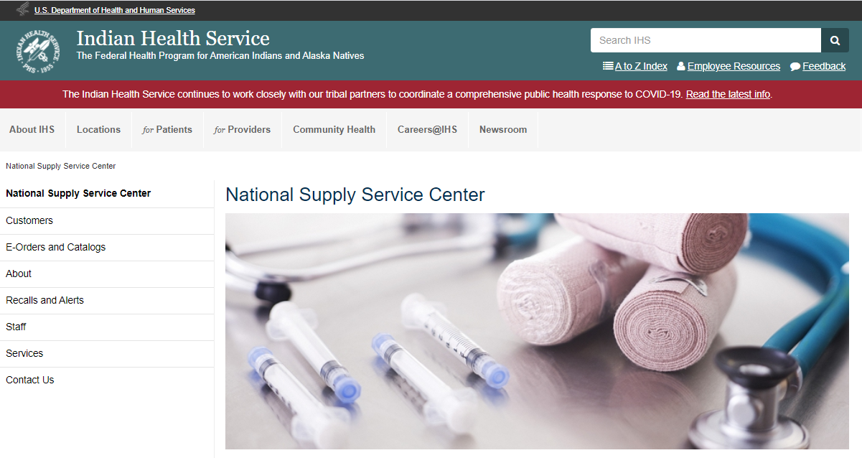
N95/PPE Resources
https://www.ihs.gov/nssc/
Notes:
One of the resources available to us is the IHS National Supply Service Center. Link here provided.

Slide 28
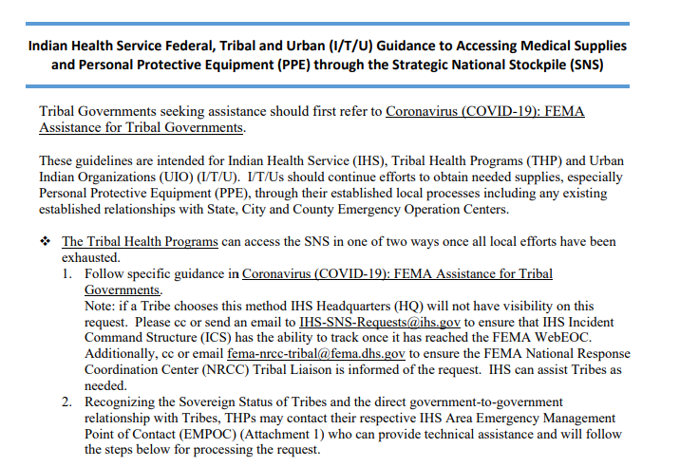
N95/PPE Resources
https://www.ihs.gov/sites/coronavirus/themes/responsive2017/display_objects/documents/ITU_Resource_Request_Guidance_04022020.pdf
Notes:
Also available are the Instructions for accessing PPE through the Strategic National Stockpile. This is a one page document.

Slide 29
COVID-19 Vaccination
What to expect in the near future?
The Washington State Department of Health is preparing for a future COVID-19 vaccine. At this point, all potential vaccines are still in clinical trials. We do not know when a vaccine will be approved and released and which communities the vaccine will be approved for. We are watching the current vaccine development efforts closely, and we are committed to ensuring any vaccine that is approved for use in Washington State is safe and effective.
Once there is a safe and effective vaccine available, there may not be enough for everyone. The Washington State Department of Health is creating a plan for how to prioritize COVID-19 vaccine and we want your feedback. Specifically, we are looking for:
Recommendations on how COVID-19 vaccine should be prioritized across Washington state.
Insight into how people are currently feeling about the vaccine in general.
Please take this survey to provide feedback by 11:59PM, Monday, October 26, 2020 and share with your relevant partners and networks. This is a general feedback opportunity, and we are especially interested in hearing from communities, partners, workers, businesses, and sectors who are disproportionately impacted by COVID-19.
Notes:
A recent survey was sent to dentists (and others) in Washington asking for feedback on prioritizing the vaccine once it becomes available. I would expect similar action in Idaho and Oregon.

Slide 30
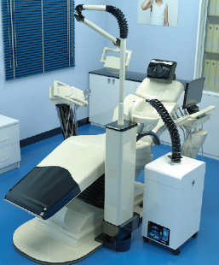
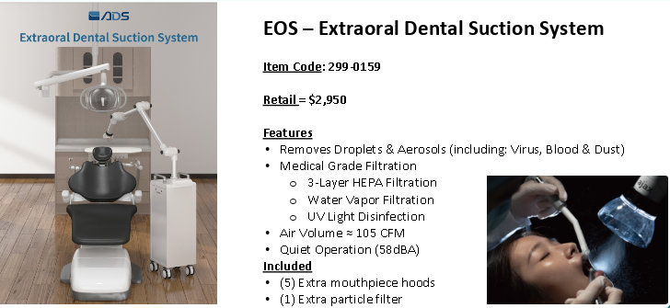
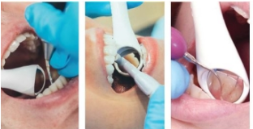
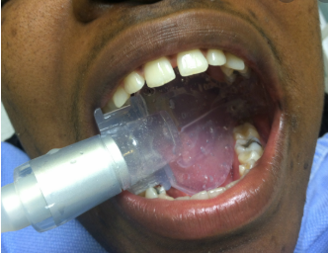
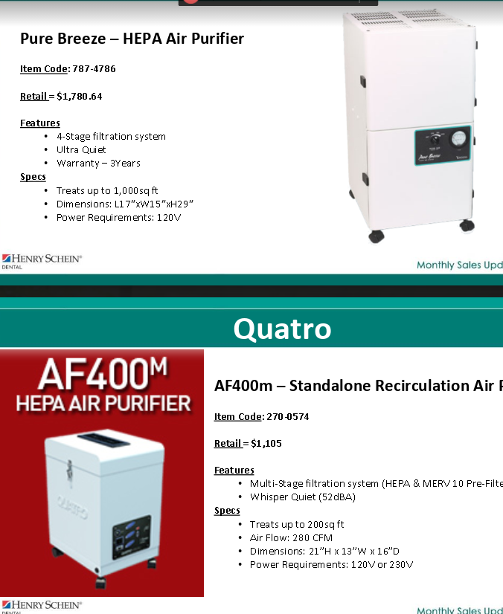
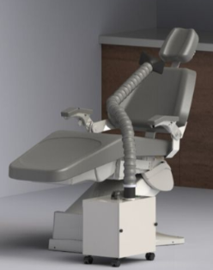
Other Armamentarium?
-Mirrored HVE tips (i.e. Purevac HVE)
-DryShield/Isolite/Isodry/Mr. Thirsty
-Extra-oral Dental Suction
-Air Purifiers
-What else?
-What works and what
doesn’t work? And Why?
Notes:
A list of other armamentarium. Good to participate in monthly Area Dental Consultant meetings to share experiences, what works and what doesn’t.

Slide 31
CONSTANT CHANGE
The decision to implement new or different technology to mitigate risks brings an additional level of concern. With such efforts to solve a problem there seems to be more problems to solve. Varied views of a particular product causes one to ask, “will this become the new standard, or will it soon be antiquated, and we just spent $2,000 on a paper weight?” This problem solving amid constant change has highlighted mental health concerns. Worry and mental fatigue has brought our own mental health to the forefront.
Notes:
An example: the decision whether to purchase an extra-oral evacuation system. From our recent Area Dental Consultant meeting we briefly discussed these systems. Noise levels were a concern which then lead to a discussion regarding hearing protection. These types of decisions in the face of change and uncertainly, the adding of one more thing to the list of things to do, increases our exposure to stress.

Slide 32
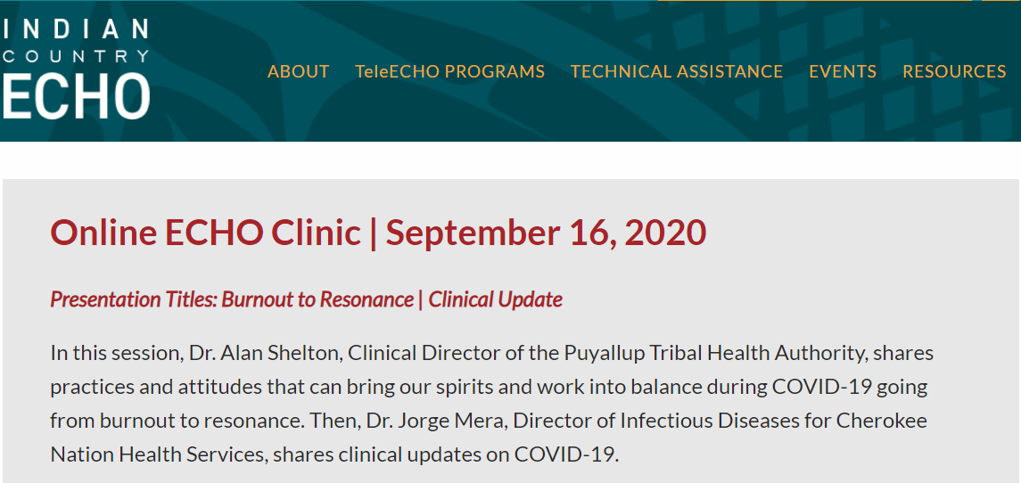
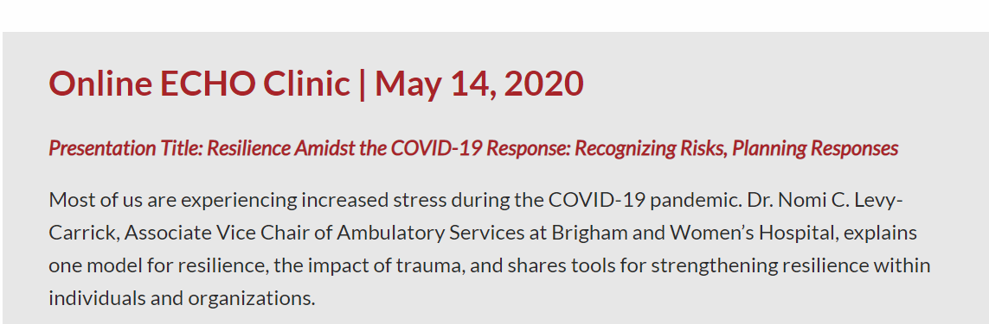
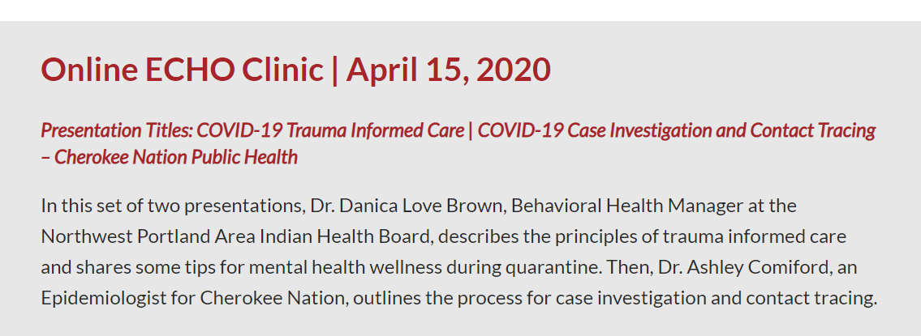
Our Mental Health
https://www.indiancountryecho.org/covid-19/topic-presentations/september-16-2020/
https://www.indiancountryecho.org/covid-19/topic-presentations/may-14-2020/
https://www.indiancountryecho.org/covid-19/topic-presentations/april-15-2020/
Notes:
Three Indian Country ECHO presentations are available that address the topic of mental health.

Slide 33
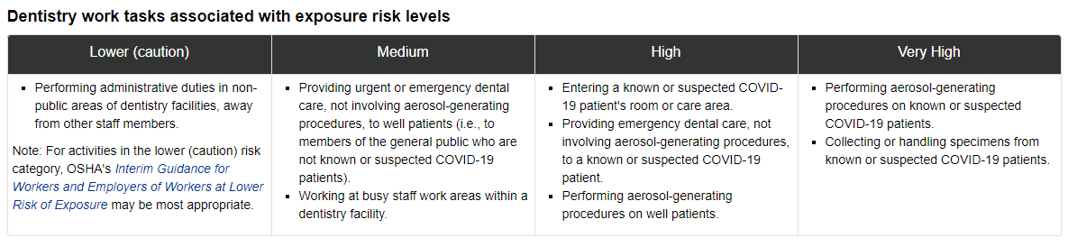
We are at risk so let us proceed thoughtfully and carefully.
https://www.osha.gov/SLTC/covid-19/dentistry.html
Notes:
OSHA provides exposure risk levels for dentistry amid this pandemic. We are on the front lines but we CAN make a difference for our patients keeping them, our staff and ourselves safe. So let’s do so thoughtfully and with a great amount of care.

Slide 34
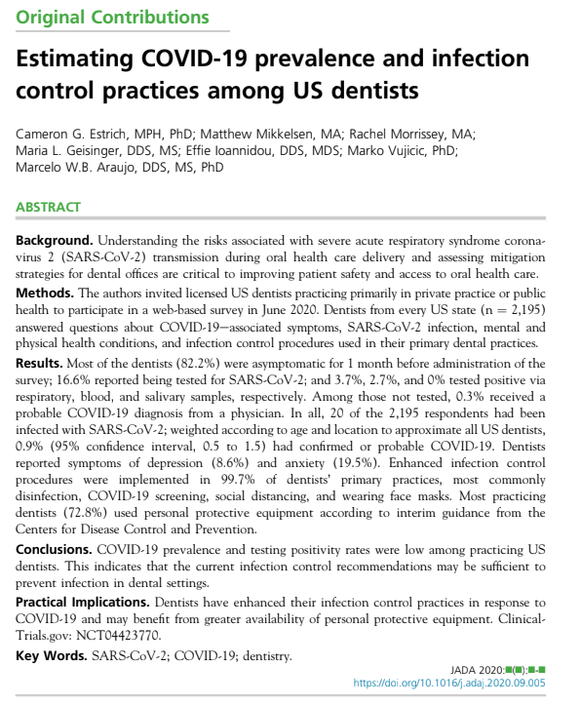
With that said this study in JADA
https://jada.ada.org/article/S0002-8177(20)30658-9/abstract
https://jada.ada.org/article/S0002-8177(20)30658-9/fulltext
Notes:
This study was published in JADA: Conclusions. COVID-19 prevalence and testing positivity rates were low among practicing US dentists. This indicates that the current infection control recommendations may be sufficient to prevent infection in dental settings.

Slide 35
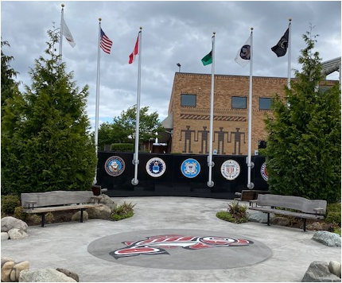
Thank You
Notes:
With Veteran’s (or Warrior’s Day for our Tribe) coming soon I want to say thank you to all the men and women who have bravely served our nation.

Slide 36
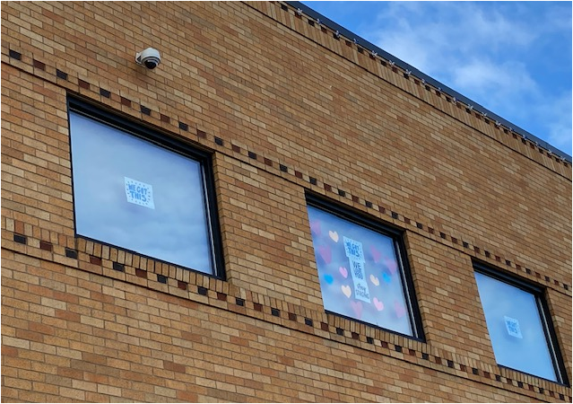

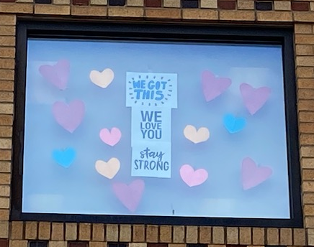
QUESTIONS???
Sean Kelly
sean@eptha.com
Or
drkelly55@gmail.com
Notes:
Thanks again. Any questions?

