Slide 1
CHAP Learning Collaborative: CHAP and Legislation
February 9, 2021, 9-10:00am (PDT)
Christina Friedt Peters, Tribal Community Health Provider Project Director
VIRTUAL

Slide 2
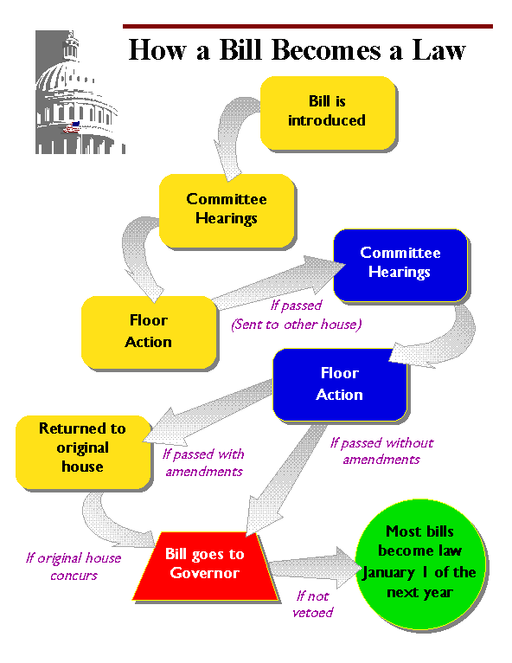
How a bill becomes a law
Some state legislatures can have different legislative processes
Legislative champion
Coalition
Tribal leadership champion
Cut offs
Fiscal note
Notes:
Very briefly:
How a bill becomes law – the legislative process can be confusing and intimidating if you’ve never worked on legislation. We will talk later about when you will need legislation to implement a chap program and when you do not. We will also discuss specifically dental therapy legislation and the challenges this specific kind of legislation presents. And because there are varying levels of experience on this call, I won’t spend too much time on how a bill becomes a law, but I did want to provide some vocabulary and a general overview of the state legislative process.
In order to get a bill introduced, which is the first official step in a bill becoming a law, you will need a legislative champion. For dental therapy legislation, you need a very strong legislative champion. Your legislative champion will shepherd your bill through the legislation process from the inside. She will work to generate support within her caucus and how hard she works the bill will make a difference in the success of your bill.
Leadership and advocacy from tribal leaders is key. They have important relationships and their leadership will also make big difference in the success of your bill.
After a bill is introduced, it has a certain amount of time to get voted out of committee before it dies. Essentially a bill needs to keep moving long the process or it will die. A dead bill is just that – a dead bill.
Fiscal note is a report of how much it will cost to implement or the impact the passage of the bill will have on the state budget.
On all of our bills, we’ve worked closely in coalition with the Tribes in our area, with non-tribal partners, and with other key partners, including state agency partners. Particularly for dental therapy, working in coalition is necessary and strengthens your campaign for your bill. It also brings a diversity of voices to the issue that legislators like to see, especially in controversial bills

Slide 3
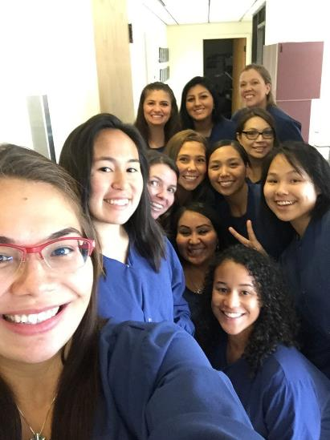
Why is it important to include DHATs in your CHAP program?
Our Board is interested in supporting long term sustainable solutions that build up our communities, create opportunities for our youth and tribal members, educate our healers and train the next generation of work force.
Notes:
Because whole body health is important the CHAP program includes community health, behavioral health, and oral health because that is what our communities need. Including dental therapists in your CHAP program is artificially hard because of politics and systemic racism. But don’t let that deter you from doing the hard work of providing a full wraparound health system to your communities.
CHAP is not just about improving access
It also addresses important Social determinants of health such s educational attainment and economic stability.
Providing for the health and well being of your citizens doesn’t mean just bringing more dentists or doctors to Indian country, it means creating educational pathways and employment opportunities that will also improve access to care as well as address other issues that will strengthen the community. That is what makes CHAP different from other programs that improve access to care.

Slide 4
Yukon-Kuskokwim Health Corporation in Alaska
DHATs are an effective part of the CHAP team
DHATs are reducing costly emergency care
DHATs are increasing access to dental exams
Notes:
And the health results are there – these are some results from a study in 2014 where you can see emergency visits going down, and preventive care going up
We looked closely at the health corporations in Alaska that were using dental therapists and for example Dental Therapists in the Yukon-Kuskokwin health corporation are increasing dental exams, particularly in the under 5 age group, reducing the need for emergency care and increasing access to preventive services.
These are the types of results we are hoping to replicate in Oregon and Washington.
(2009 Pre DHAT integration)

Slide 5
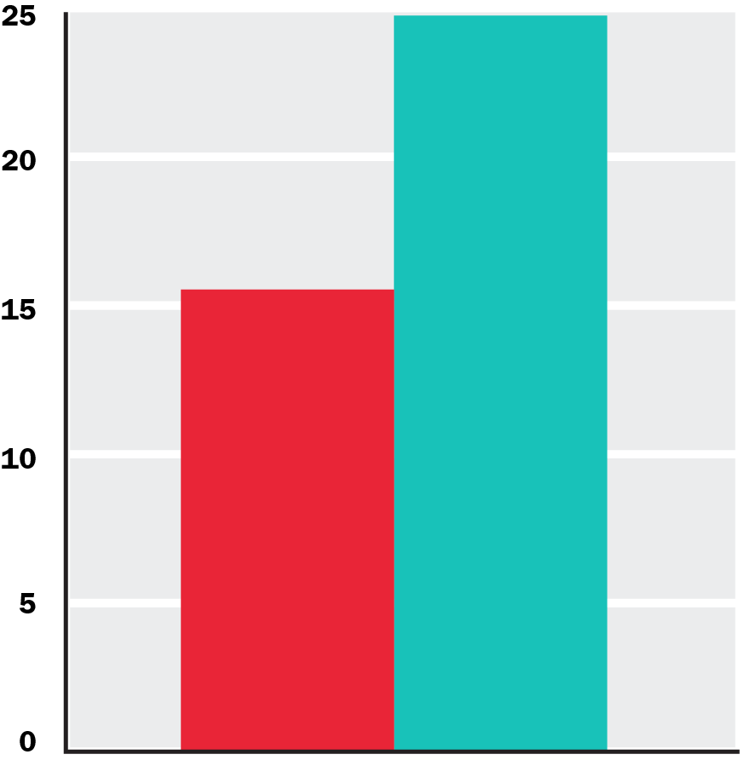
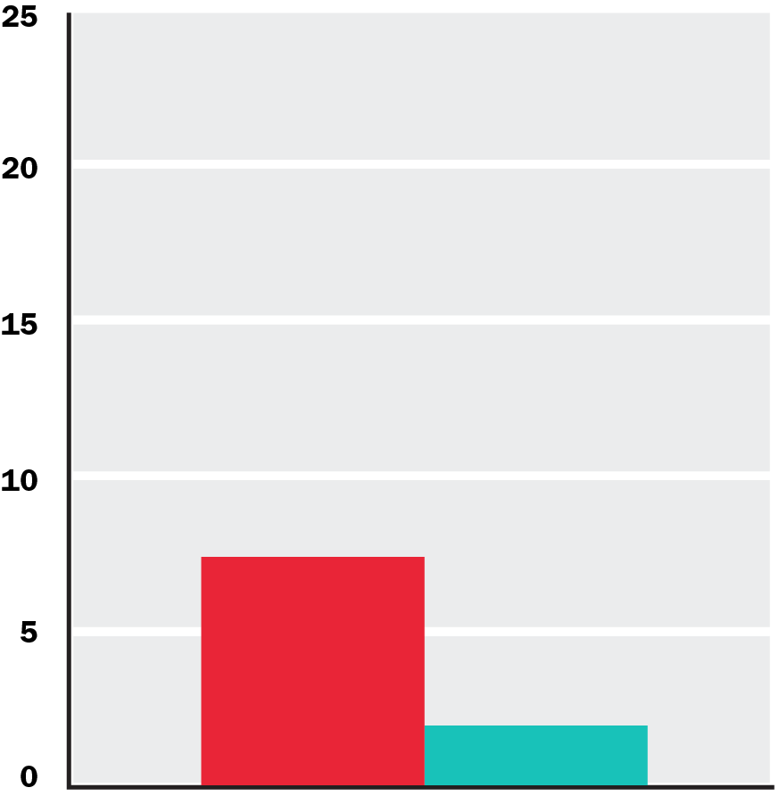
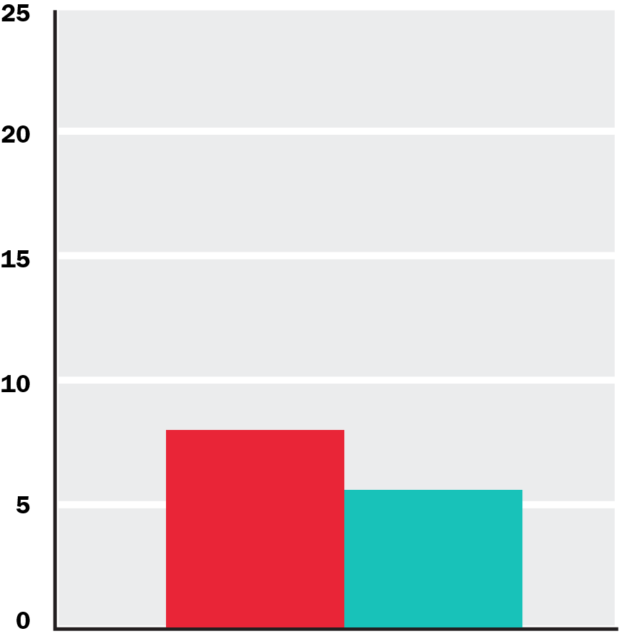
In High-DT Communities:
More kids get preventative care.
Kids need fewer front teeth extractions.
Fewer kids need general anesthesia.
24.8%
15.5%
7.3%
7.9%
5.5%
1.9%
Child Preventative Care
Child Extraction Rate
Child General Anesthesia Rate
No DT Communities
High DT Communities
Dental Utilization for Communities Served by Dental Therapists in Alaska’s Yukon Kuskokwim Delta: Findings from an Observational Quantitative Study Final Report August 11, 2017
Principal Investigator Donald L. Chi, DDS, PhD Associate Professor University of Washington, School of Dentistry dchi@uw.edu Co-Investigators Dane Lenaker, DMD, MPH; Lloyd Mancl, PhD; Matthew Dunbar, PhD; Michael Babb, MA
Notes:
People always say well, this isn’t Alaska, butiIt doesn’t matter if you life next door to a dental clinic or 500 miles away over polar bear infested tundra. If you can get through the door of that clinic because of fear or embarrassment, or cost or language, the result is the same.
This is what it is all about. Children keeping their teeth. Children not having to go under general anesthesia for full mouth restoration surgeries. Children getting preventive care right in their village.
This is just a teaser. Don Chi, a researcher at the University of Washington-working with colleagues including those at Yukon Kuskokwim Health Consortium--will be publishing this data soon.

Slide 6
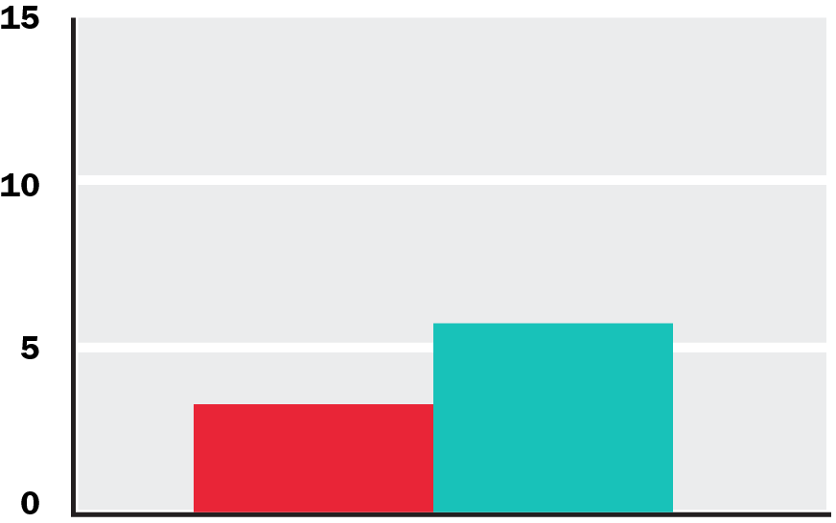
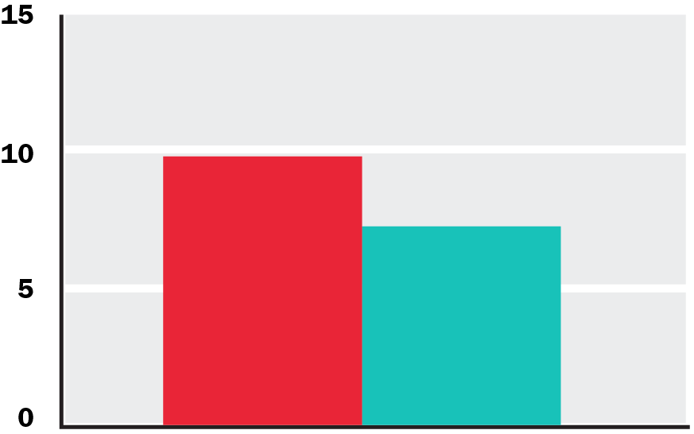
In High-DT Communities:
More adults get preventative care.
Adults need fewer teeth extractions.
9.6%
7.1%
5.6%
3.2%
Adult Preventative Care
Adult Extraction Rate
No DT Communities
High DT Communities
Dental Utilization for Communities Served by Dental Therapists in Alaska’s Yukon Kuskokwim Delta: Findings from an Observational Quantitative Study Final Report August 11, 2017
Principal Investigator Donald L. Chi, DDS, PhD Associate Professor University of Washington, School of Dentistry dchi@uw.edu Co-Investigators Dane Lenaker, DMD, MPH; Lloyd Mancl, PhD; Matthew Dunbar, PhD; Michael Babb, MA
Notes:
And it isn’t just kids that are benefitting from DHAT. DHATs are caring for their whole community from babies to elders and everyone in between.

Slide 7
Why is dental therapy legislation “controversial”
Notes:
Politics, structural racism, greed, protectionism

Slide 8
CHAP is a federal program, why do we need legislation?

Slide 9
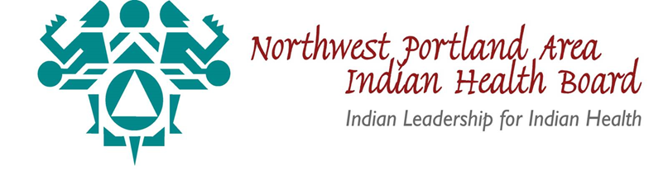
Dental Health Aide Therapist restriction:
. . .the national CHAP. . . “shall exclude dental health aide therapist services from services covered under the program.”¹ . . . except. . . where DHAT services are “authorized under State law to supply such services in accordance with State law.”²
DHATs also must meet the minimum federal training requirements for certification.³
Existing OPM-approved PD for DHAT (GS-0640-09)
Circular No. 20-06 did not give detail about Dental Health Aide roles other than DHAT
  Their specific roles and responsibilities will be specified in National CHAP Standards and Procedures and other applicable ACB requirements
    This process will start next month with CHAP TAG and could take two years
25 U.S.C § 1616l(d)(2)(B).
25 U.S.C §1616l(d)(3).
IHS Circular No. 20-06 (4)(F).
Notes:
25 U.S.C §1616l(d)(2)(B) provides that the national CHAP “shall exclude dental health aide therapist services from services covered under the program.”
Section 1616l(d)(3) provides that this exclusion of DHAT services:
In General Subparagraph (B) of paragraph (2) shall not apply in the case of an election made by an Indian tribe or tribal organization located in a State (other than Alaska) in which the use of dental health aide therapist services or midlevel dental health provider services is authorized under State law to supply such services in accordance with State law.
CHAP Circular 4 (F). DHATs also must meet the federal training requirements for certification. However, DHATs shall only practice in states that authorize the use of DHAT services. This requirement applies to Tribes and Tribal Organizations seeking to include a CHAP as a PSFA in an ISDEAA contract or compact.

Slide 10
Do other CHAP providers need state legislation?
NO
Legislation could be helpful as your CHAP program becomes operational if your state Medicaid agency needs support in making some of the changes related to billing and/or state plan and is looking for something from the state legislature.
  the legislation is for the state agency to be a better partner NOT to authorize providers.
STATES HAVE NO JURISDICTION OVER PROVIDERS IN THE CHAP PROGRAM
  Except limited jurisdiction in the case of DHAT as per the IHCIA.
The CHAP program is intended to sit outside of state regulatory authority to allow Tribes the flexibility they need to tailor these providers to meet their needs.
Notes:
Refer back to the language in the last slide – point out how important it is to have broad state language that delegates the authority of HOW DHATs work back to the tribal or federal authority.
AND FOR OTHER PROVIDERS – it is important to note that even if a state believes that it can limit the scope of other CHAP providers or make certain requirements on their training, certification, etc. . . That federal law will trump that state law (that is how Alaska DHATs won their case) and the state limits won’t have any standing on the CHAP program – which is a federal program.
But, Medicaid is a federal/state partnership and the tribal health programs work closely with the state Medicaid agencies, so including the state Medicaid agency in your planning will make life so much easier down the road.

Slide 11
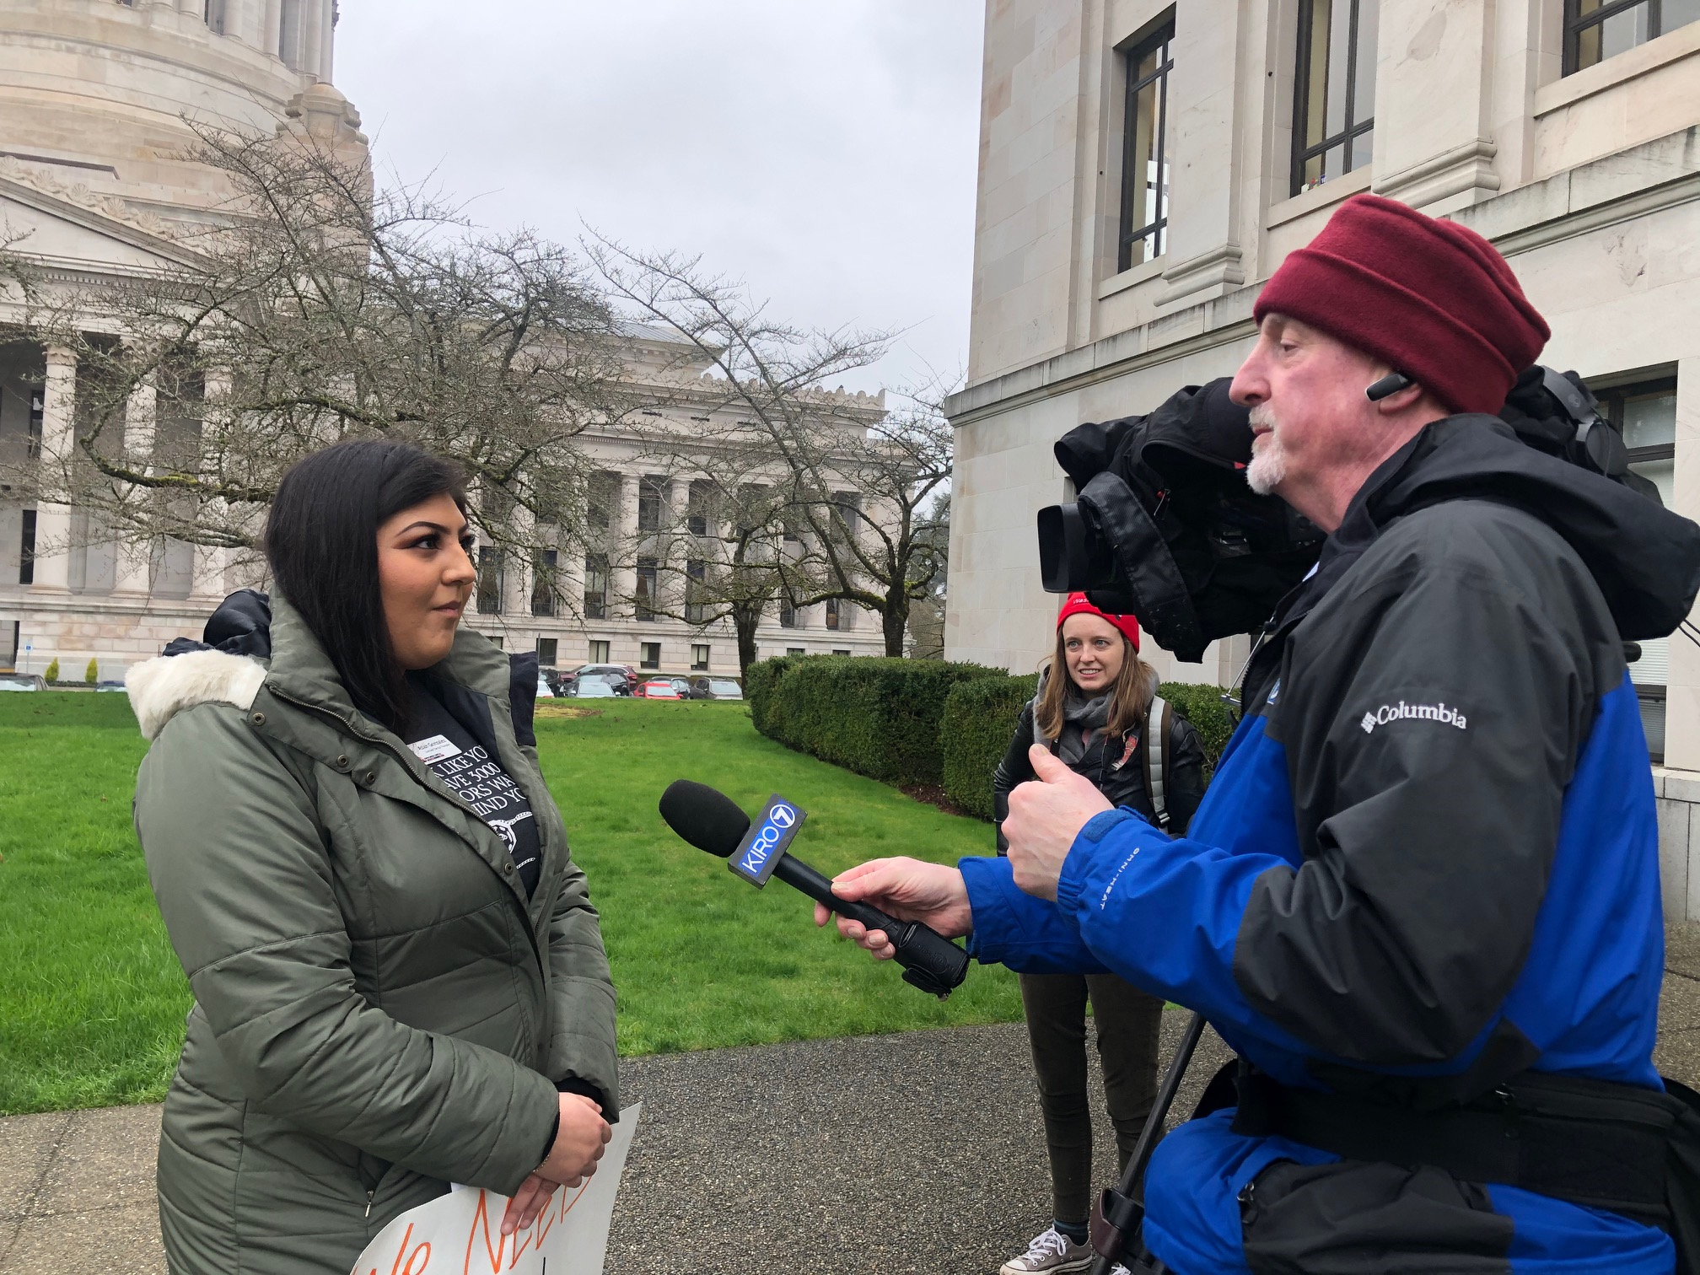
Portland Area Legislation
Swinomish DHAT Asia Gonzales being interviewed in Olympia at a 2019 rally for statewide dental therapy legislation in Washington

Slide 12
Legislation in the Portland Area
A coalition in Washington state will continue to pursue statewide dental therapy legislation after passing tribal only legislation in 2017.
A coalition in Oregon introduced statewide licensing bill in 2021 session. The Dental Therapy pilot project expires in May 2022, and legislation is best pathway to allow current DHATs to continue practice and establish the profession in OR for all underserved populations.
Idaho passed legislation in 2019 that will grant state licenses to dental therapists that graduate from CODA accredited programs practicing on tribal lands.

Slide 13
SB 5079 (2017) WA Tribal DHAT Bill Summary
Delegates authority back to Tribe or CHAP program
No language about scope or education requirements
Authorizes DHATs in Washington that are
  Certified by a CHAP Certification board
  Licensed by a Federally Recognized Tribe
All DHAT services must be performed:
  In a practice setting within the exterior boundaries of a tribal reservation and operated by an Indian health program
  On persons who are members of a federally recognized tribe or otherwise eligible for services under Indian health service criteria, pursuant to the Indian health care improvement act, U.S.C. Sec. 1601 et seq.
Directs HCA to coordinate with CMS for Medicaid Reimbursement
Excluded urban health programs and limited tribes ability to serve its population
This has caused problems
Notes:
Gold star – no language about scope or education requirements because those are left up to the regulatory authority – tribes and CHAP program
Good job – delegated authority back to Tribes and CHAP
2020 hindsight – allowing the population restriction and urban programs were excluded. – Didgwalic – has dental program, just off the reservation boundary, can’t use DHATs like their main dental program down the road. Excludes tribes that don’t have land, SPA denial

Slide 14
Oregon Dental Therapy Legislation
HB 2528 allows Oregon Board of Dentistry to license dental therapists who have completed CODA accredited education program, or an education program approved by a state pilot project and passed an exam. Dental therapists could work in all practice settings under general supervision (off-site) with a signed practice agreement with dentist. – includes language specific to CHAP
NPAIHB convenes the Oregon Dental Access Campaign, a broad coalition of dental and health care organizations, educators, community organizations and Tribes. More information and a link to the bill at: odac.nationbuilder.com
Notes:
Important because unified programs

Slide 15
Oregon DT Bill HB 2528 (2021)
SECTION 6. (1) A person may not practice dental therapy or assume or use any title, words or abbreviations, including the title or designation “dental therapist,” that indicate that the person is authorized to practice dental therapy unless the person is licensed under section 3 of this 2021 Act.
(2) Subsection (1) of this section does not prohibit:
. . .
(g) The performance of duties by a federally certified dental health aide therapist or tribally authorized dental therapist in a clinic operated by the Indian Health Service, including, as described in 25 U.S.C. 1603, an Indian Health Service Direct Service Tribe clinic, a clinic operated under an Indian Self-Determination and Education Assistance Act of 1975 (P.L. 93-638) contract or a clinic operated under an urban Indian organization.

Slide 16
Washington Dental Therapy Legislation
SB 5142 licenses dental therapists statewide, in limited practice settings: FQHCs; hospitals, nursing homes, schools and tribal clinics. Importantly, this allows Urban Indian Programs to hire dental therapists. Private practice settings were removed from this bill in response to lawmaker and opposition concerns. This year’s bill also adds additional hours to the preceptorship.
Tribal dental therapists will still work under the authority of a tribal license, but this bill would offer opportunity for dual licensure. This could allow for patient and community care outside of tribal lands, or care for non IHS-eligible patients.

Slide 17
PER FEDERAL LAW ONLY DHATS REQUIRE STATE AUTHORIZATION – other categories of CHAP providers including all levels of CHA/P, BHA/P,
and DHA I & II, and EFDHA I & II
DHAT law in Washington:
RCW 70.350.020
Authorization—Conditions.
(1) Dental health aide therapist services are authorized by this chapter under the following conditions:
(a) The person providing services is certified as a dental health aide therapist by:
(i) A federal community health aide program certification board; or
(ii) A federally recognized Indian tribe that has adopted certification standards that meet or exceed the
requirements of a federal community health aide program certification board;
Notes:
I think a brief state policy discussion might be helpful here to 1) clear up any confusion about which providers need state authorization and to provide some language.

Slide 18
License / Certification
Tribal License:
Tribes may create own licensing board
May license for own Tribe only or also for other Tribes (with legal agreement)
State License:
Requires state legislation
Oversight by state board
Not limited to IHS/Tribal sites
Federal Certification: Community Health Aide Program (CHAP)
  Alaska CHAP has certified providers in Alaska since 1968
  IHS Circular approved CHAP nationalization in 2020
    Creates national and Area CHAP Certification Boards
    Certifies providers working in IHS/Tribal sites only
    Requires include CE and clinical oversight
Notes:
Important to note that per the circular – federal certification is the only acceptable certification for participation in a Community Health Aide Program (language below from the policy section 5C).
In this forum, it will be important to support tribal sovereignty by saying that a Tribe as a sovereign government has the right (and responsibility) to regulate health care providers as part of carrying out its duty to provide for the health and wellbeing of their community, however, for participation in a CHAP program (i.e ability to use federal CHAP funds (if they are available), ability to add CHAP to their funding agreements, ability for IHS facilities to use CHAP providers) the providers must also be certified by the federal or area certification board.
(I see there is another DHAT slide – so this could be moot, or we can add this here). Discussion of state licensure for CHAP providers might be confusing as it is not necessary – except perhaps in the case of DHAT. So this discussion should include the language from the ISDEAA that removes DHATs from the federal CHAP program except by state authorization. So that you can circle back to that and show why it is necessary (unlike with the other providers) and be sure that there is some language about “in accordance with state law” when explaining this – and be sure to include the provision from the CHAP circular that says that DHATs must:
4 F. DHATs also must meet the federal training requirements for certification. However, DHATs shall only practice in states that authorize the use of DHAT services. This requirement applies to Tribes and Tribal Organizations seeking to include a CHAP as a PSFA in an ISDEAA contract or compact.
5 C. Certification Boards. All providers who wish to provide services under the CHAP must be certified by one of the following boards:
1. CHAP National Certification Board (NCB). The NCB is a federal board chaired by the IHS Chief Medical Officer (CMO) or his or her delegate and may be comprised of Federal and Tribal representatives from each ACB. Functions of the NCB and board composition are addressed in the Standards and Procedures.
2. CHAP Area Certification Boards (ACBs). The ACBs are federal certification boards located in the contiguous 48 states and may be comprised of Federal and Tribal representatives. Their membership must include at least one federal representative appointed by the respective IHS Area Director. The ACB establishes board composition in its standards and develops the procedures of each respective board to certify individuals as their respective provider types.

Slide 19
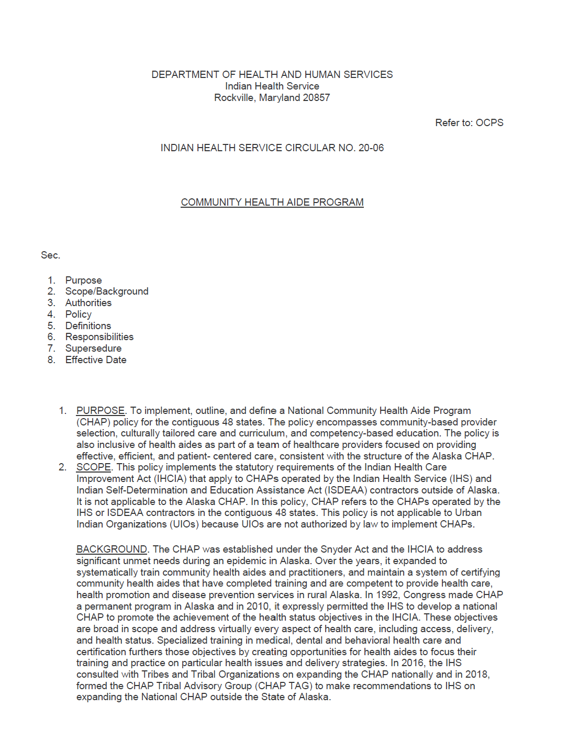
IHS Circular 20-06:
National CHAP Expansion
Tribal Organizations outside of Alaska may carry out a CHAP
  Must amend their ISDEAA agreements
  Excludes Urban Indian Organizations from Federal CHAP
Establishes National Certification Board
Authorizes Area Certification Boards
  Areas may also enter into agreements with other ACBs
NCB determines baseline requirements and scope of practice for ALL CHAP provider types.
Notes:
Provides federal baseline for federal community health aide program through national standards and procedures (in development). Also ensures continuity and portability through national certification board.
(5)(C) 1. CHAP National Certification Board (NCB). The NCB is a federal board chaired by the IHS Chief Medical Officer (CMO) or his or her delegate and may be comprised of Federal and Tribal representatives from each ACB. Functions of the NCB and board composition are addressed in the Standards and Procedures.
2. CHAP Area Certification Boards (ACBs). The ACBs are federal certification boards located in the contiguous 48 states and may be comprised of Federal and Tribal representatives. Their membership must include at least one federal representative appointed by the respective IHS Area Director. The ACB establishes board composition in its standards and develops the procedures of each respective board to certify individuals as their respective provider types.

Slide 20
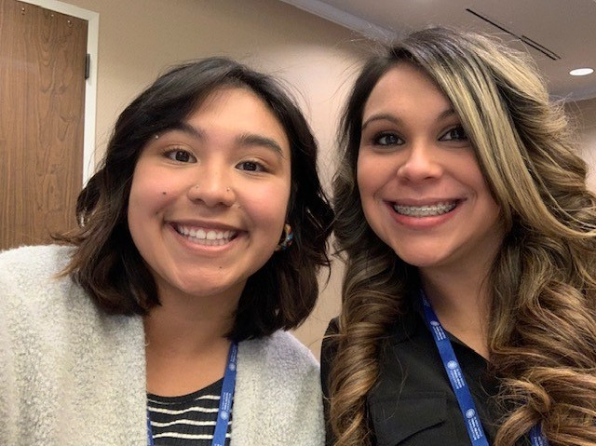
BHAs in the Portland Area
Philysia Deleon, Swinomish
Amy Redner, Lower Elwha K’lallam
Ken Hamilton, Colville
Sasha Corpuz, Yakama
Jenece Howe, Yakama/Colville
Kamien Sanchez
Adrianne Hamilton, Assiniboine/Sioux
Elizabeth Villa, Nez Perce
Venissa Williams, Upper Skagit
Shaniya Shipman
Andrea Batin, Yakama

Slide 21
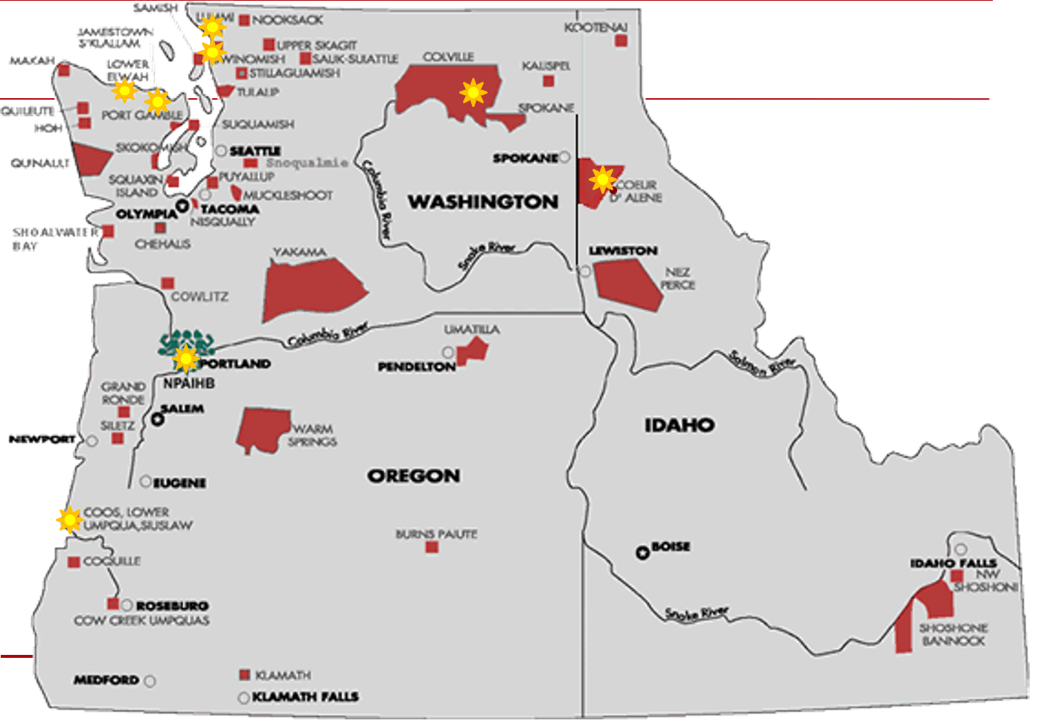
Dental Therapists in the Portland Area
Notes:
In our area, eight clinics have added DTs to their teams, and one clinic (in pink) will be adding theirs later this year.

Slide 22
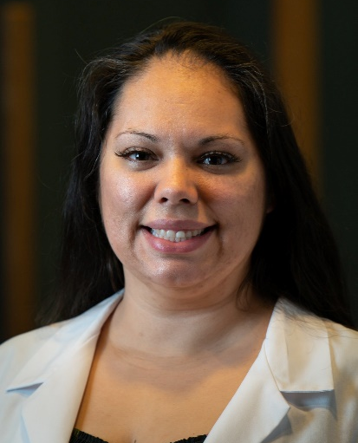
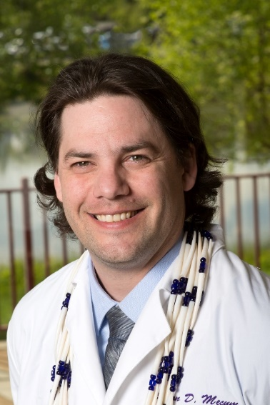
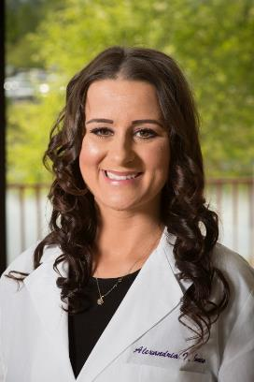
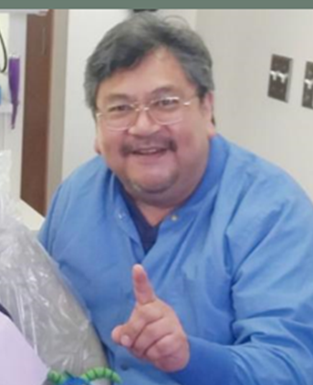
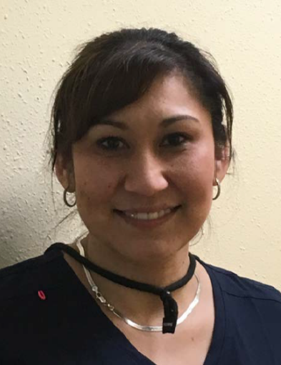
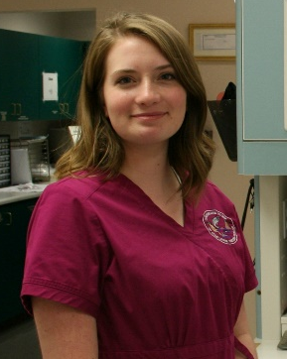
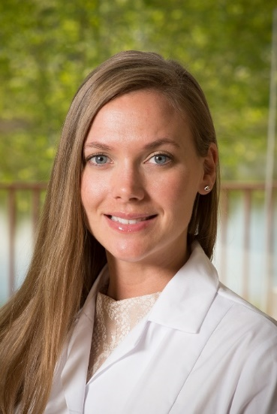
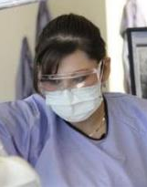
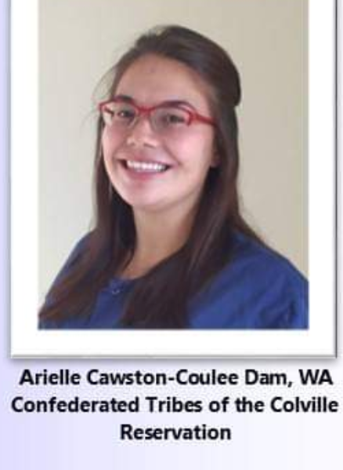
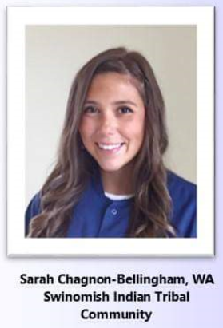
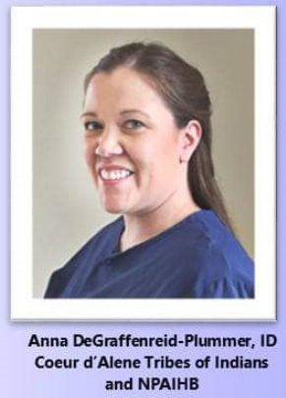
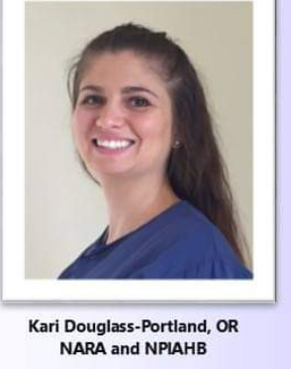
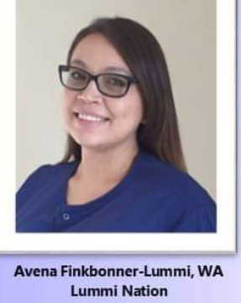
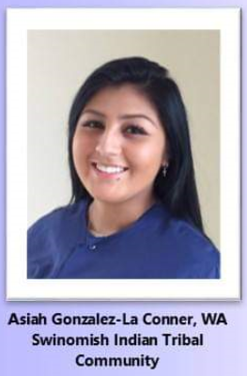
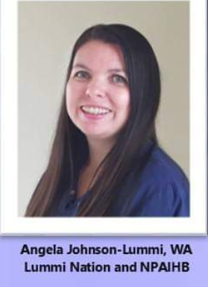
Dental Therapists
in
Washingon, Oregon,
and Idaho
Inga Weddle – Tulalip, WA
Tulalip Tribes
Rochelle Ferry – Port Gamble, WA
Port Gamble S’Klallam Tribe
Naomi Petrie – Coos Bay, OR
Confederated Tribes of Coos, Lower Umpqua, and Siuslaw Indians
Marissa Gardner – Coos Bay, OR
Confederated Tribes of Coos, Lower Umpqua, and Siuslaw Indians
Jason Mecum – Port Angeles, WA
Lower Elwha Klallam Tribe
Coquille Indian Tribe
Alex Jones
Coquille Indian Tribe

Slide 23
Tribal Community Health Provider Project
– The Community Health Aide Program Project & The Native Dental Therapy Initiative –
Northwest Portland Area Indian Health Board
2121 SW Broadway, Suite 300, Portland, Oregon 97201
503.228.4185 Main │ 503.228.8182 Fax │www.npaihb.org
Christina Peters, Tribal Community Health Provider (TCHP) Director cpeters@npaihb.org
Miranda Davis, Native Dental Therapy Initiative (NDTI) Director mdavis@npaihb.org
Carrie Sampson-Samuels, Community Health Aide Program Director csampsonsamuels@npaihb.org
Danica Brown, Behavioral Health Director dbrown@npaihb.org
Pam Johnson, NDTI Manager pjohnson@npaihb.org
Tanya Firemoon, TCHP Specialist tfiremoon@npaihb.org
Dove Spector, NDTI Specialist dspector@npaihb.org
Katie Hunsberger, BHA Student Support Coordinator khunsberger@npaihb.org
Asia Brown, NDTI Social Media Intern ambrown@npaihb.org
Samantha Wells, NDTI Legislative Field Organizer swells@npaihb.org
https://twitter.com/NWDentalTherapy www.npaihb.org/ndti/

