Slide 1

Tribal Community Health Provider Project (TCHPP)
April 13th, 2021
Oregon, Washington, Idaho Tribes

Slide 2

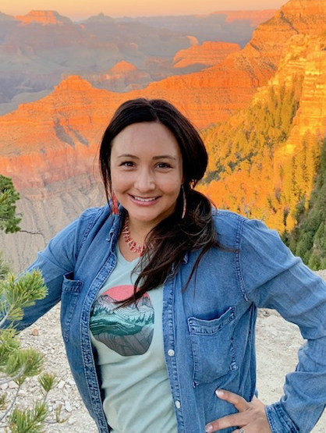
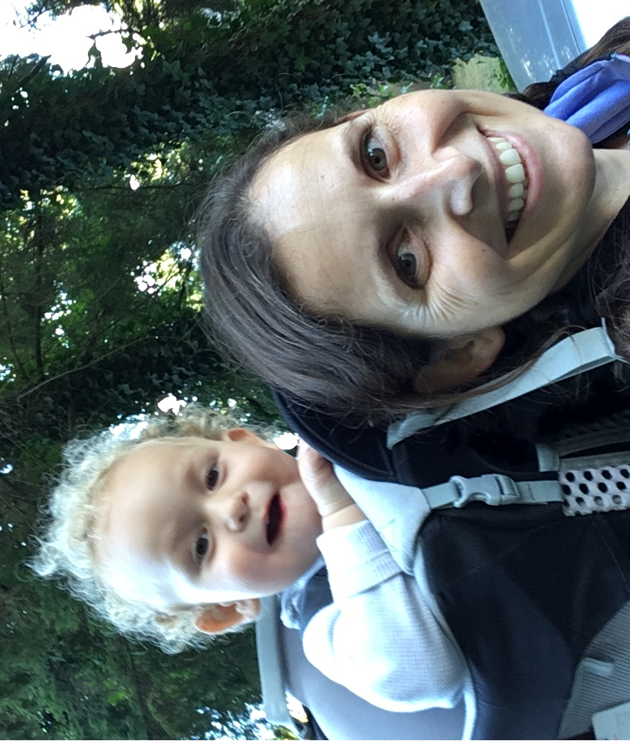
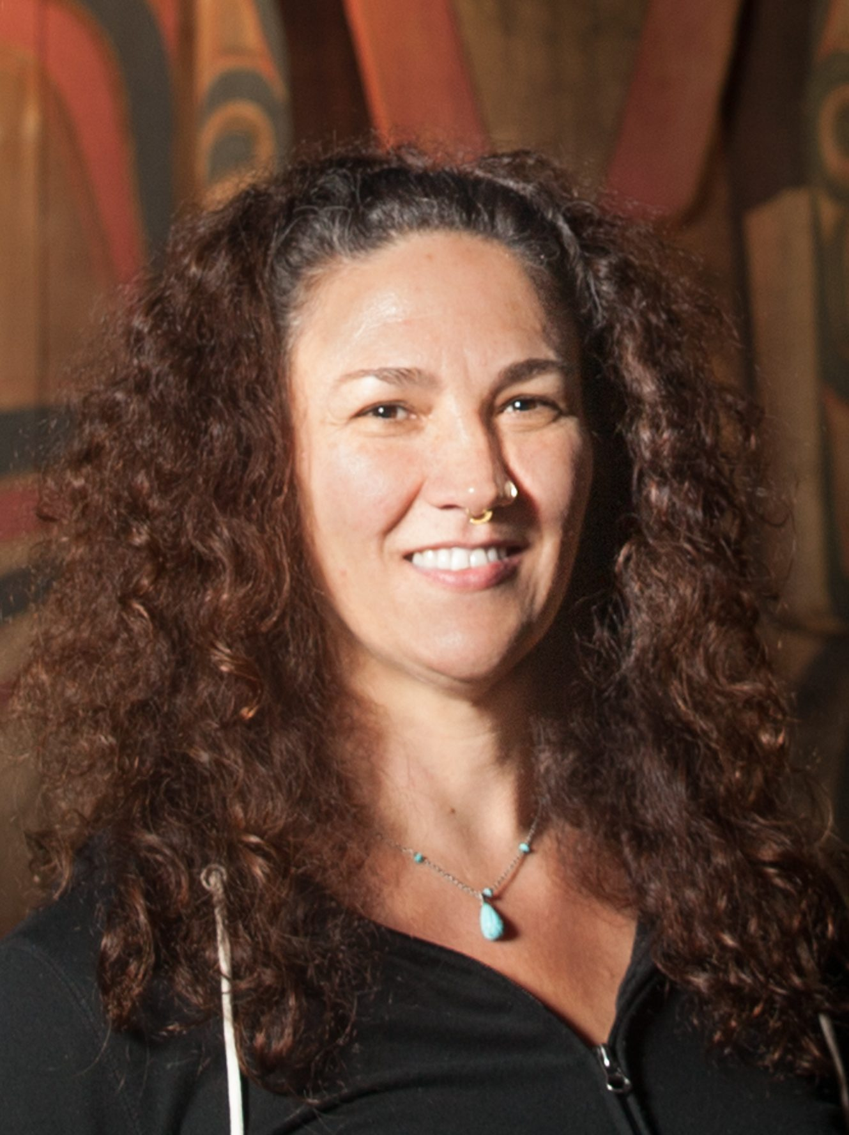
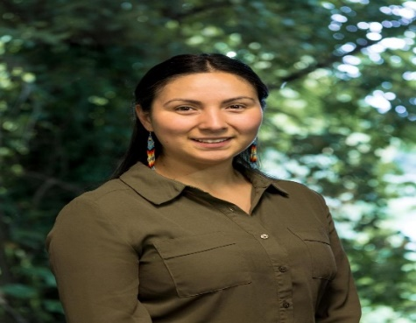
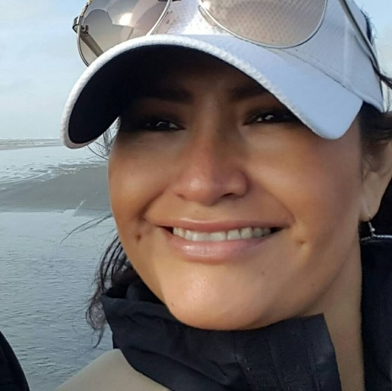
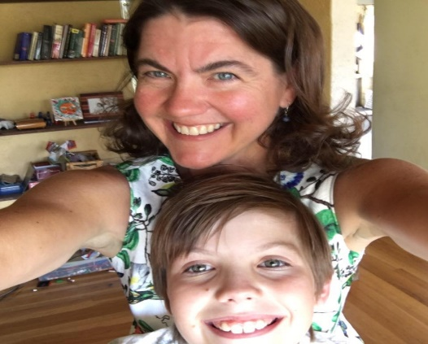
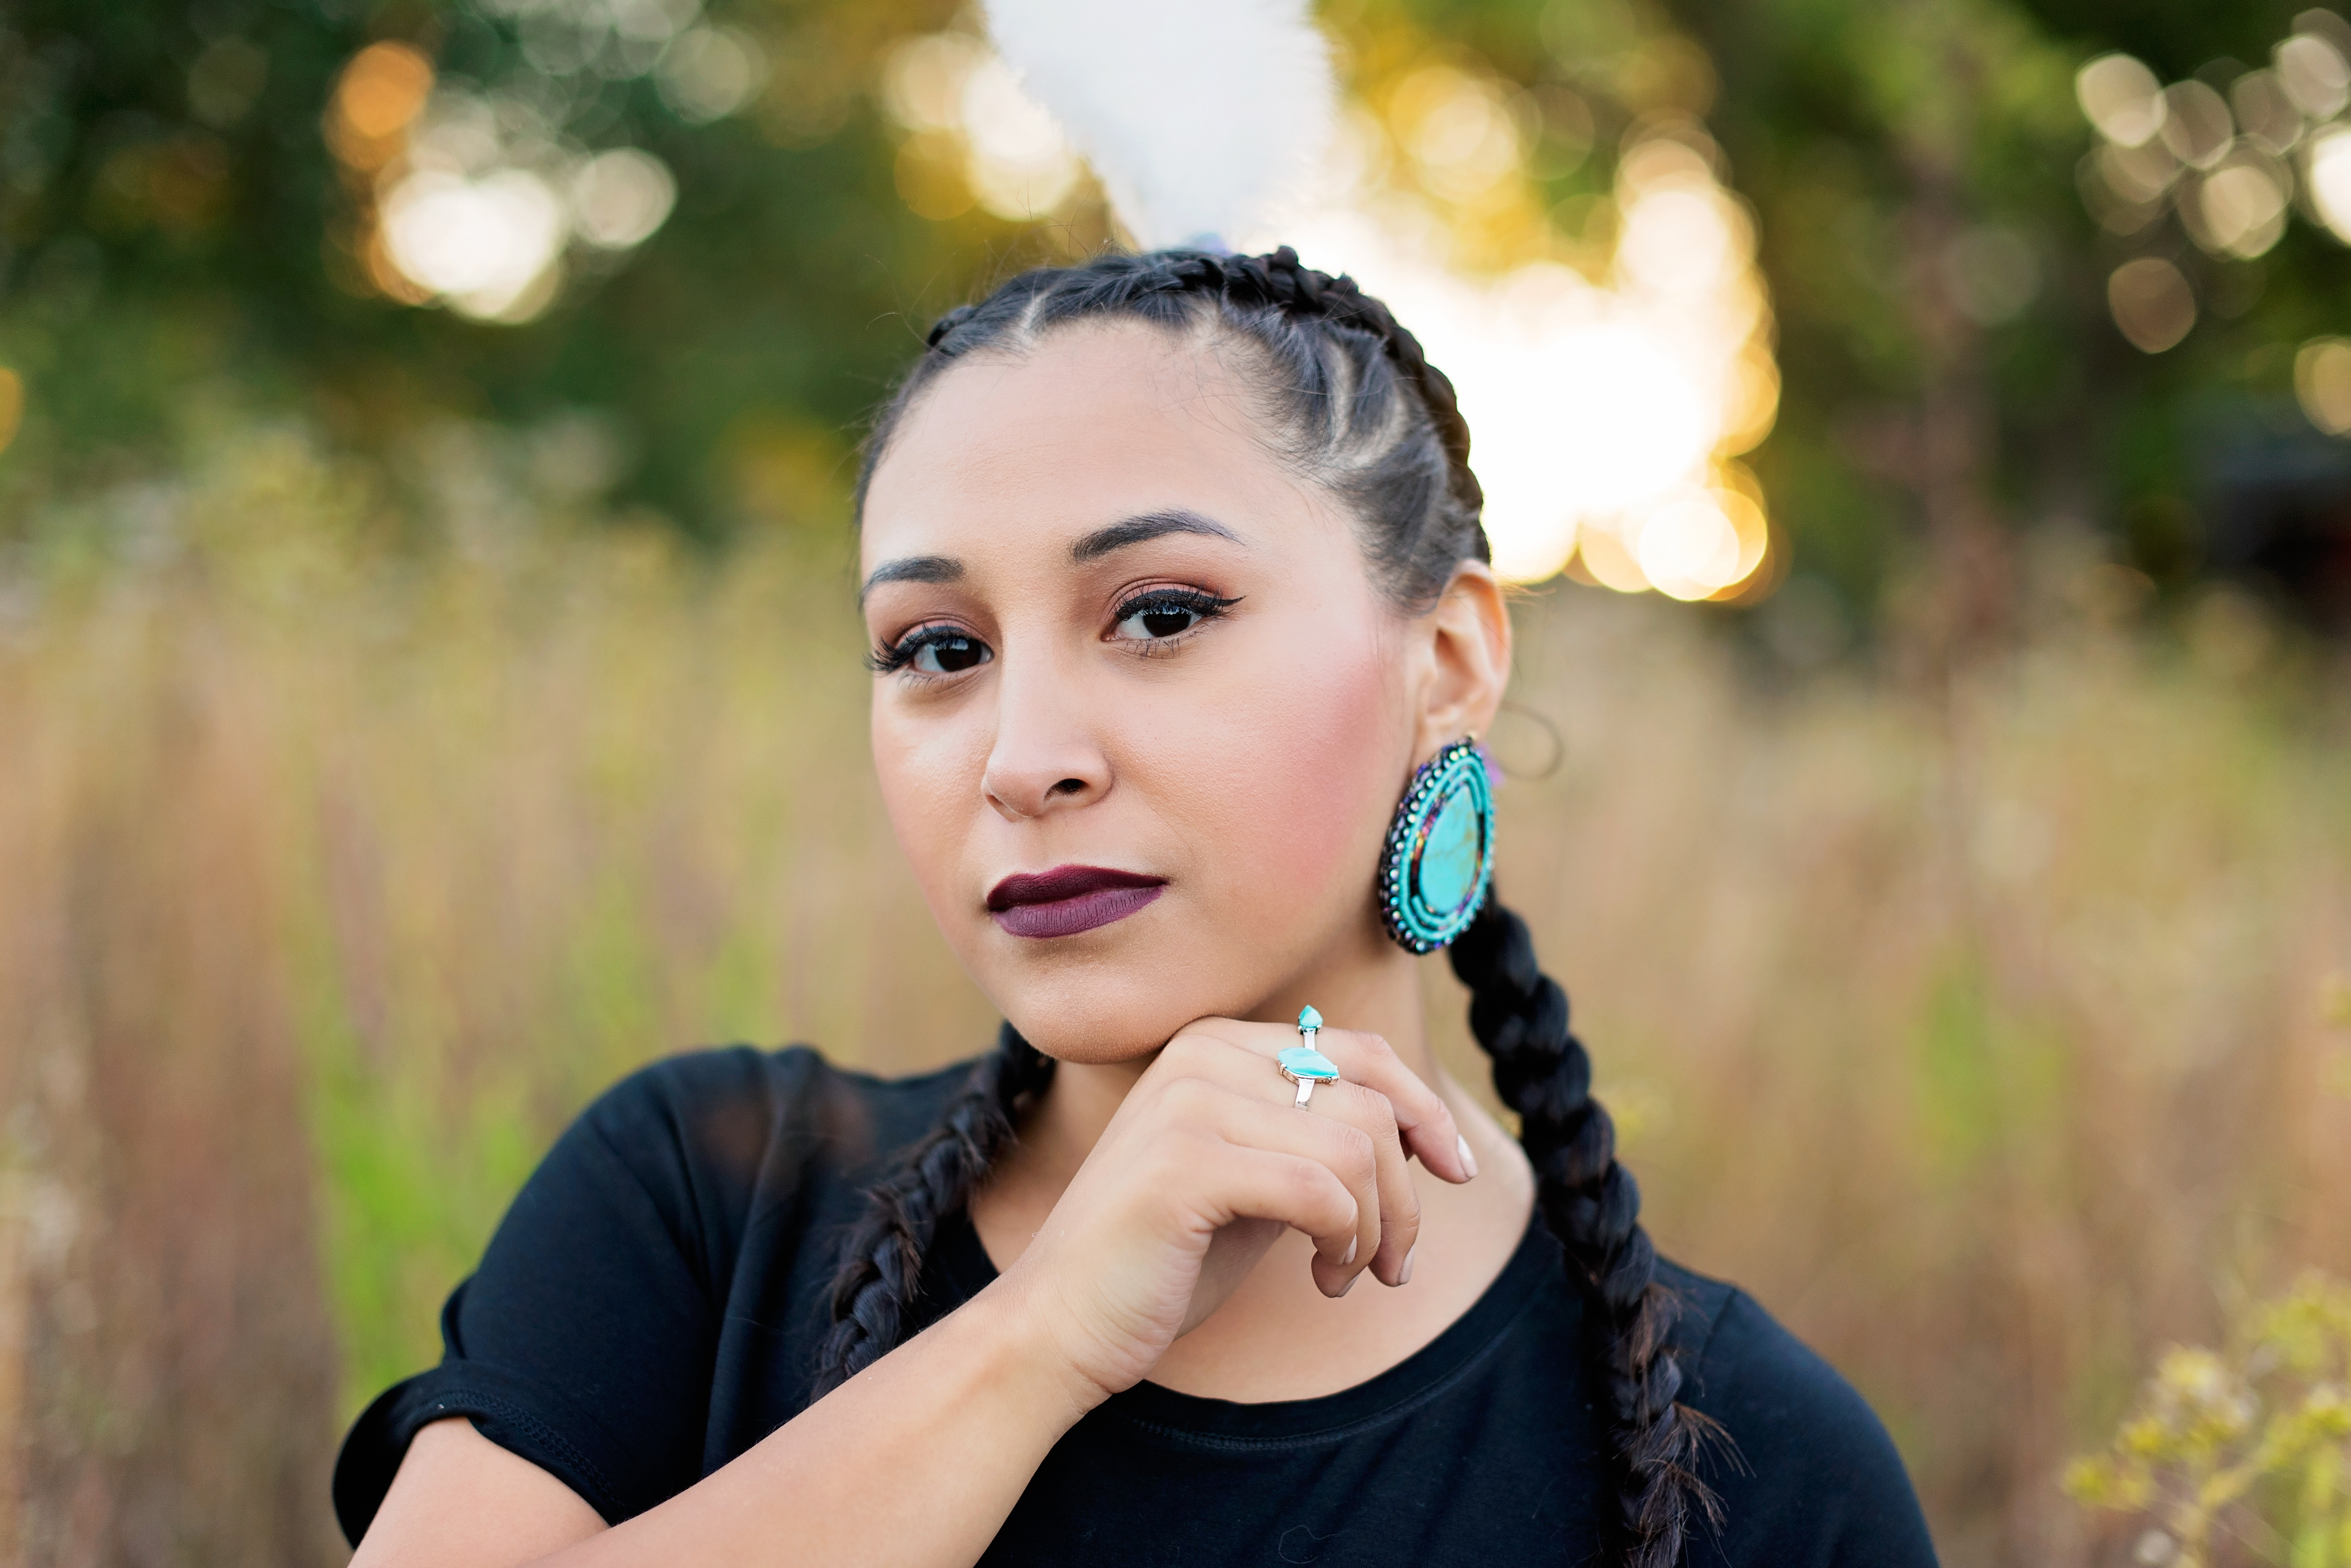
Tribal Community Health Provider Project (TCHPP) Team
Christina Peters
Carrie Sampson-Samuels
Miranda Davis
Danica Brown
Dove Spector
Tanya Firemoon
Pam Johnson
Katie Hunsberger
Notes:
Christina is our TCHPP Director
Miranda is the NDTI Director
Miranda and Sue directly report to Christina.
Pam is the NDTI project manager. Dove is the NDTI project specialist and Tanya is the TCHP project specialist.

Slide 3
Objectives
Provide an overview of the Tribal Community Health Provider Project (TCHPP)
Introduce the Community Health Aide Program (CHAP)
Describe BHA Scope of Work
  Across the continuum of care
Describe key elements of BHA program
  Context
  Education Pathways
Notes:
Carrie/Tanya

Slide 4
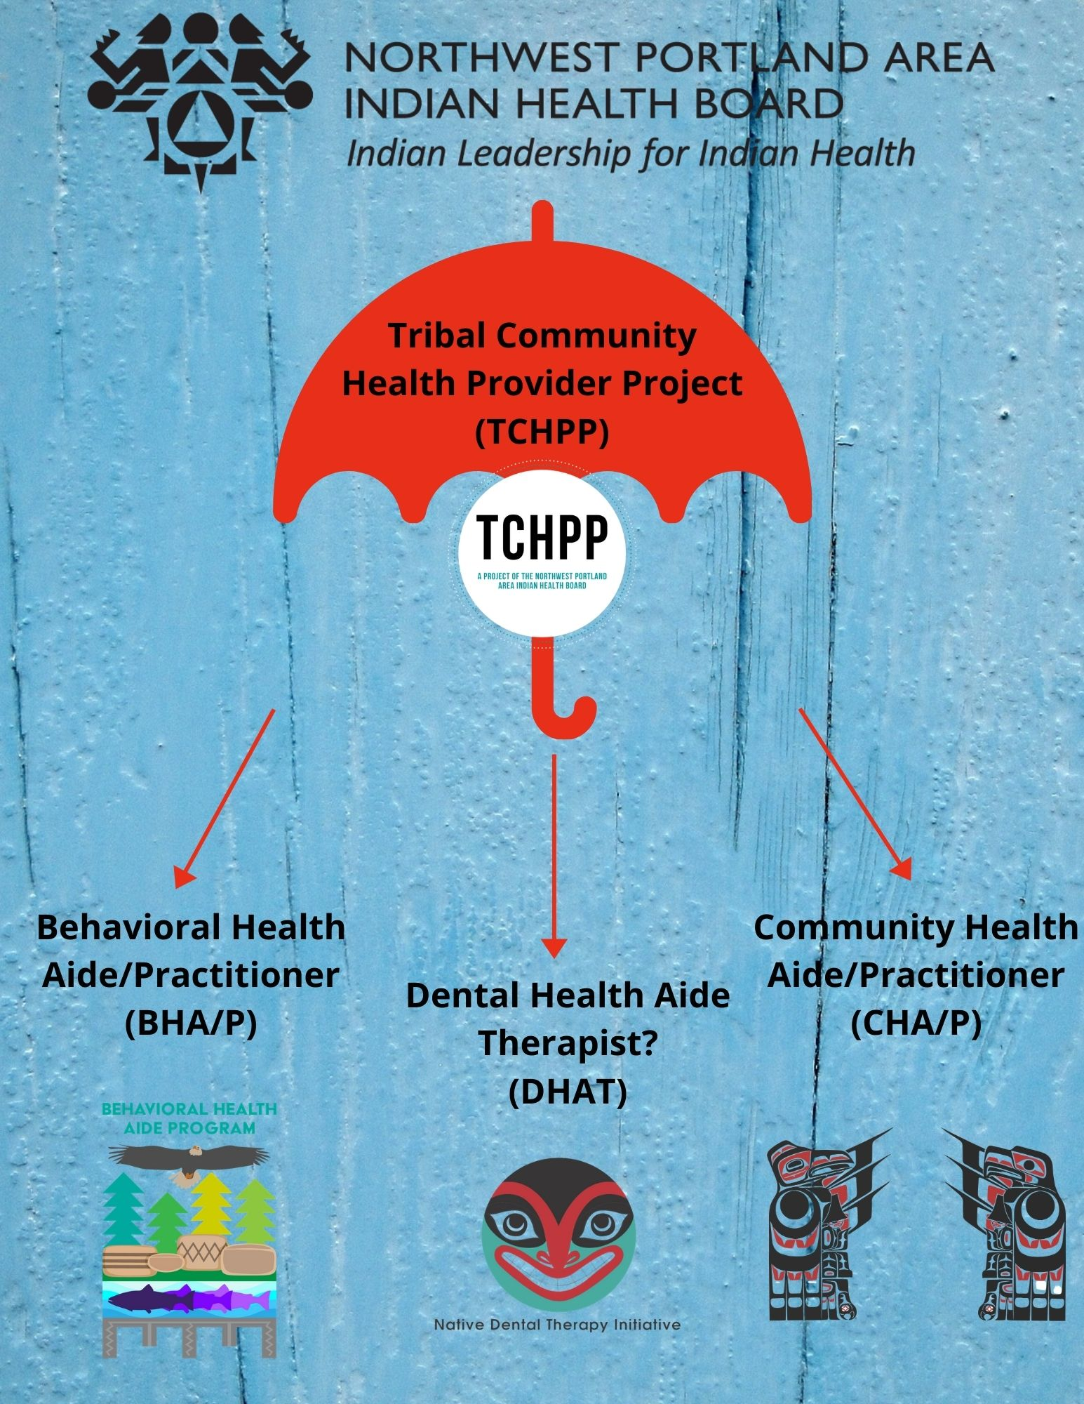
Notes:
Carrie

Slide 5
What is the Tribal Community Health Provider Project?
Dental Health Aide (DHA)
Community Health Aide/Practitioners (CHA/Ps)
Behavioral Health Aide (BHA)
DHAs are primary oral health care professionals that can provide clinical dental treatment, patient education and preventative services.
BHAs are counselor’s, health educators, and advocates. BHAs help address individual and community-based health needs such as alcohol, drug and tobacco abuse and mental health. BHAs use a combination of Western and traditional-based practices to provide care.
CHA/Ps work with guidelines of the Alaska Community Health Aide/Practitioner Manual (CHAM) to assess and provide emergent, acute and chronic care to residents and their respective rural communities.
Notes:
Carrie

Slide 6
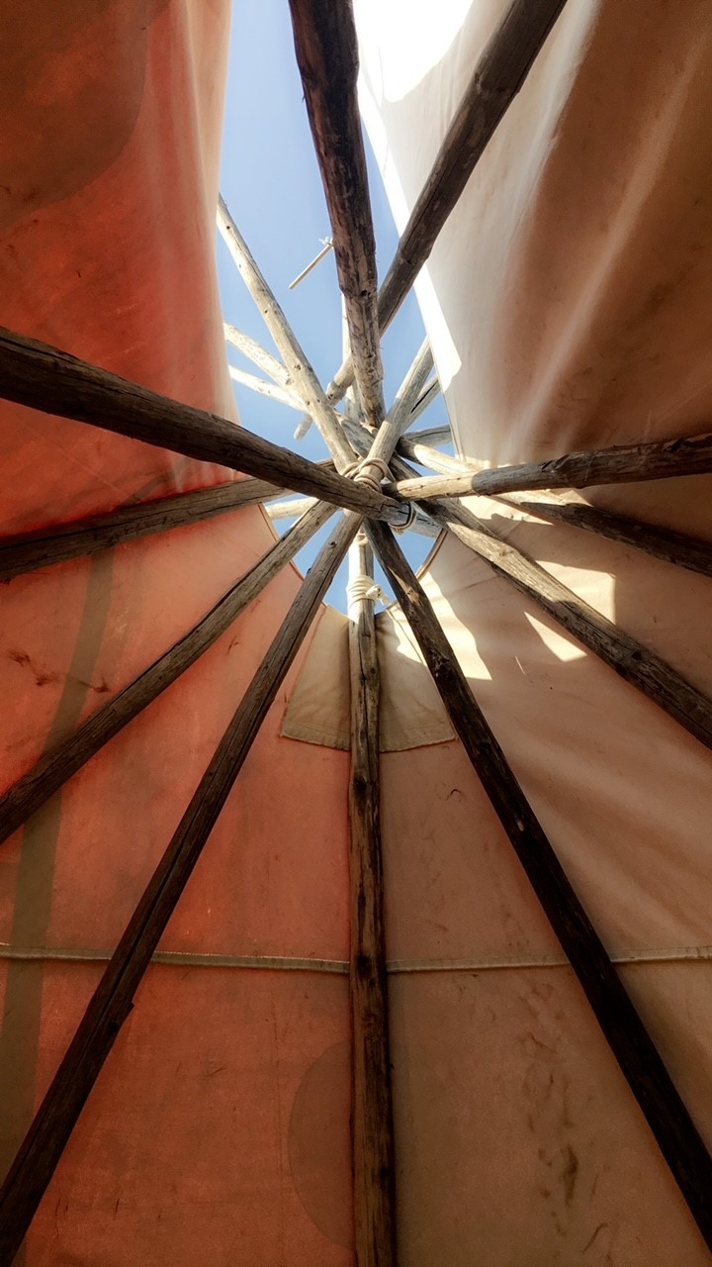
Why CHAP Matters
Proven history of safe, quality care in Alaska for over 50 years
Uniquely developed for Alaskans by Alaskan and the same is true for Northwest Tribes
Tribes can tailor their programs to their needs
Increases AI/AN Providers
Decreases travel for routine or non-emergency care
Increases AI/AN local workforce
Home grown, culturally knowledgeable and respected providers
Competency based, skilled providers who increase access to care
Extend the reach of services into hard to access areas
Creates wrap around care and referral services for Tribes
Increases the number of AI/AN providers
Creates a career path for AI/AN providers
Notes:
Carrie
This work is important especially in light of COVID-19. Increased access to behavioral health services is critical for our tribes. Our needs assessment from 2018 indicated that our WA tribes need a minimum of two BHA each. Idaho tribes would benefit from much the same.

Slide 7
CHAP Accomplishments in 2020
CHAP National Policy approved
Resolution and membership seating plan for Portland Area CHAP Certification Board (PACCB) approved
Federal funding for CHAP implementation secured
10 Behavioral Health Aide (BHA) students from Washington and Oregon started training
Partnerships with Northwest Indian College, Heritage University and Yellowhawk Tribal Health Center (Umatilla Tribe) to build BHA education programs in Oregon and Washington
HRSA grant secured to support Behavioral Health Aid education
Development started on the BHA curriculum for NW tribes
PACCB Advisory Workgroup has been hard at work setting the foundation for our CHAP
BHA Advisory Workgroup has been meeting regularly to write the standards and procedures and provide guidance on the BHA education program
Notes:
Carrie

Slide 8
What is the CHAP Certification Board?
CHAP National Certification Board (NCB)
CHAP Area Certification Boards (ACBs)
Outlines the minimum program standards for all CHAP provider types (outside of Alaska)
Chaired by the IHS Chief Medical Officer
Made up of representatives of the area certification boards
Include at least one federal representative appointed by the respective IHS Area Director
Establishes standards and procedures that detail board composition
Notes:
Upcoming activities:
Affirm 13-member implementation board
Affirm acting bylaws, Standards and Procedures
Develop Academic Review Committees (ARCs)
Behavioral Health and Dental Health (BHARC and DHARC)
Conduct independent reviews of curriculum to ensure alignment with current AI/AN health needs

Slide 9
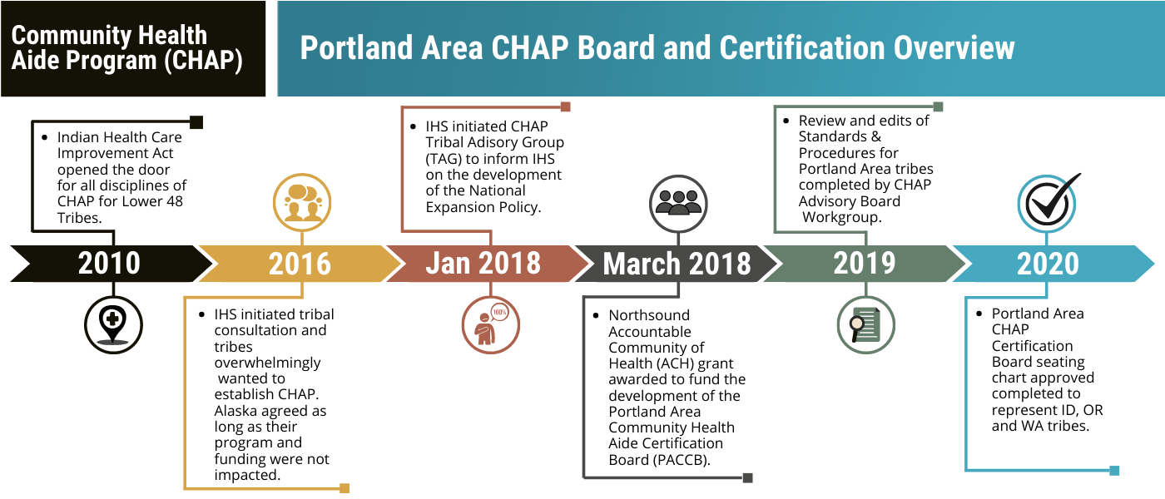
Notes:
Prior to 2010 – CHAP was unique to Alaska. The CHA and BHA model was created in Alaska. The DHAT program is a successful model created in 1918 is New Zealand.
2010 – IHCIA supporting CHAP expansion outside of Alaska.
2016 - As a result of Tribal Consultation in 2016, where Tribes overwhelmingly supported CHAP expansion outside of Alaska, IHS began putting in motion the necessary step to implement CHAP.
2018 - CHAP Tribal Advisory Workgroup (TAG) IHS Circular 18-01 was formed.
2019 - The CHAP TAG in partnership with IHS released a draft interim National Policy on CHAP for Tribal Consultation
This policy development included Tribal and IHS representation
We await the final approvals of the policy for CHAP expansion
The CHAP TAG does not support eliminating or defunding the CHR program
Review and edits of the S & Ps for DTs practice
2020 – S & Ps review for BHAs with inclusion of MAT for OUD and NW tribal traditional edits
Recommendations for seating the CHAP Board finalized

Slide 10
CHAP Goals in 2021
Advocate for federal infrastructure to support Area CHAP programs
Seat the Portland Area CHAP Certification Board (PACCB) and conduct the first meeting
Increase federal re-occurring funding for CHAP, area certification board and education programs
Dental Health Aide Review Committee (DHARC) and Behavioral Health Aide Review Committee (BHARC) approval by NPAIHB and Portland Area IHS Director
Design Behavioral Health Aide (BHA) Curriculum and ensure an independent, degree granting BHA education program
Establish Medicaid reimbursement with respective states
Continue working with tribes to stand up education programs and recruit students for existing programs
Identify and establish relationships with education institutions for potential CHAP training sites
Start to lay foundation for Community Health Aides
Notes:
Carrie

Slide 11
BHA Education Program
Danica Brown: Behavioral Health Director
Katie Hunsberger: BHA Student Support Coordinator

Slide 12
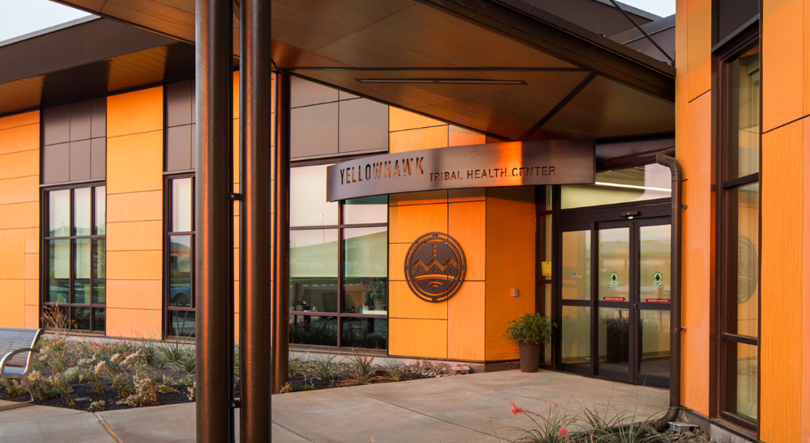
Behavioral Health in the Lower 48 Tribes
Domestic violence
Unintentional Injury
Suicide
Substance misuse
  Binge drinking
  Alcohol abuse mortality
Adverse childhood events
  Historical trauma

Slide 13
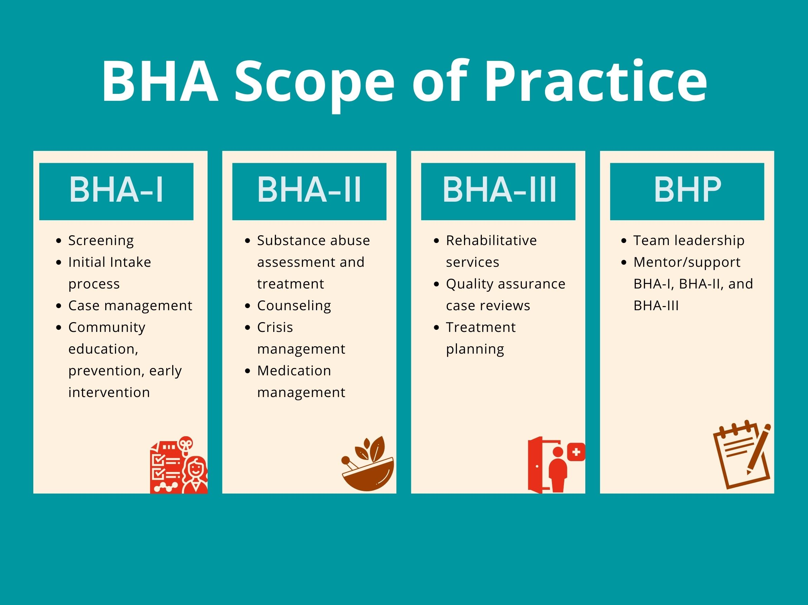
Behavioral Health Aides/Practitioners
More about BHA/Ps
They are culturally informed, community and/or residential based, behavioral services Tribal Health Providers (THP).
Educated in traditional healing/spiritual healing as mentored by tribal respected practitioners providing holistic care for their community.
Treatment includes screening, case management, community education, substance abuse assessment and treatment, rehabilitative services, and quality assurance for case reviews.
Connects mental health and SUD services.
Notes:
Katie

Slide 14
Behavioral Health Aide Program
Standards and Procedures
  Employed by a tribe or tribal organization
  Clinicial supervision (Master's level)
  2 levels
    BHA-1, BHA-2
Certification requirements
  Training
  Coursework
  Practicum
  # of work hours

Slide 15
Current BHAs Serving Their Communities
9 current BHAs through ANTHC BHA Training Certification
  Jenece Howe // BHA 3
  Sasha Corpuz // BHA 2
  Ken Hamilton // BHA 2
  Adreanne Hamilton // BHA 1
  Andrea Batin // BHA 1
  Venissa Williams // BHA 1
  Shaniya Shipman // BHA 1
2 current BHA 2 through Ilisagvik College
  Amy Redner // Lower Elwha Klallam Tribe // Graduates June 2021
  Philysia Deleon // Swinomish Indian Tribe // Graduates June 2021
Notes:
Katie

Slide 16
Enrollment and Application
Heritage University and Northwest Indian College
Application Requirements
There are three pathways a student can pursue
  Chemical Dependency degree at Northwest Indian College
  Social Work degree at Heritage University
  Certification in Behavioral Health (SUD)
Currently working for a Tribal Health Organization (THO)
High school diploma/GED
Clinical Supervisor reference
Resume/Cover Letter
3 short response narratives
Notes:
We work with the students to help them define a clear route/pathway for them to pursue. This is through conversation with the BHA student Support Coordinator, BHARC, and Dr. Brown.

Slide 17
Recruitment
We will be introducing our first cohort this Fall of 2021! Courses are projected to start early 2022. We are seeking 6-12 students, which can range from BHA-1 and BHA-2.
Notes:
https://form.jotform.com/203145816156150

Slide 18
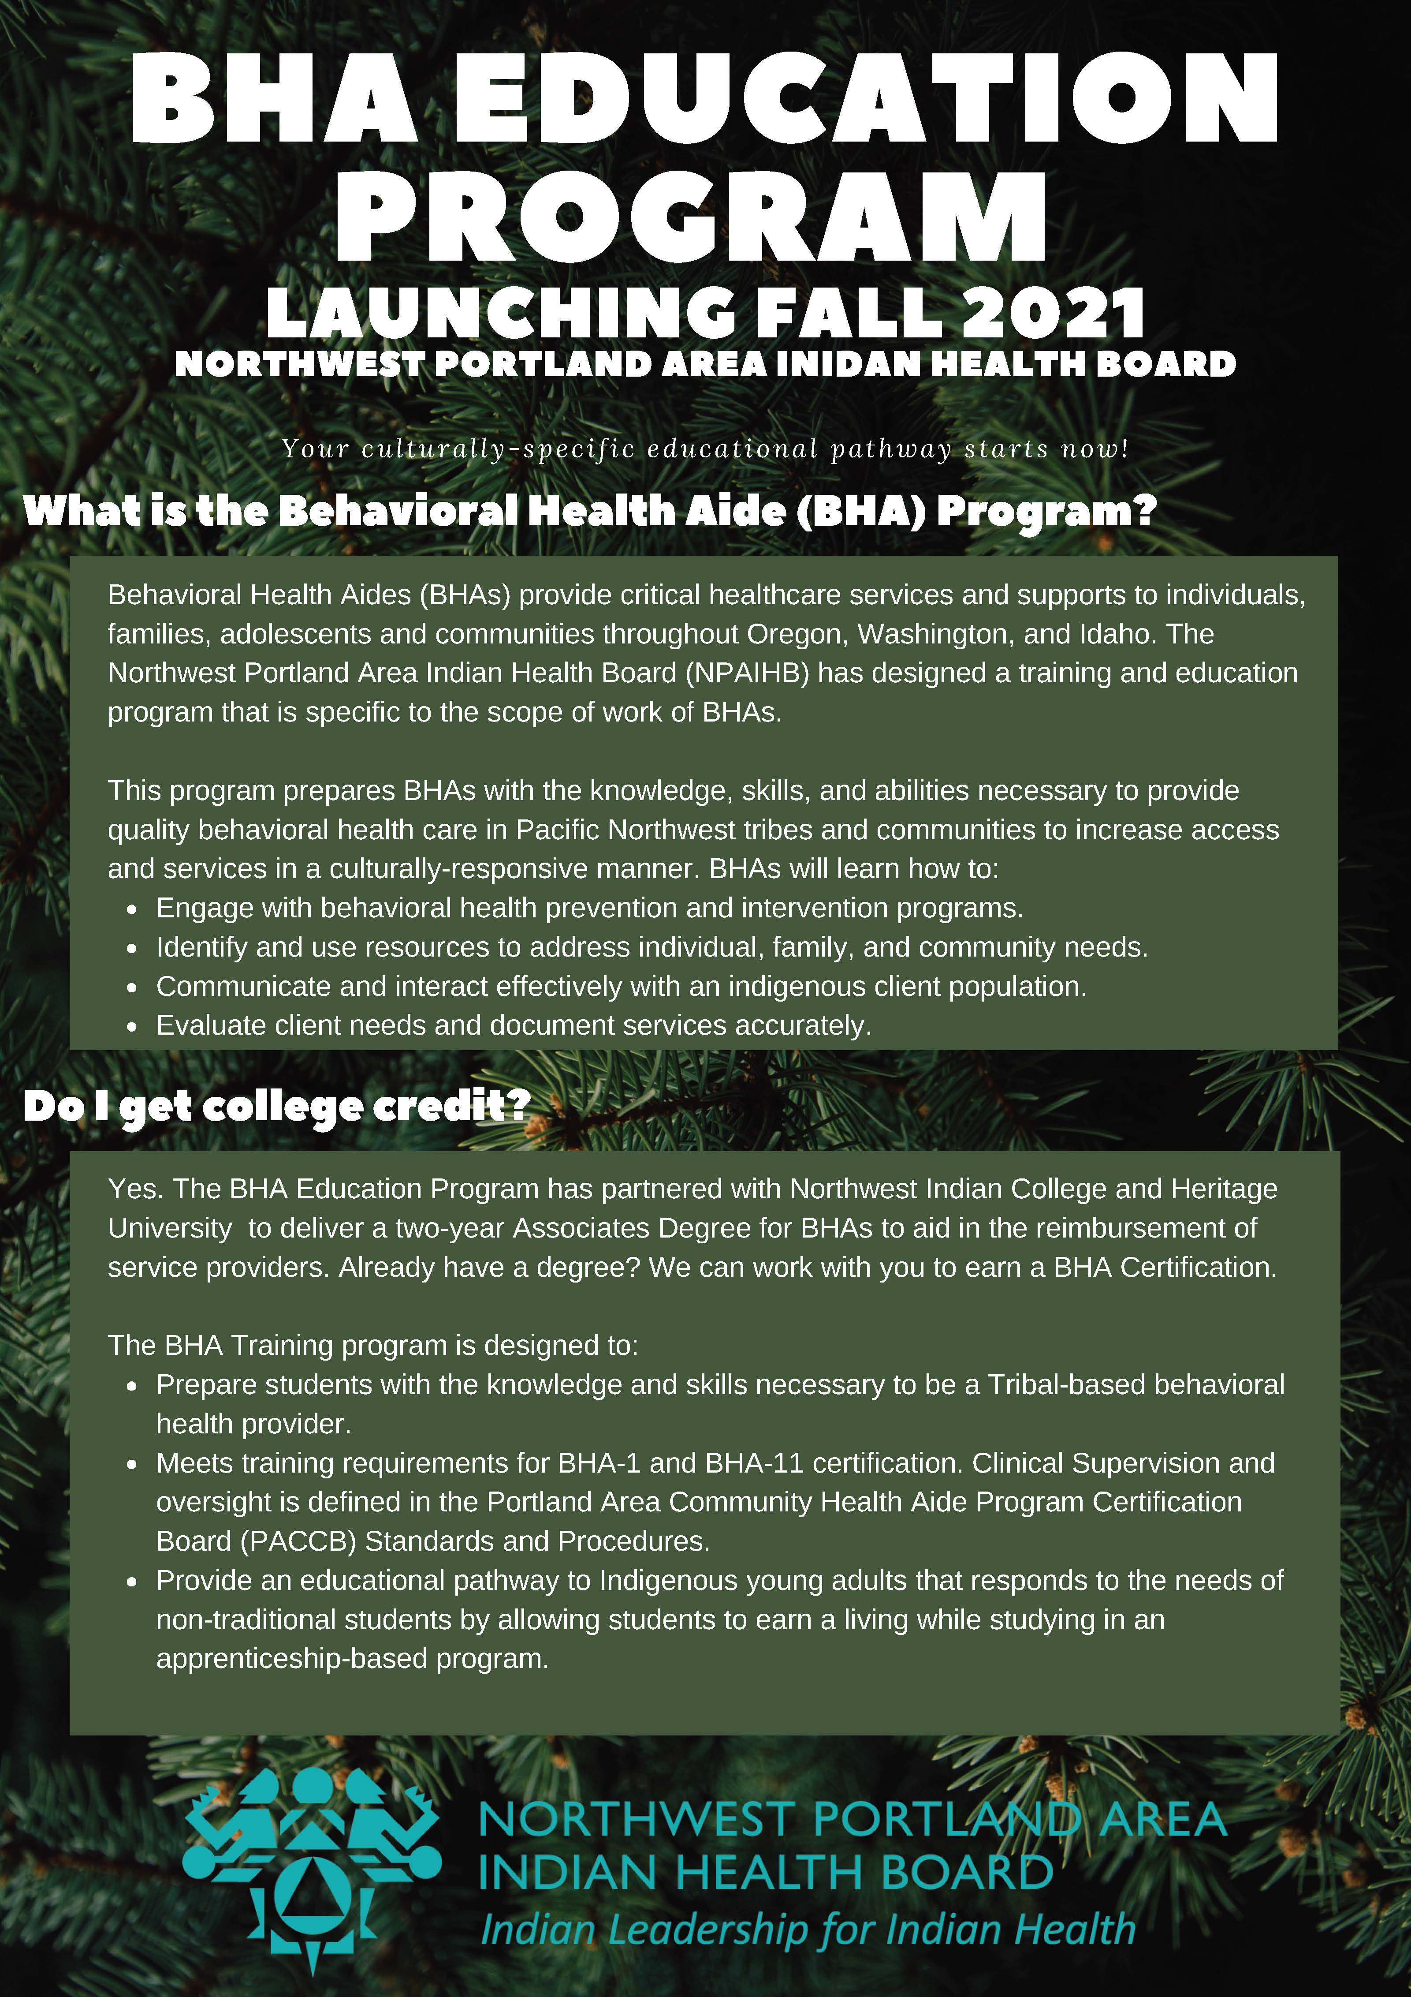

Notes:
*Insert flyer

Slide 19
TCHPP Website
To learn more about the Tribal Community Health Provider Project, visit www.TCHPP.org. Here you can learn more about the team, the Providers, policy work, and the BHA Education Program.
Notes:
Katie
https://chrysalis-clarinet-c3js.squarespace.com/config/settings

Slide 20
Electronic Behavioral Health Aide Manual (eBHAM)
The BHAM provides fundamental information and best practices for addressing many of the issues and concerns identified during client care visits. It is also intended as a guide for other providers who work with BHA/Ps; it will help providers to reinforce BHA/P training, reduce errors and confusion, and enhance BHA/Ps’ confidence in service and treatment planning.
The BHAM was created exclusively for the ANTHC Behavioral Health Aide Program with input from Alaska Native BHA/Ps, clinical supervisors, and clinical and content experts throughout the state. The manual recommends culturally and clinically appropriate services for our Alaska Native people based on best practices tailored specifically for this Alaskan program.
The Pacific Northwest is tailoring the eBHAM to provide specific information to the lower 48 Tribes. We are currently working to make the eBHAM online.
Notes:
Danica

Slide 21
General Orientation Course
28 contact hours
Notes:
Danica

Slide 22
What is a Clinical Supervisor?
Notes:
Danica

Slide 23
NW Elders and Knowledge Holders
Notes:
Tanya

Slide 24
Join us at our next ECHO Learning Collaborative
June 8, 2021

Slide 25
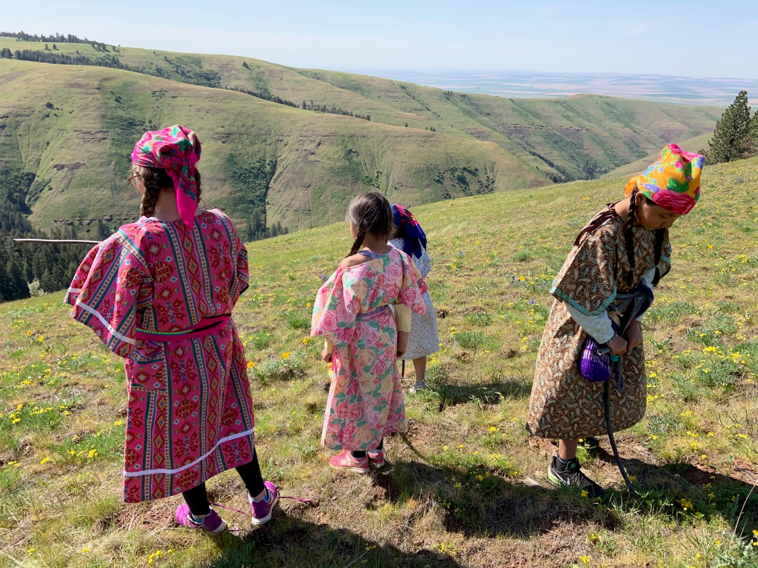
Questions?
Christina Peters, Tribal Community Health Provider Project Director – cpeters@npaihb.org
Carrie Sampson-Samuels (Umatilla, Walla-Walla), Community Health Aide Program Project Director – csampsonsamuels@npaihb.org
Tanya Firemoon (Nakoda), Tribal Community Health Provider Project Specialist– tfiremoon@npaihb.org
Katie Hunsberger (Yavapai), BHA Student Support Coordinator – khunsberger@npaihb.org.
Danica Brown (Choctaw), Behavioral Health Director – dbrown@npaihb.org

