Slide 1

What do Behavioral Health Aides actually do?
CHAP Learning Collaborative ECHO
June 8, 2021

Slide 2
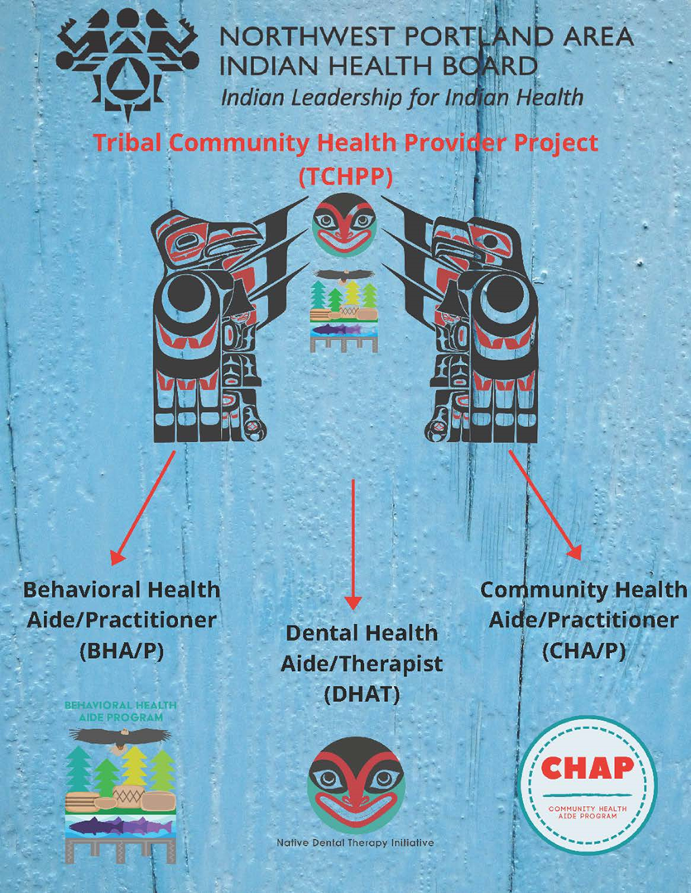
Notes:
Carrie

Slide 3
BHA Background
In the early 1990’s, Alaska began establishing a need for a Behavioral Health Aide model
  Alaska legislature established the Rural Human Services Systems Project and funded village-based counselors in 40 villages
In early 2000’s, IHS funds were provided by Congress to develop a Behavioral Health Aide Program, this was done in Alaska
In 2009, the process for establishing and certifying BHA’s in Alaska was fulfilled and the first BHA was certified
In 2016, CHAP expansion to other IHS areas
In 2018, the NPAIHB established a BHA Advisory work group to begin the development of a BHA program in the Portland Area

Slide 4
What is the definition of a BHA?
A Behavioral Health Aide (BHA) is a counselor, health educator, and advocate. BHAs help address individual and community-based behavioral health needs, including those related to alcohol, drug and tobacco abuse as well as mental health problems such as grief, depression, suicide, and related issues. BHAs seek to achieve balance in the community by integrating their sensitivity to cultural needs with specialized training in behavioral health concerns and approaches to treatment.
Alaska Native Tribal Health Consortium (ANTHC), https://anthc.org/behavioral-health-aide-program/, Accessed 6/7/21

Slide 5
Who can be Behavioral Health Aides?
Natural helpers – tie in cultural activities
Community members- homegrown
Counselors - good listeners
Advocates
Holistic caregivers and healers – tie in traditional practices
Peer recovery mentors, peer support specialists, traditional health workers, community health workers or community health representatives that want to take the next step in their careers

Slide 6
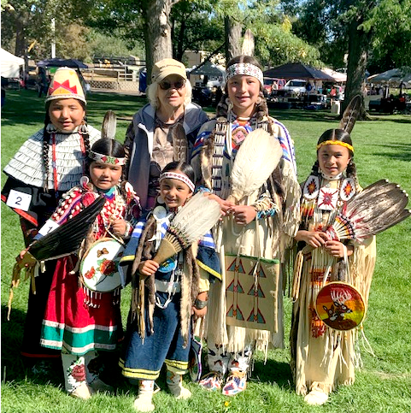
Who do BHAs serve?
ENTIRE COMMUNITIES!
  Elders
  Older Adults
  Adolescents
  Children
BHAs serve Tribal Health Organizations
BHAs may have cultural knowledge and expertise and be asked by their Tribal organizations to provide trainings to staff or local and state partners

Slide 7
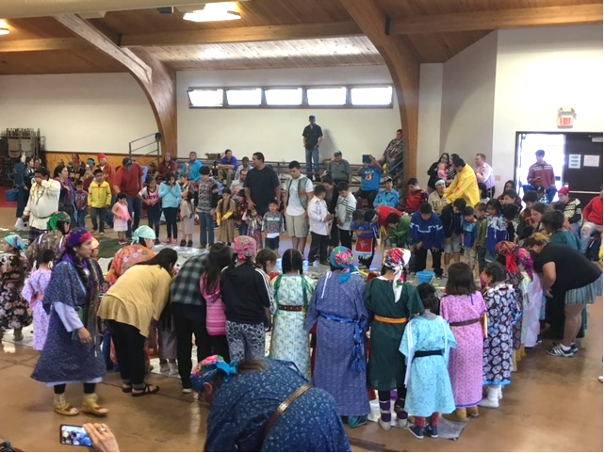
What services do BHAs provide?
Community prevention activities
Health Education
Screening
Case management and referrals
Early intervention
Crisis intervention
Substance abuse assessment and treatment
Postvention

Slide 8
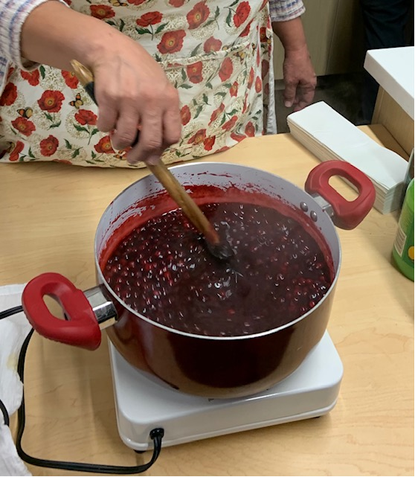
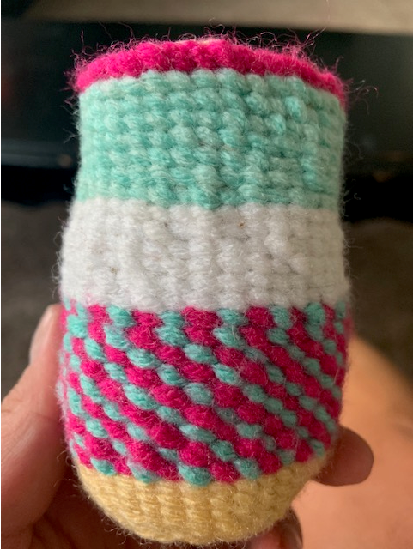
1. Community Prevention Activities
Sobriety Pow-wows
Community Potlucks
Community Smudge
Recognition Walks
  MMIW
  Suicide Awareness
  Domestic Violence and/or Sexual Assault
Community Parades
Culture classes such as:
  Ribbon skirt making
  Wing dress making
  Ribbon shirt making
  Moccasin making
  Baby boards or cedar baskets
  Basket weaving
  Hand drum making
  Fish net making
  Salmon, deer, elk, berry canning
  Totem carving

Slide 9
2. Health Education
Parenting classes
Anger management classes
Prevention topics - violence, alcohol and drug, bullying
Mental health promotion
Self care practices
Managing stress - Yoga, exercise, meditation, gardening
Conscious Discipline, Native STAND, Wellbriety, Sons and Daughters of Tradition, Healing of the Canoe, 49 Days of Ceremony, Gathering of Native Americans (GONA)
Incorporating traditional practices into ALL OF THIS! (as much as possible)

Slide 10
3. Screening and Assessment
Gathering information using appropriate screening tools and forms
  Asking the right questions;
  Being personable;
  Nonjudgmental;
  Provide a comfortable environment;
  Make the client feel safe
Assess and identify client needs
  Determining if their needs fall under the BHA scope
  Make appropriate referral if needs are beyond BHA scope
  Link to appropriate resources

Slide 11
4. Case Management and Referrals
Address resource needs that need to be met
Work with integrated care team which may include a primary care provider, certified mental health or chemical dependency counselor, peer support specialist or mentor, community health representative, etc.
Service link and referral to meet unmet needs or expanded care

Slide 12
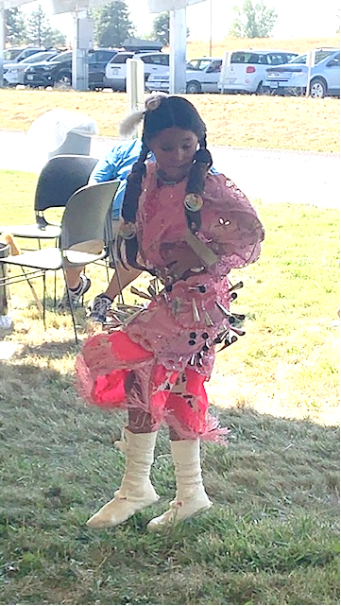
5. Early Intervention & Crisis Intervention
Early Intervention:
  Early intervention prevents the onset of delinquent behavior and supports the development of a youth’s assets and resilience (I)
    Bullying prevention programs
    Mentoring programs
    Afterschool recreation programs
Crisis Intervention
  Time-limited using a specific psychotherapeutic approach to stabilize clients in crisis
  This could be done within their role in a crisis response team
I. Prevention & Early Intervention | Youth.gov

Slide 13
6. Substance Abuse Assessment and Treatment
Screening clients routinely at clinic visits
Assess level of risk to determine appropriate type of intervention
Brief intervention and assess motivation
Consider a referral for treatment\
Access to jobs, housing and resources after treatment
Recovery support, may work closely with transitional living facility

Slide 14
7. Postvention
Intervention after a suicide loss or attempted suicide
Providing a team response to schools or other locations to support those closely impacted by a suicide loss
Providing access to support resources and aftercare

Slide 15
What topics do BHAs need to understand?
Substance abuse
Healthy relationships
Grief
Development of healthy coping strategies
Suicidality
Parenting
Caring for Elders
Development across a lifespan
Developmental disorders
Hallucinations and delusions
Trauma and PTSD
Stages of change
Cooccurring disorders
Medication management
Behavioral health and medical conditions
Fetal Alcohol Spectrum Disorders
Foster care and CPS
Incarceration
Abuse and neglect
Mood disorders
Learning and cognitive disorders
Bullying
Anger
Motivation

Slide 16
What other knowledge do BHAs need to have?
Working with others – communicating effectively and building relationships, may include meetings internally or with partners
Integration with other providers within the Tribal health system
Documentation and Medicaid billing
Mandatory reporting
Understanding of risk management and malpractice
HIPAA and confidentiality
Electronic health records
Traditional practices

Slide 17
BHA Levels and Scope of Practice
Certification Requirements
  Training
  Practicum
  # of work hours
  General Orientation at NPAIHB
BHA-1
  Screening
  Initial intake process
  Case management
  Community education, prevention, early intervention
BHA-2
  Substance abuse assessment

Slide 18
Let’s break it down…the more you know!
BHAs must be employed by an Indian Health Service facility, a Tribe, or a Tribal Health organization that operates a community health aide program. They can provide services outside the clinic, if and when it is clinically appropriate to do so. In Alaska, this is included in their license, which allows them to bill for these home- and community-based services.
Job Titles of a BHA may vary among the tribes as they also vary in Alaska
Location where they work may vary, some may be located within a clinic, some may work within a large behavioral health department, or a health and human services department

Slide 19
Continued..
Certification is extremely valuable
  Process of certification will be outlined while in the BHA program, certification will be done by the Portland Area CHAP Certification Board with the guidance of the Behavioral Health Academic Review Committee (BHARC)
  Certified BHAs may become billable within their respective states and therefore become a sustainable resource for their organization
BHAs must practice under a master’s level clinical supervisor
An Electronic Behavioral Health Aide Manual (eBHAM) will be available for BHAs to reference during and after completion of the program
THIS PROGRAM IS VERY NEW FOR THE NORTHWEST! We are still working through many details ☺

Slide 20

Now that you know what you know,
What could the BHA role look like in your community?

Slide 21
What gaps do you see in providing behavioral health services in your community?
How would integrating BHAs into your workforce be a benefit?
Where could you see BHAs working with different Tribal programs: Tribal courts? Family services? Education? Public health? Housing? Elder programs? Family Violence programs? Language or cultural programs?
What other skills or certifications would benefit a BHA within your Tribe or state?

Slide 22
BHA Education Program
Katie Hunsberger – BHA Student Support Coordinator

Slide 23


Private University in Toppenish, Washington
$14,000 average financial aid package
95% of undergrads receive financial aid
Generous scholarships page with updates
Semester-based
Campus locations
  Toppenish
  Tri-Cities
  Yakima (Yakima Valley Community College)
Notes:
https://www.heritage.edu/

Slide 24

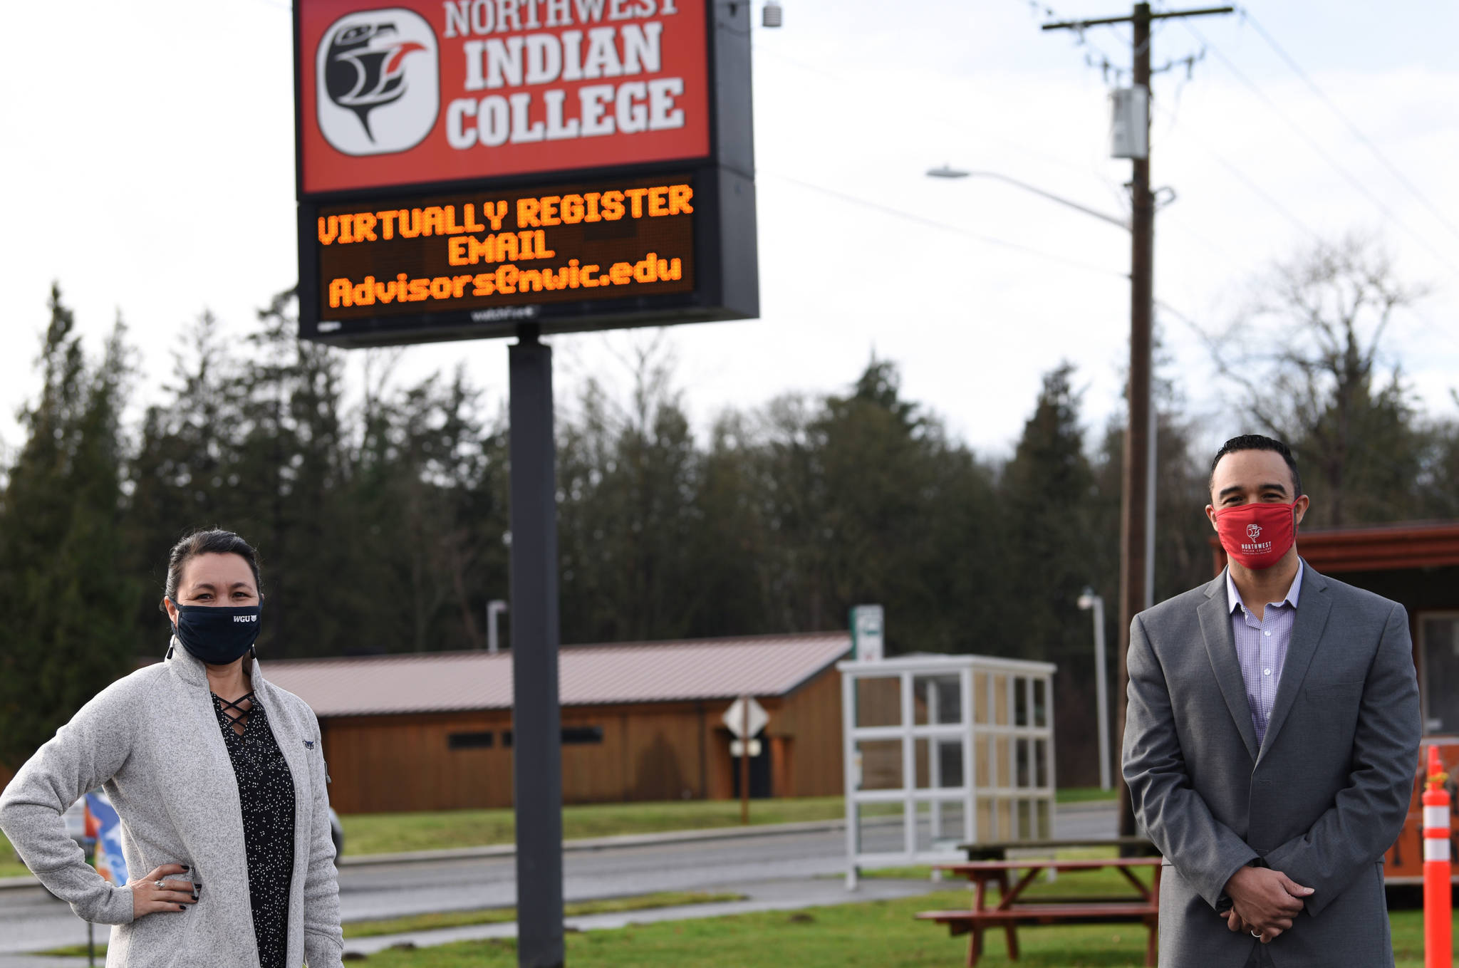
Tribal College in Bellingham, Washington
FAFSA + Scholarship opportunities
Term-based
Campus Locations
  Muckleshoot Campus offers Associate of Technical Arts in Chemical Dependency Studies
Notes:
https://www.nwic.edu/

Slide 25
Educational Pathways
Full time student vs. Part time student
  Level 1 = 12 months
  Level 2 = 18 months
Alternative vs. Specialized Matrix
  Student can work with Coordinator to determine which level they would be the best fit for
We are currently working on creating 3 pathways for students
  Certificate/AA in Social Work at Heritage University
  AA in Chemical Dependency from Northwest Indian College
  Certificate/AA in Behavioral Health from either Institution
Notes:
Full time: About 3 hours a week of training activities.
Part time: 1.5 hours a week of training activities.
Alternative track: If you have prior education. Satisfies those who have a degree in Human Services, Addictions, Chemical Dependency, Behavioral Health, Psychology, Social Work, Counseling, Marriage/Family Therapy, Nursing with BH speciality, or related field. + Work experience: Certificates, training, hours of work experience.
Specialized Matrix: Work related experience – providing village-based behavioral health services. 1000-2000 hours under supervision of a licensed behavioral health clinician or BH professional.

Slide 26
Student Support & Program Benefits
First cohort in the lower 48!
Student stipends
Mentor/Elder support
  Gathering of NW Elders, Knowledge Holders, and Culture Keepers
Relationship with NPAIHB
  BHA Student Support Coordinator
  Student Agreement Form
  Laptop eligibility
  Course help

Slide 27

Upcoming Events
This Photo by Unknown Author is licensed under CC BY-NC

Slide 28

NW Elders, Knowledge Holders, & Culture Keepers
Notes:
Tanya

Slide 29
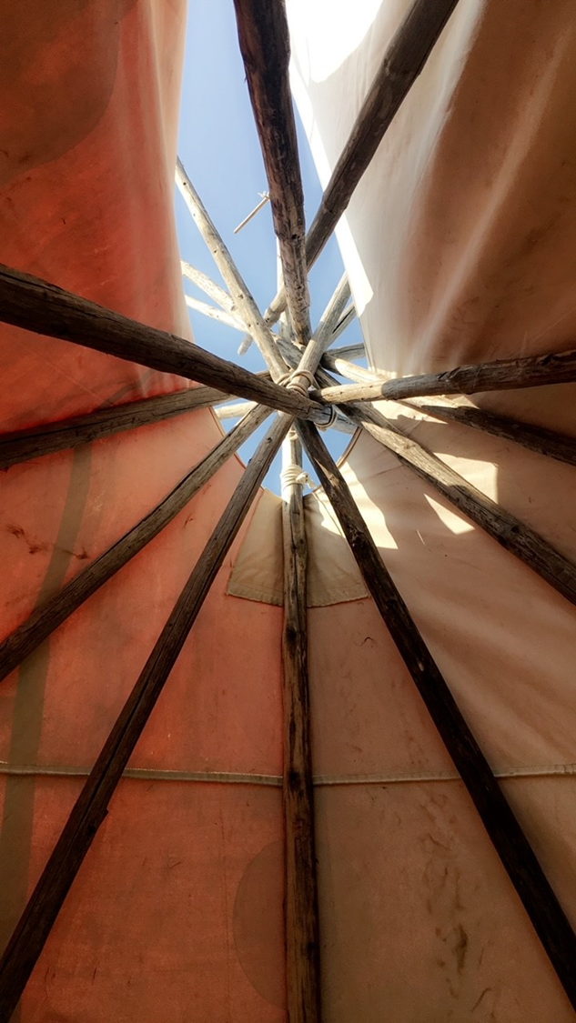
Questions?
Carrie Sampson-Samuels:
csampsonsamuels@npaihb.org
Danica Brown: dbrown@npaihb.org
Katie Hunsberger: khunsberger@npaihb.org
Tanya Firemoon: tfiremoon@npaihb.org
Visit our website at www.TCHPP.org

